Slide 1
Identity Management Overview
CSO Seminar
20 January 2017

Slide 2
Topics
Standard Authentication Framework Environment (SAFE)
Public Service Identity
Public Service Card
MyGovID

Slide 3
SAFE Principles
Standard Authentication Framework Environment
Rules based standards for establishing and authenticating identity
Varying levels of assurance of an identity
  SAFE Level 0 = No assurance;
  SAFE Level 1 = Balance of probabilities;
  SAFE Level 2 provides a substantial assurance
  SAFE Level 3 = Beyond reasonable doubt
Facilitate access to public service across multiple channels

Slide 4
SAFE Registration
Based primarily on a face-to-face identity registration
  verification of identity data already held by the Department through documentary and database checks
  capture of photograph and signature
  facial image matching
  expanded to capture and verify mobile phone number
Issue Public Services Card incorporating the captured photograph and signature

Slide 5


SAFE Programme - Benefits
SAFE Registration
Public Service Identity
Rules based standards
Reduction in numbers who fraudulently claim to be someone else and in the potential for forgery
Enhanced ability to detect fraud
Facial image matching
131 individuals referred for identity fraud investigation/ prosecution
160 stations in 100 locations nationwide
PPSN/PSI key enabler for Public Services
Data collected & verified
Identity with substantial level of assurance [SAFE Level 2]
Single Customer View (SCV)
Integrated Government services
Data Sharing – Revenue; SOLAS; SUSI; HSE; LA’s etc.

Slide 6
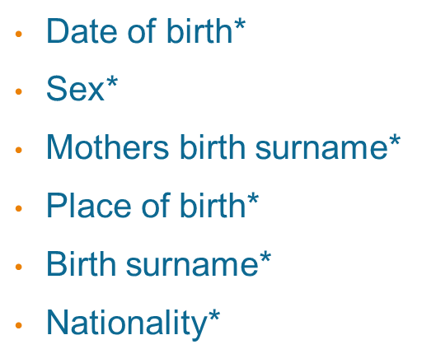
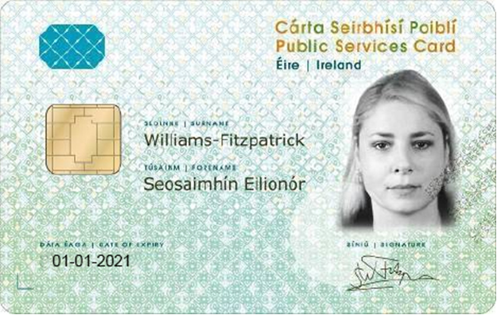
Data on the public services card
Name
PPS number
Photograph
Signature
Card issue number
Expiry date
*encoded on chip
The above data is part of the Public Service Identity (PSI) dataset

Slide 7

SAFE Programme - Benefits
Public Service Card
Identity & Access Management
Smartcard: highly secure design
Government standard token for flash pass ID authentication
Save time re-verifying an individual’s identity
Circa 2.3 million PSC issued
Circa 700,000 Free Travel
70% target and circa 53% of over 18s
MyGovID
Trust Framework – available to all public bodies
Basic accounts - anonymous
Verified accounts - SAFE Level 2
150k accounts
Further data via SAFE API (subject to DP)

Slide 8
What is it?
A new more secure way to prove who you are online
It is designed to provide safer, simpler and faster access to multiple government services
It stops someone else pretending to be you, and helps prevent identity theft

Slide 9
How to get started
1
Create an account
You will need:
Primary Email Address
Secondary Email Address
Mobile Phone Number
2
Confirm your contact
and personal details
Confirm
Confirm
Enter and Confirm:
Email Address
Personal details and
set a password
Mobile Phone Number
You will then have a basic account
This gives you access to some services but for others we’ll need a little more proof of who you are. This additional security helps protect your identity

Slide 10


Verify your Account
3
Verify your basic account
Enter your PPSN so we can identify you
4
Choose how you wish to receive a verification code
We can send it by post or to your verified mobile number, it’s up to you
Depending on how you choose you may be asked to
confirm :
Your Postal Address
Your Public Services Card Details
Your Verification Code
You will then be fully verified
This means we are safe in the knowledge that you are who you say you are and you will have access to all services available to MyGovID

Slide 11
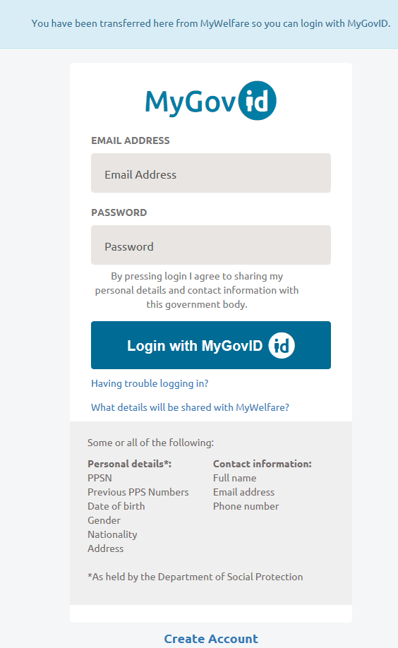
Mygovid-Data sharing approach
MyGovID shifts responsibility of PSI data sharing to the customer
The customer explicitly decides if s/he wish to share PSI data with partner online service to
enable RPs to link the MyGovID verified digital identity with internal customers record
Improve customer user experience on relying party service
Only PSI data appropriate to relying party service is shared
All data sharing is subject to existing legislation & MOAs between organisations

Slide 12
Building a Trust Framework
“A trust framework is a certification program that enables a party who accepts a digital identity credential (called the relying party) to trust the identity, security, and privacy policies of the party who issues the credential (called the identity service provider) and vice versa” **
Shared Benefits
Central Government
Individual Departments
Citizen
One identity to access eGovernment services
Gather contact details (e.g. email and phone) to interact with Government agencies.
Citizen identity information in one central location
Secure and robust platform
Enables digital services for citizens across public service.
Public Service ICT Strategy (2015)
IAM service in place
Customers can complete business processes across multiple Government entities
Can combine proofing methods & reduce risk of fraud
** http://iddataweb.com/?page_id=94

Slide 13
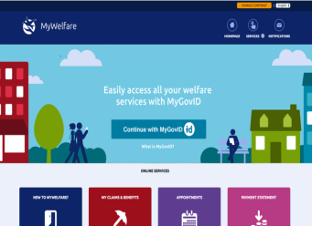
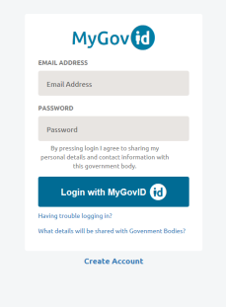
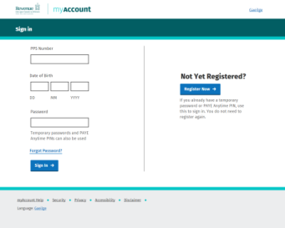

Building a Trust Framework
MyGovID Basic Registration
Relying Party
token
Policy Store
MyGovID Verified Registration
Validate PSI
Validate PSC
For example:
Validate Code
For example:
+
PPSN
PSI
PSC
Welfare+
Driving
Licence
P60

Slide 14

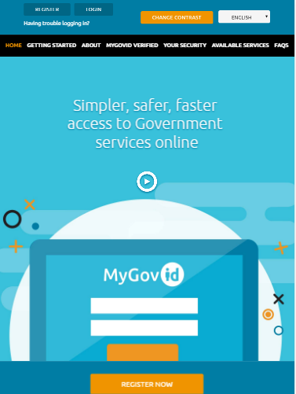
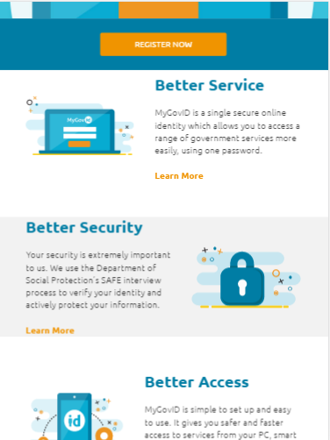
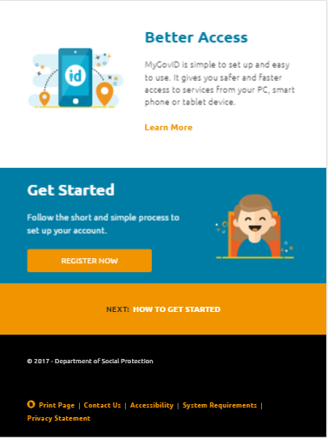
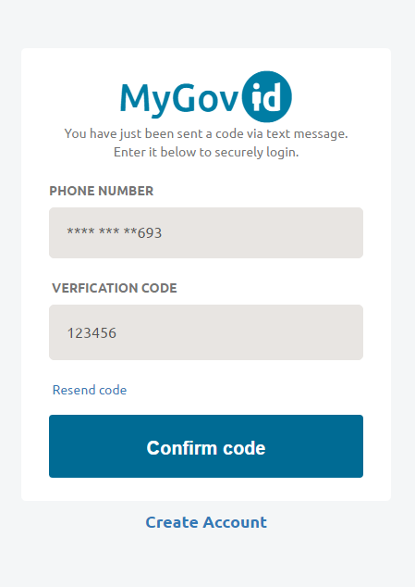
Responsive Design
Mobile, Tablet and Web

Slide 15
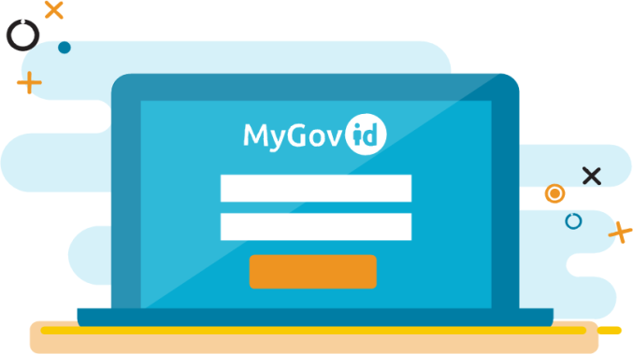
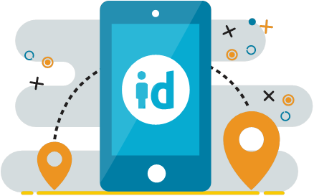
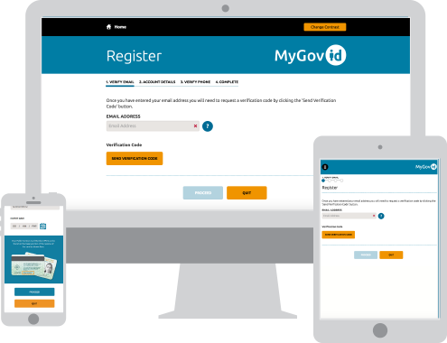
Responsive Design
Mobile, Tablet and Web

Slide 16
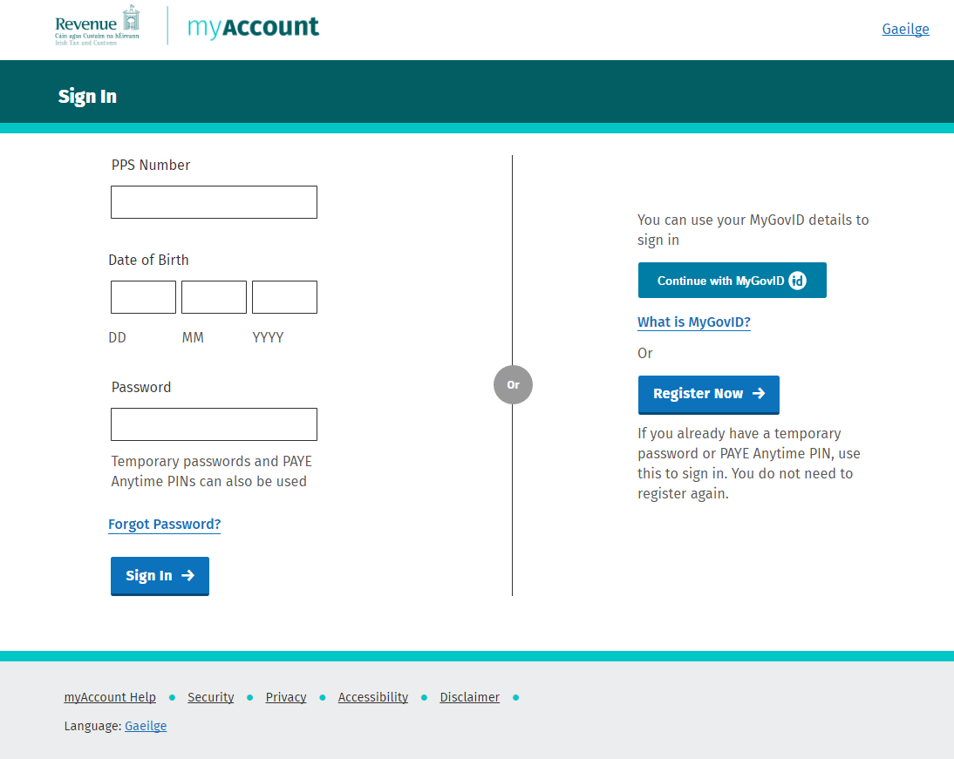
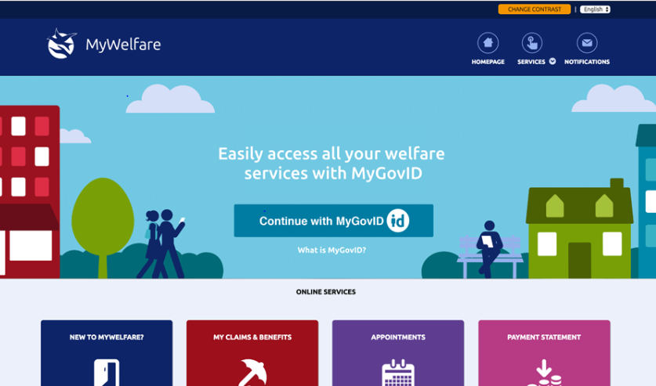
Relying parties
MyWelfare for Citizens, Revenue MyAccount & Job Ireland

Slide 17
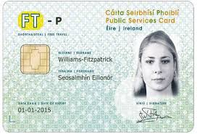



Technology
Open Standards
Technology
Open Standards
  Using a cloud based SaaS identity platform as a scalable multi-tenant policy engine (Microsoft Azure AD)
  Identity proofing components integrated using Open ID Connect built on Microsoft technology
  Open ID Connect (OAuth 2.0)
  Leveraging international standards such as GPG (UK) and NIST (US) to develop a flexible, modular solution (RA, CSP, RP)
Process
Channel Strategy
  Identity proofing and verification using PSI , PSC
  Flexible model to incorporate any business processes specific to other organisations
  Policy based approach allows for custom user journeys for both registration and login depending on the relying parties requirements
  Provisioning an IAM solution as a key enabler for the delivery of consistent citizen online services
  Delivering a solution capable of being extended to other channels types

Slide 18
Questions?
Contact us
www.mygovid.ie
Daragh O’Connor
Sean Gaffney
daragh.oconnor@welfare.ie
sean.gaffney@welfare.ie

