Slide 1
Benefacts.ie - the database of Irish nonprofits
20 January 2017
John Lyons
Head of Programmes & Operations

Slide 2
What is Benefacts?
Benefacts|
A strategic collaboration between Irish government and major philanthropies to build an essential data infrastructure for a sector that attracts 10% of public expenditure in Ireland.

Slide 3
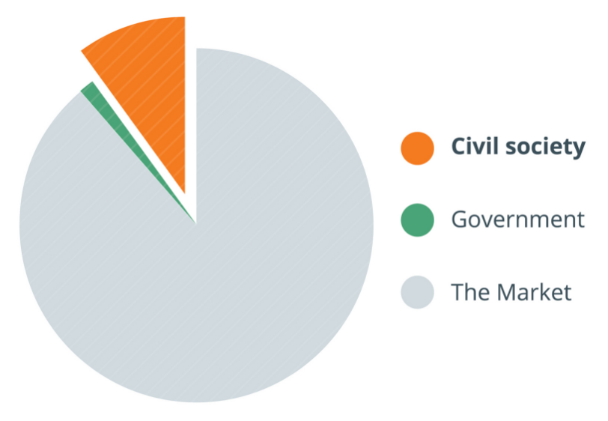
Every organisation that isn’t part of the market, or the government
Community and voluntary associations
Political, professional and representative bodies
Trade unions
Sports bodies
Schools
Churches and faith bodies
Not-for-profit companies
Social enterprises
Charities (today 25%)

Slide 4
Our Project 2015 – 2017:
Build the Database of Irish Nonprofits
Promote its use by the public, nonprofits and their stakeholders in government and elsewhere
To transform the accessibility and visibility of Ireland's civil society organisations

Slide 5
Up to now, public understanding of this sector has been very limited
Our role is to:
Specify the population
Identify the sources of public data (including open data)
Acquire, clean, analyse, digitise, aggregate and store the data
Classify each entity and add its URL
Publish the data on benefacts.ie
Disseminate the data through other channels

Slide 6
Quality and Authority
We add value by combining the data to provide a unique view of the non-profit sector
Significant effort required to normalise and clean data from disparate sources
Resulting in a unique, authoritative body of data for nearly 20,000 organisations

Slide 7
We get data from many sources…
Department of Education and Skills

Slide 8
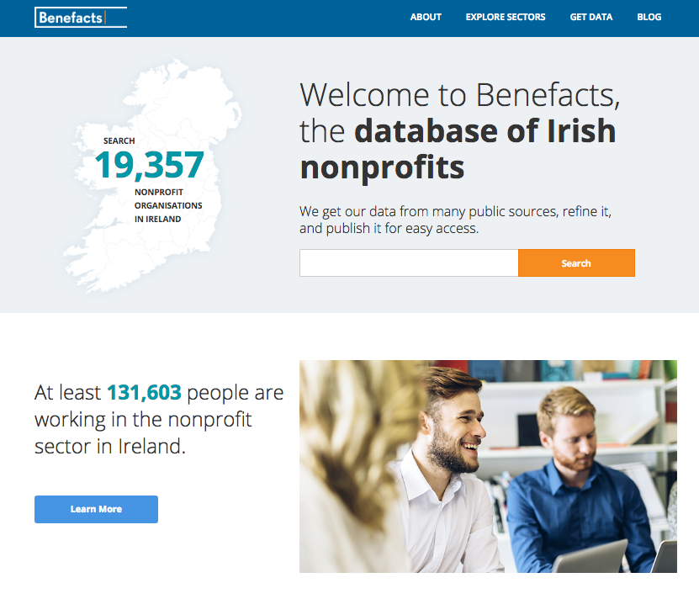

Slide 9
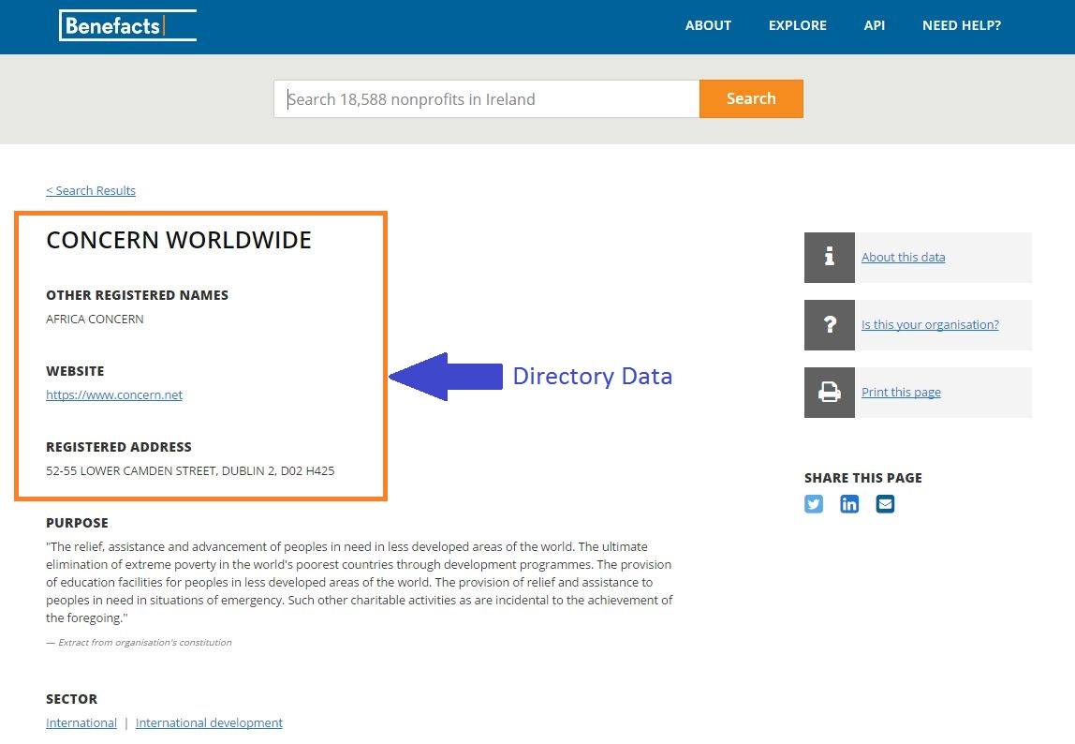

Slide 10
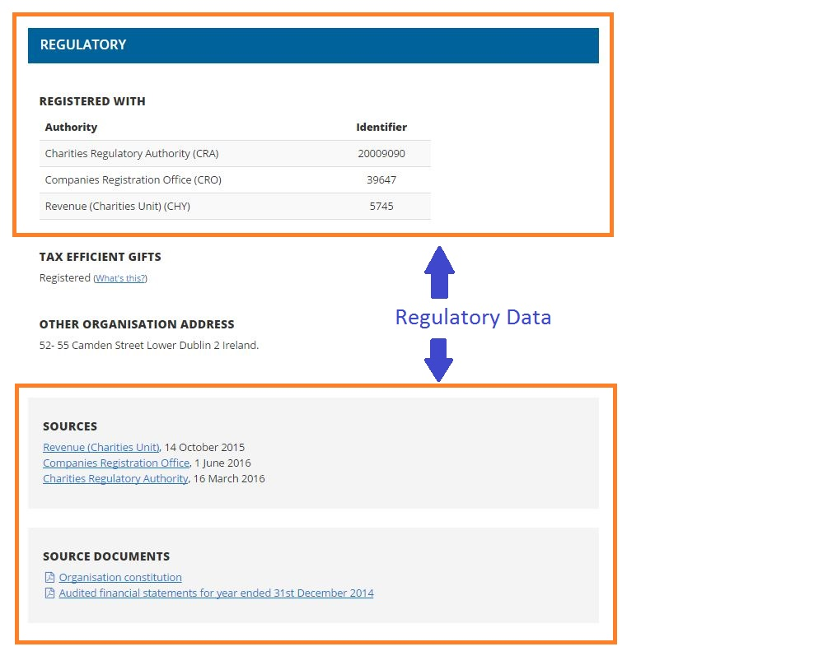

Slide 11
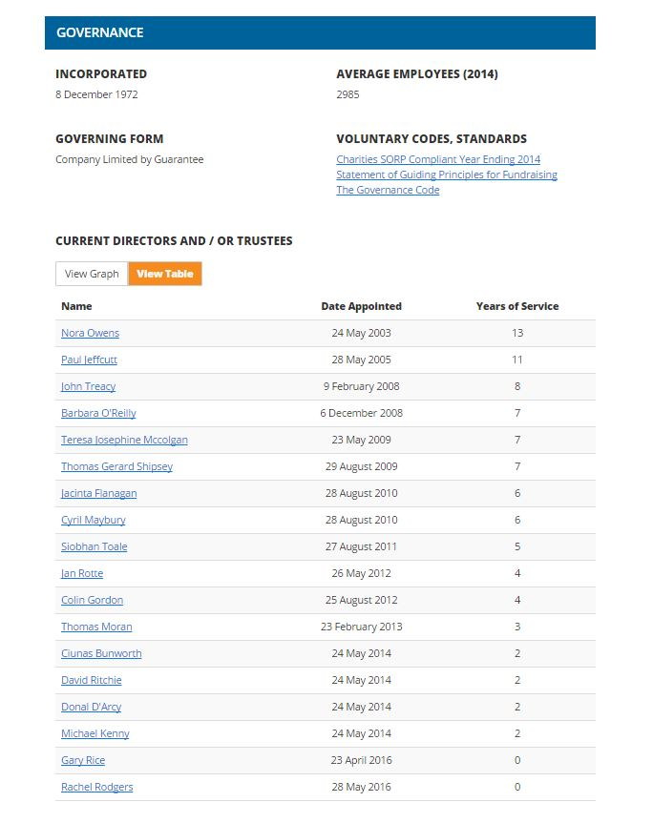
Governance Data →

Slide 12
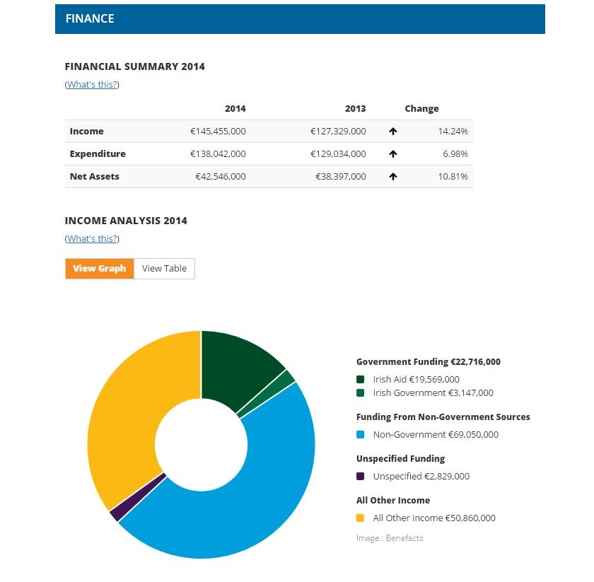
Finance Data →

Slide 13
But only some of it is open….
Name
Alternate name(s)
Registered address
County
Eircode
Legal governing form
Date of incorporation
Compliance with the Governance Code
Compliance with the Fundraising Best Practice Principles
Name(s) of regulator(s)
Regulatory number(s)

Slide 14
The rest we extract from files:
* Primary and secondary sector classification * Geolocation * nonprofit’s URL * statement of legal purpose * average number of reported employees * names and dates of appointment of serving directors/trustees * total current reported income * total reported income (prior year) * total current reported expenditure * total reported expenditure (prior year) * total current reported net assets * total reported net assets (prior year) * named current sources of public funding * named sources of public funding (prior year) * reported current sources of non-governmental funding * reported sources of non-governmental funding * (prior year) * current unspecified funding * unspecified funding (prior year) * whether the nonprofit reports using SORP
(…and from 2017)
* Directors/trustees reports on activities * reported remuneration in bands of €10,000

Slide 15
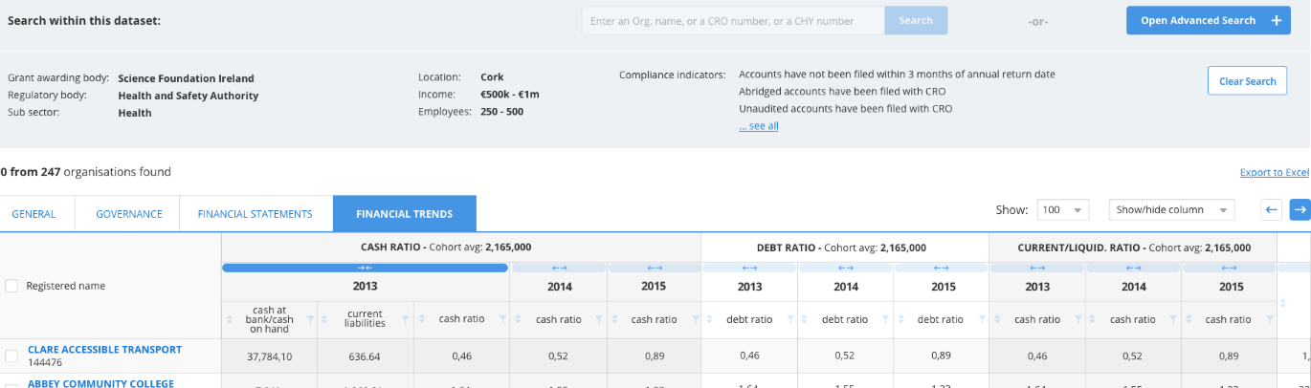
Benefacts Nonprofit Sector Analysis
Free Public Website –benefacts.ie
Benefacts Open Data
Benefacts Data Services
Benefacts Bespoke Solutions
Benefacts Analytics

Slide 16
Who uses Benefacts data today?
Government (funders, analysts, regulators)
International bodies
Nonprofits, sector representative and lead bodies
Journalists
Professional service providers
Researchers and analysts

Slide 17
Benefacts API Services
Benefacts provides 2 public APIs:
Benefacts Open Data API – provides freely accessible data under creative commons license
Benefacts Public API – provides all the data currently on benefacts.ie as a data feed. Free to use, but requires signup

Slide 18
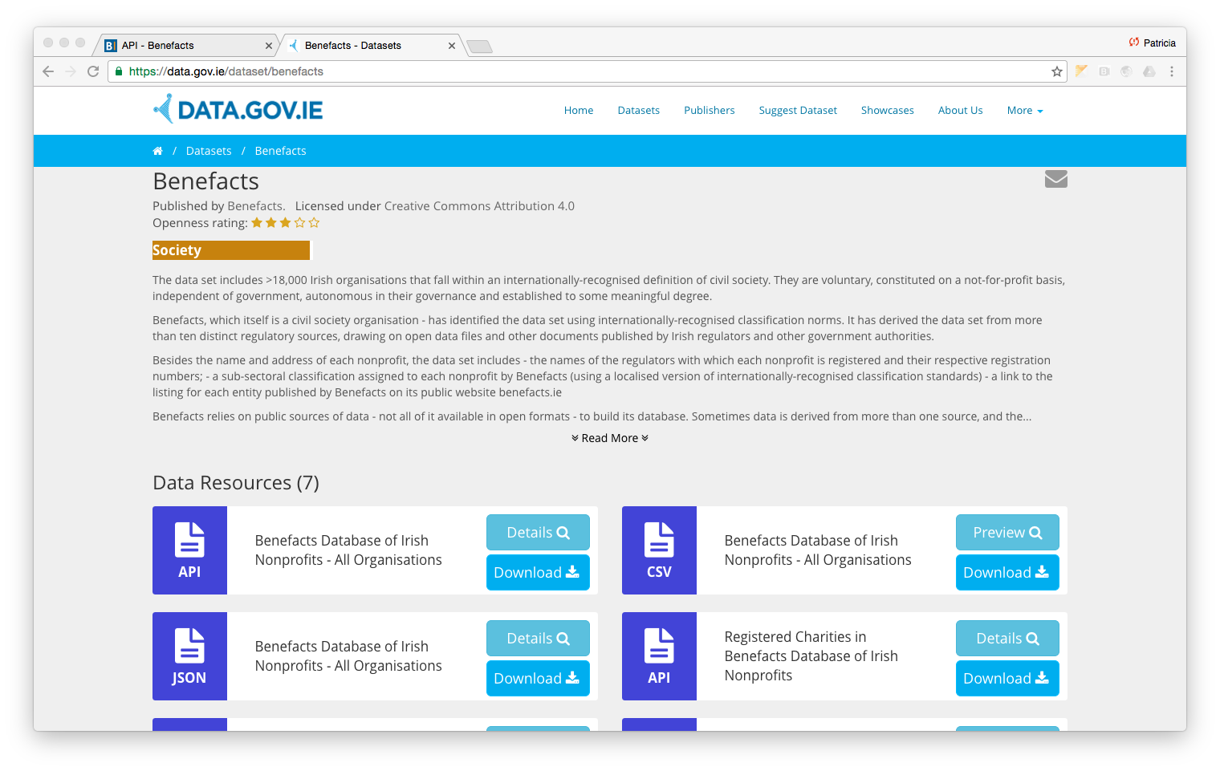
Benefacts Open Data API
Available on https://data.gov.ie/dataset/benefacts

Slide 19
Benefacts Open Data API
Provides 9 core data fields:
Benefacts ID
Registered name and other registered names (where applicable)
Benefacts classification
Address
Eircode
County
Name(s) of authorities by which the nonprofit is regulated
Regulatory numbers (CRO, CHY, CRA, etc)
Link to nonprofit listing on Benefacts.ie
Data available as a CSV file (for humans) or as JSON (for machines)

Slide 20
Benefacts Open Data API
Sample JSON:
{
"benefactsId":"1654780", "name":"OXFAM REPUBLIC OF IRELAND", "otherNames":["OXFAM IRELAND"], "subSectorCode":"10.1", "subSectorName":"International development", "address":"2ND FLOOR, PORTVIEW HOUSE, RINGSEND, DUBLIN 4", "eircode":"D04 V9Y9", "county":"DUBLIN", "regulators":[ {"regulatorName":"Revenue (Charities Unit)", "regulatorCode":"CHY","regulatorNumber":"5988"}, {"regulatorName":"Companies Registration Office", "regulatorCode":"CRO","regulatorNumber":"284292"}, {"regulatorName":"Charities Regulatory Authority", "regulatorCode":"CRA","regulatorNumber":"20009946"}], "benefactsUrl":https://benefacts.ie/org/d8b7acc9-303e-4453-90c6-372902e8ef6b?src=open
}

Slide 21
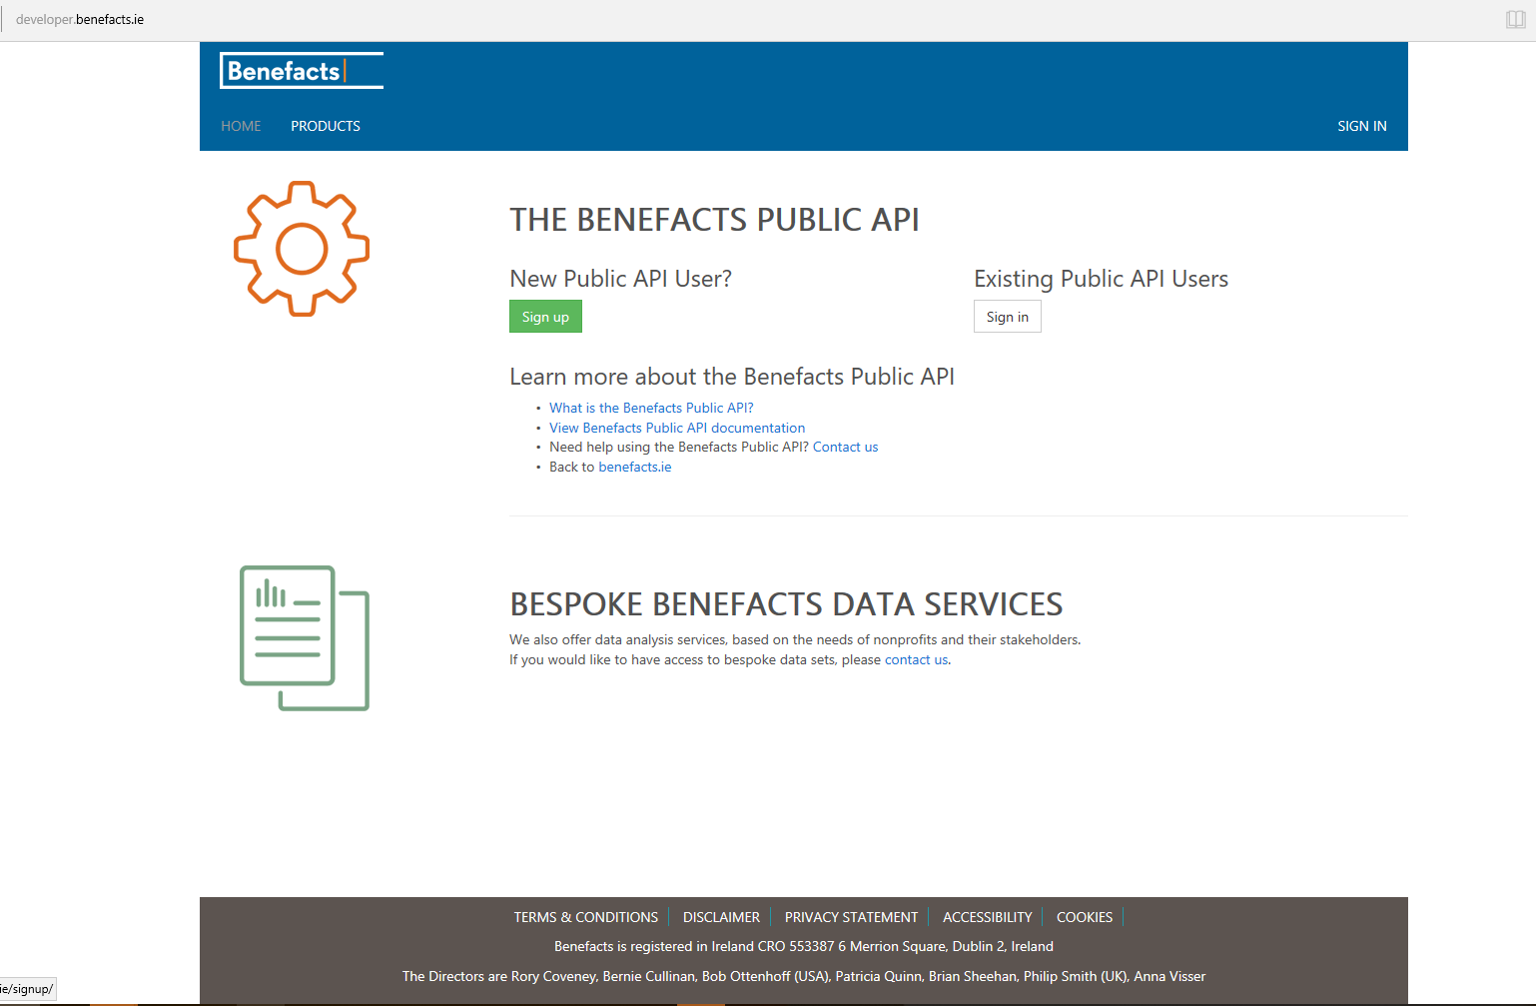
Benefacts Public API
Available on https://developer.benefacts.ie/

Slide 22
Benefacts Public API
Provides most of the data available on benefacts.ie (data protection concerns mean we don’t provide directors’ names)
Search for organisations using free-text search
Retrieve details of individual organisations

Slide 23
Benefacts Public API (cont’d)
Benefacts ID
Registered name and alternative names (e.g. trading names)
Benefacts classification
Regulatory information (regulator name & regulatory number)
Registered address and other addresses
Financial summary (income, net assets, funding, expenditure and number of employees for current and prior year)
Breakdown of funding (funding source, amount)
URL
Constitution Extract
Details of number of directors and the dates of appointment
Adherence to voluntary codes

Slide 24
Challenges
Effort involved in providing high quality data
Licensing, liability, data protection
Low take-up of the Public API
Low demand or reliance on IT staff a barrier?
Poorly designed API?
Registration a barrier?
Good take-up of the Open Data API
People like simple lists?
Data.gov.ie a popular platform for data enthusiasts?

Slide 25
Want to know more?
Search and explore on Benefacts.ie
Let us know what you think –we love feedback!
Follow us on Twitter and LinkedIn

Slide 26
Thank you
John.lyons@benefacts.ie
info@benefacts.ie
+353 1 536 7130
6 Merrion Square, Dublin 2
www.benefacts.ie

