Slide 1
CSO Administrative Data Centre Seminar 8 November 2022 7. Water Statistics
Linh Nolan
Environment and Climate Division

Slide 2
Water Statistics Overview
Releases
Domestic Metered Public Water Consumption
Domestic Waste Water Treatment Systems
Questionnaires
OECD/Eurostat Joint Questionnaire on Inland Waters
FAO, OECD questionnaires

Slide 3
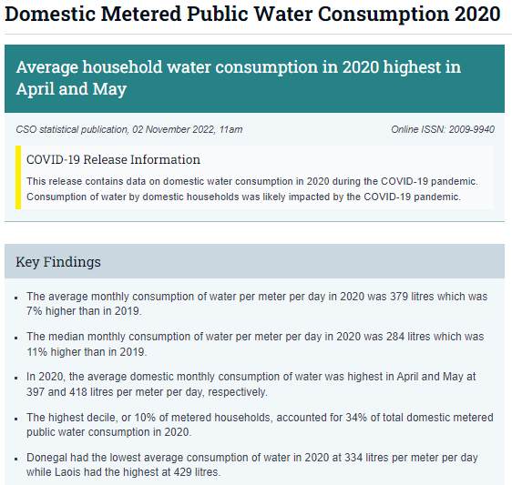
Domestic Metered Public Water Consumption
Annual release (first release: reference year 2016)
Water consumption by month, county, Dublin postal district
Uses administrative data
Data source: Irish Water meter readings
Reading captured through Automatic Meter Reading (AMR) technology
Irish Water provides data to CSO on an annual basis
Dates of readings are generally from a date at the end of the month
Readings converted into monthly usage figures by allocating the difference in two readings proportionately between the dates that the meters were read

Slide 4
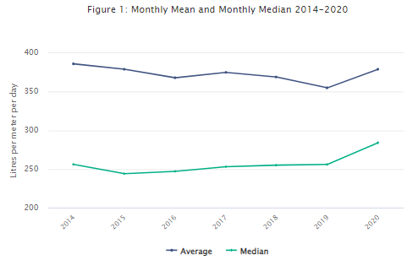
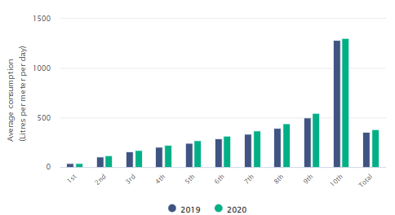
Domestic Metered Public Water Consumption
Key Findings: Domestic Metered Public Water Consumption 2020
Average consumption was 379 litres per meter per day (+7% from 2019)
Median consumption was 284 litres per meter per day (+11% from 2019)
Average and median consumption was highest in April and May
The highest decile accounted for 34% of total consumption
Average and median consumption 2014-2020
Average consumption by decile 2019 and 2020

Slide 5
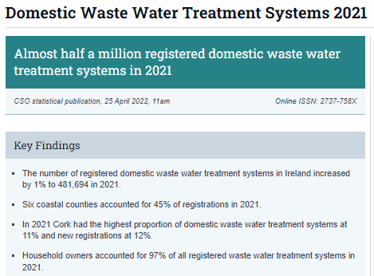
Domestic Waste Water Treatment Systems
Annual release (first release: reference year 2020)
Number of registrations by county and owner
Uses administrative data
Data source: Protect Our Water (online registration system)
All owners of domestic waste water treatment systems are required to register their systems
Introduced under the Water Services (Amendment) Act 2012 (to protect ground and surface water quality)
Annual data provided to CSO’s ADC from the Local Government Management Agency
Notes:
Domestic wastewater treatment systems include all septic tanks, waste water tanks and treatment systems receiving, storing, treating or disposing of domestic waste water (https://www.protectourwater.ie/Faq.aspx#fk2)

Slide 6
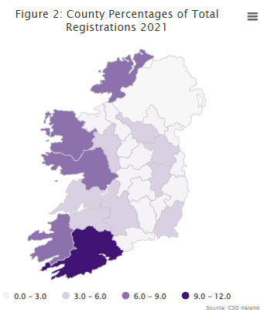
Domestic Waste Water Treatment Systems
Key Findings: Domestic Waste Water Treatment Systems 2021
The number of registered domestic waste water treatment systems: 481,694
Six coastal counties accounted for 45% of registrations
Cork had the highest proportion of domestic waste water treatment systems at 11%
Household owners accounted for 97% of all registered waste water treatment systems

Slide 7
OECD/Eurostat Joint Questionnaire on Inland Waters (JQIW)
Annual questionnaire, voluntary
Consists of 12 data tables requesting various aspects of water statistics
Water resources, water abstraction, water use, waste water
Uses a variety of data sources (e.g. Met Eireann, EPA, Irish Water, CSO Census of Population)
Data provided and compiled in different ways (e.g. directly from source, extracted from reports, extracted from website)
Provides data for other water related questionnaires (e.g. FAO, OECD)

Slide 8
Water Statistics – in development
Releases
Non-domestic metered public water consumption
Irish Water meter readings data
Water abstraction
EPA water abstraction register (already used for JQIW)

Slide 9
Thank you
Environment@cso.ie
Linh.Nolan@cso.ie

