Slide 1
Fossil Fuel Subsidies
Clare O’Hara | CSO Environment and Climate Division
CSO 11th Administrative Data Seminar
8th November 2022

Slide 2
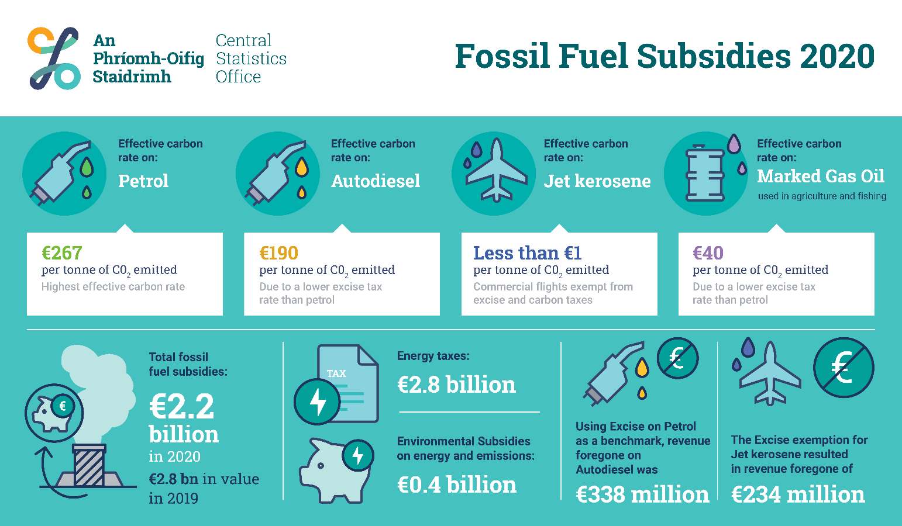
Outline
Background
Scope
Data Sources
Results

Slide 3
Background
Eurostat has developed a series of statistical modules based on the UN System of Environmental-Economic Accounting (SEEA)
  coherent with each other and with national accounts principles and classifications
  e.g. Environmental Subsidies and Similar Transfers, Environment Taxes, Air Emissions Accounts
However, the SEEA does not include a definition of potentially environmentally damaging subsidies
Despite this, there are many demands for data on these subsidies:
  SDG indicator 12.c.1 ‘Amount of fossil fuel subsidies per unit of GDP’
  Green and “brown” budgeting review – Department of Finance
  European Green Deal (“fossil-fuel subsidies should end”; “Commission will look closely at the current tax exemptions including for aviation and maritime fuels”)
Notes:
states fossil-fuel subsidies should end and, in the context of the revision of the Energy Taxation Directive, the Commission will look closely at the current tax exemptions including for aviation and maritime fuels; will create the context for broad-based tax reforms, removing subsidies for fossil fuels

Slide 4
Background
OECD, IMF and IEA all produce estimates of fossil fuel subsidies using different approaches
The OECD also publishes data on a related measure: Effective Carbon Rates (ECRs)
Eurostat will carry out a pilot data collection on potentially environmentally damaging subsidies and ECRs in early 2023
CSO Environment and Climate Division worked to develop a annual national statistical release which would
  complement our other releases that are based on Eurostat SEEA modules; and
  provide data for policy needs

Slide 5
Scope
Indicators
  Total Fossil Fuel Subsidies (based on inventory of individual measures)
  Average Effective Carbon Rates (ECRs)
  Energy Tax per Litre of Fuel
Coverage
  ESA 2010 current and capital transfers; tax expenditures; price supports; etc (broad definition)
  All fossil fuels (including peat) and electricity generated from fossil fuels
  ECRs are based on all energy taxes included in the Eurostat Environment Taxes module
  Annual data for 2000-2020 (2021 release due in March 2023)
  Energy tax per litre on selected fuels in 2020

Slide 6
Scope
Classifications
  ECRs classified according to sector (e.g. Road Transport, Aviation, Industry) and fuel
  Plan to introduce NACE classification
  Fossil fuel subsidies classified as production or consumption, and direct (budgetary) or indirect (tax expenditures)
  Energy tax per litre classified according to fuel and type of tax

Slide 7
Why three different indicators?
Fossil Fuel Subsidies (inventory approach)
Effective Carbon Rates
Energy Tax per Litre
policy makers can evaluate and track individual supports
show contribution of direct subsidies v tax expenditures
can be used to estimate overall national support to fossil fuels
compare with other environmental accounts
compare taxes paid by different sectors
provide data on specific fuels
useful for cross-country comparisons
should complement knowledge of general public (e.g. price per litre at petrol pump)
provide data on specific fuels
provide data on specific taxes

Slide 8
Data – Fossil Fuel Subsidies
Data on budgetary transfers
  usually available from accounts/reports of govt departments and public bodies (e.g. appropriation accounts, CRU PSO Levy decision papers)
  or contact relevant govt dept/public body to request data
Data on tax expenditures
  some tax expenditure data is published by Revenue, e.g. Diesel Rebate Scheme
  other estimates involve defining the relevant benchmark tax rates and measuring tax expenditures as deviations from these rates using the revenue foregone approach
  => need data on fuel volumes

Slide 9
Data – Fossil Fuel Subsidies
Type of Tax | Specific Tax from Irish Regime | Unit | Benchmark Rate 2020
Excise Duty/Carbon Tax on Hydrocarbon Oils for Transport | Mineral Oil Tax on Petrol (Excise and Carbon Tax) | € per 1,000 litres | 601.69
Excise Duty/Carbon Tax on Hydrocarbon Oils for Heating | Mineral Oil Tax on Marked Gas Oil (Excise and Carbon Tax) | € per 1,000 litres | 117.78
Excise Duty on Electricity | Electricity Tax: Non-Business Use | € per MWh | 1.00
VAT on Energy Products | Standard VAT Rate | % of price | 23
$$\text{Revenue} \text{foregone} \text{on} \text{fuel} \text{A}\text{ = (}\text{benchmark} \text{rate}\text{ − }\text{tax} \text{rate} \text{on} \text{fuel} \text{A}\text{) × }\text{volume} \text{of} \text{Fuel} \text{A}$$

Slide 10
Data – Fossil Fuel Subsidies
Fossil Fuel Subsidy | Type | Data Source
Electricity generation from fossil fuels | Direct subsidy | Electricity market regulator reports
Fuel poverty supports | Social transfers | Government accounts
Research and development funding | Capital grant | Direct requests to universities and government departments
Repayments of Excise/Carbon Tax on fossil fuels | Tax expenditure | Revenue data
Revenue foregone: fossil fuel Excise duty | Tax expenditure | Estimated using Revenue data
Revenue foregone on VAT on fossil fuels | Tax expenditure | Estimated using CSO and Revenue data
Gas and oil royalty revenue foregone | Tax expenditure | Estimated using industry accounts
Revenue foregone: free emission permits | Tax expenditure | Estimated using EU ETS data
Expensing of exploration costs | Tax expenditure | No data available

Slide 11
Data – Effective Carbon Rates/Tax per Litre
ECRs: net energy tax receipts divided by carbon dioxide emissions from fuel combustion (€/ t CO₂)
Energy Tax per Litre: net energy tax receipts divided by fuel volumes
Data on tax receipts by fuel and fuel volumes are available from Revenue
  e.g. Mineral Oil Tax (carbon and non-carbon components) on petrol – net receipts (Euro) and fuel volume (thousand litres)
  for ECRs convert fuel volumes to tonnes of carbon dioxide emitted using SEAI emission factors
Use Energy Balances/Business Energy Use survey data for sector breakdown

Slide 12
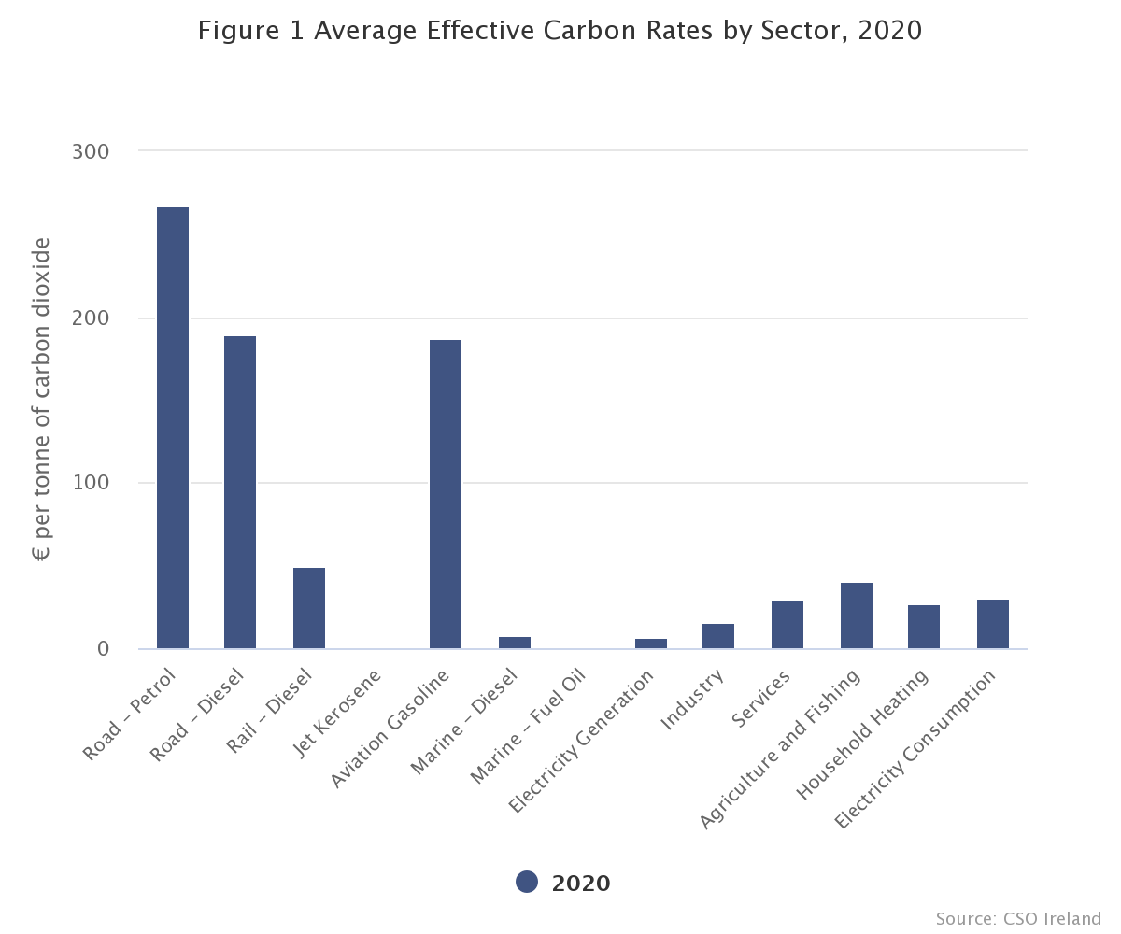
Results
Figure 1 shows average ECRs by sector
The average ECR on petrol was €267 per tonne of CO₂ in 2020
Road Diesel was €190 per t CO₂
Jet kerosene was €0.09 per t CO₂

Slide 13
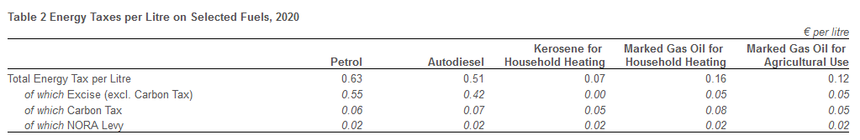
Results
In 2020, the average tax per litre on petrol was 63 cent, of which 55 cent was Excise (excluding Carbon tax), 6 cent was Carbon tax and 2 cent was the NORA Levy

Slide 14
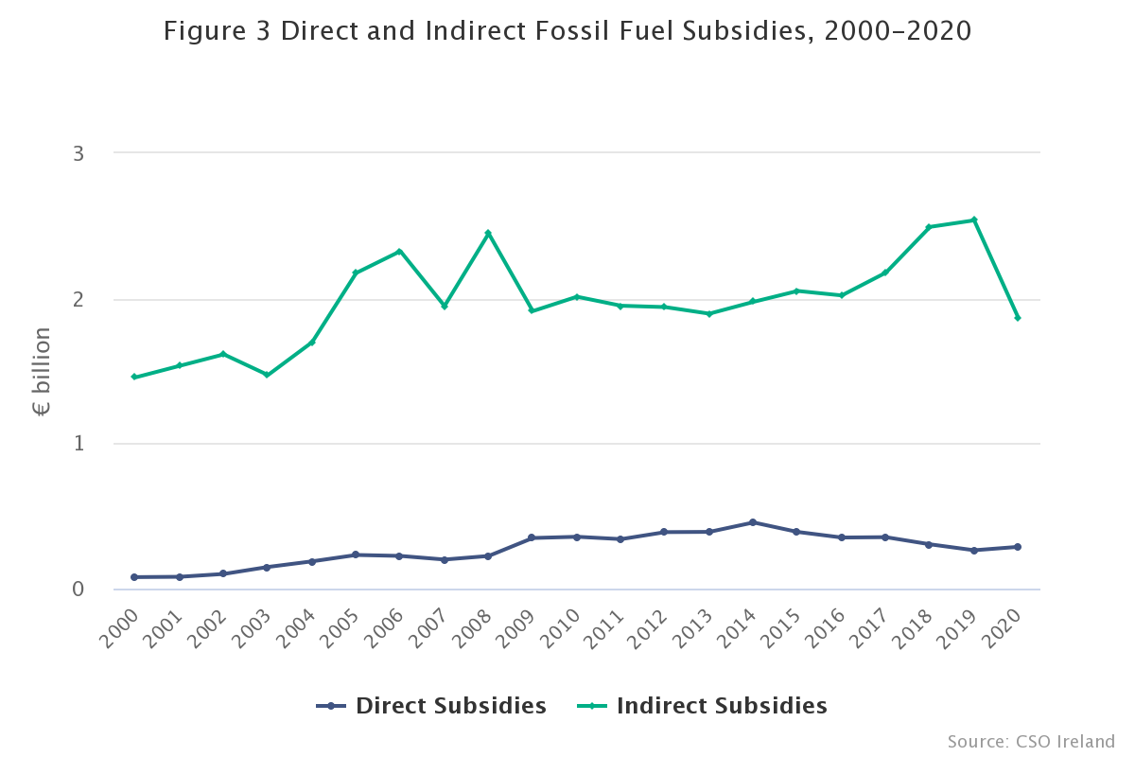
Results
The graph shows the contributions of direct/budgetary supports and tax expenditures
Tax expenditures dominated and were 87% of fossil fuel subsidies in 2020

Slide 15
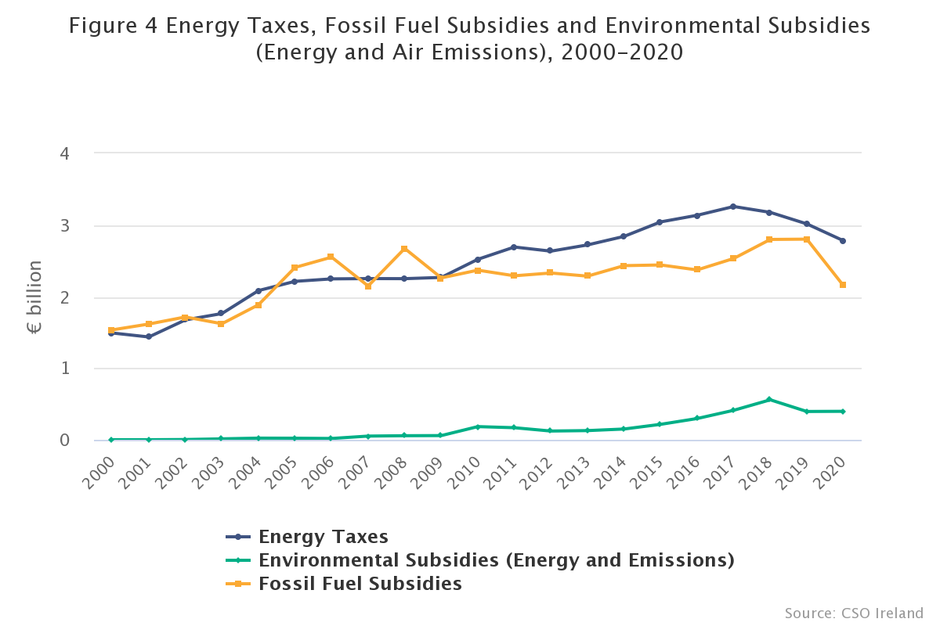
Results
The graph shows a comparison of energy tax receipts, fossil fuel subsidies and environmental energy subsidies
In 2020 energy taxes were €2.8 billion and €0.4 billion was spent on environmental energy subsidies. Fossil fuel subsidies were €2.2 billion

Slide 16
Thank you
Email: clare.ohara@cso.ie

