Slide 1
CSO Administrative Data Centre Seminar 8 November 2022 8. Environment-related Administrative Microdata
Gerry Brady
Environment and Climate Division

Slide 2
Strategic Approach
We use administrative microdata to publish statistical releases and to complete Eurostat environment accounts and other modules
We use the Statistics Act, 1993 to obtain access to confidential microdata files with high statistical potential held by public authorities
We receive electricity, gas, and water meter level data from utility companies
Geocode the microdata to more detailed geography to facilitate analyses across datasets at county and Dublin postal district level
Develop longitudinal files with the administrative microdata
Thematic analyses using a subset of the microdata e.g. data centres

Slide 3
Strategic Approach
Encourage the data owners to develop their coverage of unique identifiers such as Eircodes
Add statistical value by combining related microdata files
We work closely with EPA and SEAI and use their emissions, energy, water, and waste datasets as part of our work
Meet policy needs e.g. a 2021/2022 electricity and gas meter level analysis would show how customers responded to higher energy prices
Business Energy Use, Waste Generation, and Environmental Expenditure surveys
CSO Census of Population, Trade, Census of Industrial Production, Annual Services Inquiry, PRODCOM, and Government Accounts

Slide 4
Dissemination - CSO Website Environment-related Categories
Agri-Environment
Climate
Ecosystem accounts (separate Division)
Energy
Environment economic accounts
Fishery
Forestry
Environmental indicators
Environmental-social
Water and waste water

Slide 5
Main Administrative Microdata Sources (environment-related)
ESB electricity meters (from 2015) Gas Networks meters (from 2011) Irish Water meters (from 2014) SEAI Building Energy Ratings (from 2009) SEAI large industry energy network SEAI public sector energy programme EPA emissions trading scheme EPA water abstraction register EPA licensed waste returns | NWCPO licensed waste collectors returns LGMA domestic waste water treatment systems Forest Service afforestation premia (from 2007) Forest Service forestry scheme payments DAFM agri-environment data Sea Fisheries Protection Authority fish landings Revenue return of oil movements (from 2015) NCT and CVRT vehicle tests (from 2007)

Slide 6
Examples of Using Unique Identifiers to Combine Microdata
MPRN is common to the Building Energy Ratings (BER) and Electricity meter datasets resulting in a very high matching rate
Eircode was used to match the BER file with the 2016 Census of Population and with the gas meter datasets
CRO number used to combine EPA and CSO waste generation data
Eircodes give access to X/Y coordinates and other geography
Electricity and gas meter data would be of much greater statistical value if they contained a unique business identifier
Combining BER and electricity meters showed how consumption varied by energy rating
BER/Census analysis showed who lives in low energy-efficiency dwellings

Slide 7
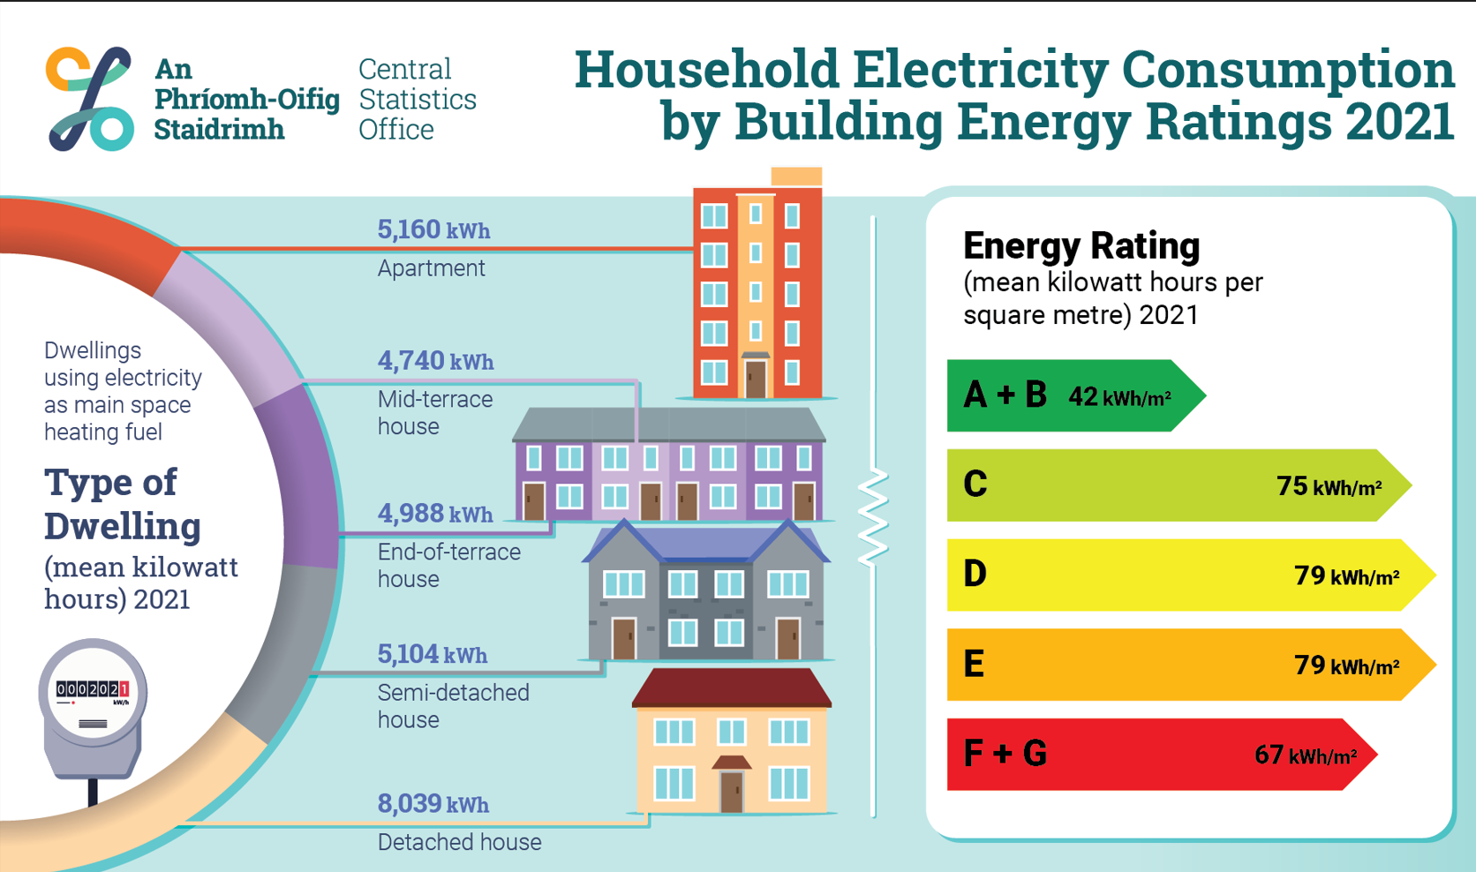

Slide 9
New Releases 2022
We made a focused effort to publish new releases this year
Metered Electricity Consumption (January - ESB)
Data Centres Metered Electricity Consumption (January - ESB)
Wood and Paper Exports and Imports (March – CSO Trade)
Plant Protection Products (April - DAFM)
Afforestation Area (April – Forest Service)
Forestry Scheme Payments (June – Forest Service)
Fertiliser Sales (July - DAFM)
Household Gas Consumption by Building Energy Ratings (August – GNI/SEAI)
Household Electricity Consumption by Building Energy Ratings (September – ESB/SEAI)
Non-Domestic Electricity Consumption by Building Energy Ratings (October – ESB/SEAI)

Slide 10
The Road Ahead (long and winding!)
Forecourt fuel sales (Revenue ROM1)
Domestic and Non-domestic electricity and gas energy costs (SEAI prices and ESB/GNI meters)
SILC and Building Energy Ratings RMF file (SEAI and CSO)
Gross Nutrient Balances (DAFM)
Vehicle odometer readings (NCT and CVRT)
Non-domestic metered water consumption (Irish Water)
Economic impact on selected NACE sectors of reducing emissions (EPA, SEAI, CSO)
Climate data rescue indicators (Met Éireann)
Environmental Protection Expenditure (CSO)
Electric Vehicle Transition (Various sources)
Display Energy Certificates (SEAI)
County Environmental Indicators (Various sources)
Sales of Wood and Paper Products (PRODCOM)
Economic accounts for forestry (DAFM, Teagasc, CSO)
Water accounts (Irish Water, EPA, Met Éireann)

