Slide 1
PIAAC: Origins, international dimension, concepts and aims
William Thorn, OECD
william.thorn@oecd.org

Slide 2
Objectives
Provide some background to PIAAC regarding:
Its origins
Its objectives,
Its novel elements, and
Its output.

Slide 3
Origins
1980s - early 1990s
interest in literacy levels of workforce
‘competence’ movement
Developments in large-scale testing
Development of international adult literacy/skills surveys:
IALS (1994, 1996, 1998): 21 countries (including Ireland in 1994)
ALL (2003, 2006): 13 countries

Slide 4
Origins
Work on PIAAC began in early 2000s
Updating measures to increase relevance to the digital world
Expansion of the range of skills about which information collected (e.g. ‘generic’ skills)
Interest in the ‘demand’ for skills in addition to supply
Measurement of ‘human capital’ rather than ‘literacy’

Slide 5
Objectives
Design of PIAAC finalised in 2007
Broad objectives :
Provide high quality comparable information on the level and distribution of key information processing skills in the adult population
Show the relationship of these skills to individual and social ‘outcomes’
Better understand the processes through which skills are gained, maintained and lost over the lifecycle

Slide 6
Design features: content
Direct assessment of key information processing skills
Literacy (including reading components), numeracy, problem solving in technology-rich environments (PS-TRE)
Linked to IALS and ALL in domains of literacy and numeracy
Information on the use of literacy, numeracy and problem solving at work and elsewhere
Information on use of a range of other generic skills at work
Interaction, organisation (self and others), learning and physical skills
Information on antecedents and outcomes

Slide 7
Links to previous adult surveys
PIAAC | ALL (2003-2006) | IALS (1994-1998)
Literacy (combined prose and document) | Literacy (rescaled to combine prose and document) | Literacy (rescaled to combine prose and document)
 | Prose literacy | Prose literacy
 | Document literacy | Document literacy
Reading components
Numeracy | Numeracy
 |  | Quantitative literacy
Problem solving in technology-rich environments
 | Problem solving

Slide 8
Design features
Target population – 16-65 year olds resident in national territory
Sample: probability sample representative of target population
Household survey
Computer delivery
BQ – CAPI
Assessment - CBA

Slide 9
Participation
Round 1 (2008-2013)
24 countries
Australia, Austria, Belgium (Flanders), Canada, Czech Republic, Denmark, Estonia, Finland, France, Germany, Ireland, Italy, Japan, Korea, Netherlands, Norway, Poland, Slovak Republic, Spain, Sweden, UK (England, Nth Ireland), US, Cyprus, Russian Federation
Round 2 (2012-2015)
10 countries
Chile, Greece, Indonesia, Israel, Lithuania, Portugal, New Zealand, Singapore, Slovenia, Turkey

Slide 10
Innovative elements
Proficiency in information processing in ICT environments
Reading of digital texts
Problem solving in technology rich environments
Information regarding poor readers
Reading components
Richer information regarding the use of skills
In particular, the use of generic skills
Computer delivery

Slide 11
Information processing in ICT environments

Slide 13
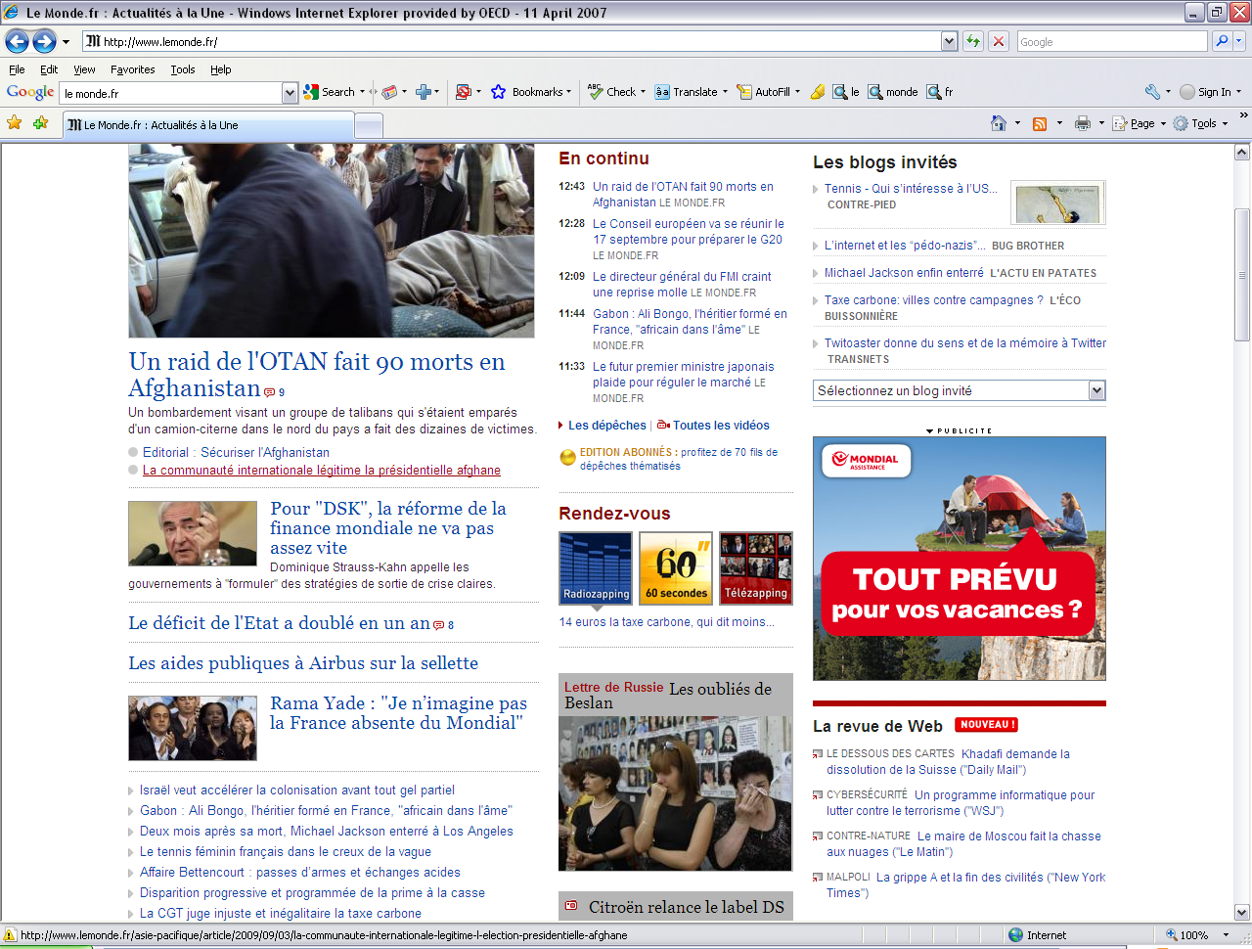

Slide 14
Information processing in ICT environments
Literacy
Construct expanded to cover the reading of digital texts
Nearly 50% of literacy items are based on digital stimuli
Problem solving in TRE
Ability to access, analyse and communicate information in ICT environments
Goes well beyond ‘computer literacy’

Slide 15
Information on poor readers
Reading components
Print vocabulary
Sentence comprehension
Passage fluency
Automaticity in these elements is precondition for comprehension

Slide 16
Use of skills
Literacy and numeracy practices and ICT use at work and elsewhere
Variety, frequency and complexity
Use of generic skills
Information on work tasks
Interaction, learning, organisation and physical demands
Perceived match of qualifications, skills and experience to job requirements

Slide 17
Computer delivery
First time CBA has been used in large-scale international assessment as main collection tool

Slide 18
Output
October 2013
International Report
Public use data set
Data explorer
Data analyser
2014-2015
Series of thematic reports

Slide 19
The first international report
Comprehensive and descriptive
2 volumes – Vol. 1: analysis and Vol. 2: methodology
Vol. 1 will contain six chapters
Context: skills and trends in technology, the labour market an society
Cross-country comparisons of the level and distribution of adult skills
The distribution of proficiency among various socio-demographic groups in different countries
The skill proficiency of workers and the use of their skills in the workplace
Developing and sustaining information processing skills
The link between information processing skills and outcomes

Slide 20
Thematic reports
Programme of analysis over 2014-2015
Six thematic reports proposed:
Skills and labour market outcomes
The use of skills in the workplace
A closer look at the population with low levels of proficiency
Digital literacy, problem solving in TRE and ICT use
Trends in proficiency, ageing and the determinants of skills
Skills mismatch

Slide 21
Some important themes
Proportion of adults with low proficiency
Both IALS and ALL found that a large proportion of population had low proficiency in literacy and numeracy and that poor literacy was linked to poor outcomes (e.g. unemployment, inactivity and low wages)
Significant policy impact in some countries (e.g. Australia, Ireland, Netherlands, NZ, UK)
PIAAC provides up-to-date measures and repeated measures for many countries
PIAAC has more information on skills of the poorest readers

Slide 22
Some important themes
Effectiveness of adult learning systems
Variations between countries
Importance of what happens in schools
Learning gains after end of compulsory schooling (To what extent does PISA provide a summary measure of the quality of output from initial education?)

Slide 23
PISA and PIAAC
PISA cohort | Age in 2011/12
2000 | 27-28
2003 | 24-25
2006 | 21-22
2009 | 18-19
2012 | 15-16
Notes:
As is mentioned in the literature review, very interesting work has been done using IALS in conjunction with other data sets.
Obviously, one of the interesting about PIAAC is that it will give us information about the age groups that have undertaken PISA. As can be seen from the table, the PISA 2000 cohort will be aged 27-28 at the time the main data collection for PIAAC is taking place.

Slide 24
Some important themes
Information processing in a digital world
Who is best placed to benefit?
Is there a ‘digital divide’?
Skills for ‘production or ‘consumption’?
Wide range of information in PIAAC
Proficiency (PS-TRE, reading digital texts)
Use of ICTs
Can link to other statistics on access, diffusion

Slide 25
Some important themes
Skill gain and loss over the lifecycle
Disentangling period, cohort and aging effects
Important issue given demographic developments and policies to increase labour force participation of older people

Slide 26
Cohort effects: comparing different cohorts of same age in both surveys
Trend of net negative
cohort effects
between 1996 and 2006
for adults aged 16-21
Trend of net positive
cohort effects
between 1996 and 2006
for adults aged 43-65
Source: IALS, 1996; ALLS, 2006.

Slide 27
Ageing effects: comparing same cohorts 10 years later
Trend of net positive
ageing effects
after 10 years
for adults aged
16-28 in 1996
Trend of net negative
ageing effects
after 10 years
for adults aged
29-55 in 1996
Source: IALS, 1996; ALLS, 2006.

Slide 28
Some important themes
Qualifications and skills match and mismatch
A recurrent theme over at least 30 years with a renewed burst of interest
PIAAC provides a way of looking at the issue in a range of ways
Qualifications mismatch - ‘objective’ and ‘subjective’ measures available
Skills mismatch – ‘objective’ and ‘subjective’ measures

Slide 29
Thank you
william.thorn@oecd.org

