Slide 1


PIAAC: Delivering the Survey in Ireland
Kevin McCormack
Senior Statistician - Social Analysis
www.PIAAC.ie
PIAAC@cso.ie

Slide 2
Overview
Background
Development
Survey Process
Content
Results
Dissemination
Handouts
PIAAC Brochure
Background Questionnaire
PIAAC Factsheet
Outline of international report
Proposed thematic reports
Notes:
This presentation will provide an overview of the PIAAC survey as it was conducted in Ireland.
We will describe the origins of the PIAAC project in Ireland; the development of the questionnaire; the data collection phase; we will describe some of the key findings of the IALS survey that PIAAC will update, and consider some of the other analyses that PIAAC will present.
Nothing too technical, but if you have specific technical questions or would like further detail we’re happy to try and answer them here or send you the information afterwards via email.
Standard CSO Disclaimer!!!
By its nature the CSO is a data collection, processing and descriptive analysis agency. Our PIAAC publications will necessarily focus on describing the data BUT not draw any policy conclusions or make recommendations. That is why a seminar such as this is important because a lot of the added value in the PIAAC data will come from external researchers.
We have placed in your pack
PIAAC Brochure...as distributed to households in the main study
Background Questionnaire
PIAAC Factsheet ...
Etc.
Laptops
We have also placed three laptops around the room to allow anyone that is interested to take a few of the computer-based assessment items. Don’t worry no results available!

Slide 3
Background
SLA 2010 - 2013
  DES (and DETE originally)
  CSO
    Statistics Act 1993
      Data collection
      Dissemination
Timeline
  2009 – 2013
  Publication Oct 2nd 2013
Notes:
Background
The CSO and DES have been attending PIAAC meetings internationally since 2008,
SLA (service-level agreement) between DES, DETE and CSO was signed in March 2010. Now just one department – DES.
A major factor in deciding to commit to the project was securing a budget and staff allocation given the difficult economic circumstances. DES pushed hard to get the project off the ground given their belief in the importance of the data and the significant need for this type of data.
PIAAC represents a departure of sorts for the CSO as it is the first time a survey of this nature has been undertaken (i.e. Skills assessment, standard survey international ...
A key feature of the SLA was that the PIAAC data would be collected under the Statistics Act 1993, which means that PIAAC data is treated exactly the same as other CSO data from the perspective of data confidentiality.
Timeline – A quick run through of the main milestones.

Slide 4

PIAAC Timeline
October 2013
Publication
International
National
&
Databases
June 2010 – July 2011
Main Study preparation:
Testing
Developing IT systems
Commissioning laptops Training interviewers
August 2011 – March 2012
Main Study
5,983 completed interviews
72% Overall response rate
70% Computer 30% Paper
May 2012 – May2013
Data processing, verification, cleaning
Table generation
National report
May 2010
Field Trial
Interviewer training
Sampling, maps, addresses
Questionnaire testing
Translation and Localisation tasks began
March 2010
SLA signed
CSO, DES, DETE
September 2009
CSO commenced formal engagement
2009
2009
2010
2010
2011
2012
2013
2013
Notes:
September 2009: Commenced - Translation, localisation, scoring testing, IT testing
March 2010: SLA signed
May 2010 : Field Trial – 800 cases – Purposive sampling – Instrument testing
June 2010 – August 2011 Main study preparation (testing & training)
August 2011 – March 2012 – Main Study
6,001 interviews, 50 interviewers,
April– May 2012: Booklet scoring, coding, data cleaning
May 31st 2012 Data submission
June – August 2012: Data cleaning, weighting
October 31 2012 – Preliminary consolidated international data file sent to ETS
January 2013 – First national database with scaled data available to countries
October 2nd 2013 – international publication and data releases
- national publication

Slide 5

Survey Development
Instrument development
  Translation and Localisation
  Scoring testing and re-testing
IT development
  Virtual Machine
  Screener and Case Management System development
Field Test
Notes:
A significant part of the work on the PIAAC survey took place well in advance of data collection: Here are a few significant highlights.
PIAAC relies on an internationally comparable background questionnaire and assessment instruments, so a stringent translation and verification process was implemented.
This involved ‘translating’ the instrument in to IRISH-English (e.g. footpath instead of pavement) and making obvious insertions such as changing ‘dollars’ to ‘euros’ and in most cases adopting metric rather than imperial scales. All changes were then subject to a verification process by the international Consortium to ensure that the comparability of the questionnaire or assessment instrument was not undermined.
algorithms within PIAAC
Another important part of the development process was testing the scoring
Another feature of the standardised approach was the use of a ‘virtual machine’ to implement PIAAC across countries. This effectively was a ‘computer within a computer’ to maintain the exact same look and feel across countries.
- Not straightforward, some glitches and complications using with in-house software.
PIAAC used a Field Test in the summer of 2010 and this was of central importance to the success of the main study.
This was valuable because it allowed us to test the various IT systems around the survey in particular the PIAAC instrument.
It also allowed us to develop our training materials and message for interviewers.
The main value of this was that it allowed us to establish ‘proof of concept’ – i.e. That a survey of this nature could be successfully carried out in Ireland, and that we could achieve a reasonably high response rate. This was a significant comfort heading into the main study.

Slide 6








Survey Development
OECD oversight
  “The Consortium”
Sampling plans
Interviewer training
Quality Control
Weighting - Westat
Data Adjudication

Slide 7
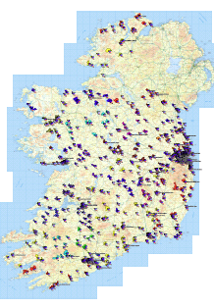
Survey Process
Randomly selected !!!
Main Study Aug 2011 – March 2012
  Sampling
  Interviewer training
  Data collection
  Data processing
700 Blocks
15 Households
1 Person
Notes:
This section describes briefly some of the important features of the survey process, to highlight the unique nature of PIAAC and the rigorous procedures that underlie the collected data.
Sampling
700 Census “Small Areas” - aka Blocks
15 households in each
1 person aged between 16-65 selected at random from within household
10,500 households in sample
Features of sample
Sample selected based on distribution of population across counties and regions, and incorporating an Education variable.
[This used the proportion of people with a third level qualification in each small area as an additional stratifying variable for sample selection. ]
Listing of occupied households from Census to avoid vacant houses
Interviewers used Census addresses and corresponding maps to locate households

Slide 8
Survey Process
Main Study
  Sampling
  Interviewer training
  Data collection
  Data processing
Mix of new and experienced interviewers
8 day training programme
  OECD specification
Focus on :
Gaining co-operation
Use of survey instrument
Other important elements:
Nature of survey
Quality control
Confidentiality
Notes:
Approx.65 interviewers were trained for PIAAC
They followed a comprehensive training programme which combined elements of the usual CSO training programme with the OECD prescribed training programme for PIAAC.
The programme focussed on two main elements gaining co-operation and use of the instrument.
Interviewers received significant hands-on training in the operation of the laptop and the protocols for the interview situation, particularly around the skills assessment.
The importance of high quality data and the need for a sensitive approach were also emphasised.

Slide 9
Survey Process
Main Study
  Sampling
  Interviewer training
  Data collection
  Data processing
Encrypted data - file transfer & laptops
Screener - random adult (16-65)
Targets and bonus payments
Incentive payment
Management information system
Unlimited call –backs
Strict weekly monitoring
Quality control
Taped interviews
10% of all interviews verified
Telephone calls, field visits,
Notes:
Some features of the data collection or the interview process.
The critical issue in terms of data collection was the need to get the highest response rate possible.
Interviewers worked an area for two weeks initially, and were expected to get 8 households
Quality control
As important as the overall production numbers were, we also placed a huge emphasis on the quality of the work.
10% of all interviews received some form of verification check.
- Taped interviews.

Slide 10
Survey Process
Main Study
  Sampling
  Interviewer training
  Data collection
  Data processing
Industry and occupation coding
Manual
Automatic
Verification against LFS
Paper booklet scoring
Inter-coder reliability design
Anchor booklets (international)
Data cleaning
Screener vs PIAAC questionnaire
Notes:
Some features of the data collection or the interview process.
The critical issue in terms of data collection was the need to get the highest response rate possible.
Interviewers worked an area for two weeks initially, and were expected to get 8 households
Quality control
As important as the overall production numbers were, we also place a huge emphasis on the quality of the work.
10% of all interviews received some form of verification check.
- Taped interviews,

Slide 11


Survey Content
Background Questionnaire
‘Core’
  IT competency
  Basic Skills assessment
Direct Assessment
  Computer Based Assessment
  Paper Based Assessment
Notes:
Background Questionnaire
Copies available – see next slide
Very few national additions (e.g. parent’s occupation at 16, reason for early school leaving) because of our late engagement.
Assessment (See slide)
A. Computer vs Paper
B. Literacy
Numeracy
Problem-Solving
C. Reading Components

Slide 12
Background Questionnaire
A. General Information – Age & Gender
B. Education and Training – Formal Education & Training
C. Current status and work history
D. Current work – Occupation & Earnings
E. Last job - Occupation & Earnings
F. Skills used at work – Frequency of use of workplace skills
G. Literacy, numeracy and ICT skills used at work
H. Literacy, numeracy and ICT skills used in everyday life
I. About yourself – Respondent attitudes and activities
J. Background information – including parents’ occupations
Notes:
See handout for full listing of BQ questions (also available on www.PIAAC.ie)
Mainly standard demographic questions
B. Ongoing and completed education and training
C. Current status and work history
D. Current work
E. Previous work
Main PIAAC-specific sections: F, G and H (Skills used at work)
I (attitudes and activities)

Slide 13
PIAAC Assessment Design
Everyone takes the BQ
Aged 16-65
BQ
FAIL <4
Basic IT Skills
6 tasks: 4 of 6 to PASS
Scrolling, clicking, highlighting,
Basic Skills (Computer)
Basic Skills (Paper)
FAIL
<4 of 8
All those who fail the simple literacy or numeracy task on computer or paper are routed automatically to the Reading Components booklet
FAIL
<3 of 6
4 literacy tasks
4 numeracy tasks
(same as computer tasks)
4 of 8 to PASS
3 literacy tasks
3 numeracy tasks
3 of 6 to PASS
Literacy and Numeracy
Numeracy and Literacy
Numeracy and Problem-solving
Literacy OR Numeracy booklet
Selected at random
Assessment (Computer)
Assessment (Paper)
Reading Components

Slide 14
PIAAC Assessment Design
BQ
Respondents had the option of skipping the Core IT assessment and proceeding directly to the Paper route
Basic IT Skills
Basic Skills (Computer)
Basic Skills (Paper)
Assessment (Computer)
Assessment (Paper)
Reading Components

Slide 15
Results
Background Questionnaire
Economic
Education
Social
Age
Gender
Skills use (work & home)
Assessments
Literacy
Numeracy
Problem-solving in Technology Rich Environments (PS-TRE)

Slide 16
PIAAC Proficiency Scales
Proficiency
  Item difficulty
  Item Response Theory & scale scores
  Cut-points (levels 1 to 5)
IRELAND: Trends from IALS to PIAAC (linked items)
Notes:
Assessment data
This will be used to create scales.
Stay away from IRT and the meaning of scale scores if possible.

Slide 17
Trends (IALS vs PIAAC)
IALS | ALL | PIAAC
Prose Literacy | Prose Literacy
Document Literacy | Document Literacy
Literacy (rescaled for trend) | Literacy (rescaled for trend) | Literacy
Quantitative Literacy
 | Numeracy | Numeracy
 | Problem solving
 |  | Problem solving in TRE

Slide 18
PIAAC Proficiency Scales
Level 2
Level 4
Level 5
Level 3
Level 1
0-225
226-275
376-500
326-375
276-325
Notes:
Difference between PISA and IALS\ALL in creating and interpreting proficiency levels - in IALS\ALL (and PIAAC) levels are based on research indicating fundamental differences in the cognitive requirements of completing different tasks.

Slide 19
Key findings of IALS
25% of Irish Adults at lowest levels of ‘literacy’
Gender: Males more likely to be at higher levels in Quantitative Literacy – otherwise little difference between males and females
Age: Older people more likely to be at lower levels of ability – related in IALS to educational attainment
Education: Higher performance related to higher levels of educational achievement.

Slide 20
Document Literacy (IALS 1997)
Quantitative Literacy (IALS 1997)
Prose Literacy (IALS 1997)
IALS 1997

Slide 21
International comparison
IALS 1997
Documents scale

Slide 22
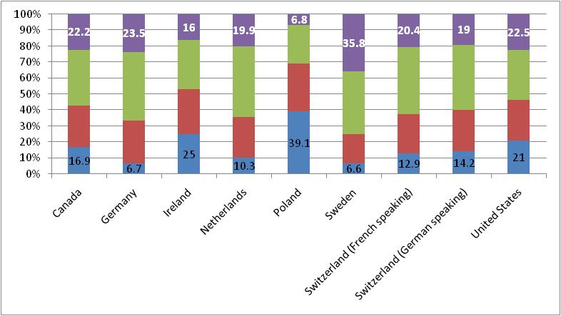
International comparison
IALS 1997
Quantitative scale

Slide 23
Some data!
Source: CSO (Census 1996 & QNHS Q2 2011)
Notes:
Although we don’t have any PIAAC data to share with you…..
There have been some important changes in the Irish population since the last time we participated in an adult international assessment.
Far greater numbers of people completing secondary level education 1996 82% vs 2011 89.8%..... Note male female differences

Slide 24
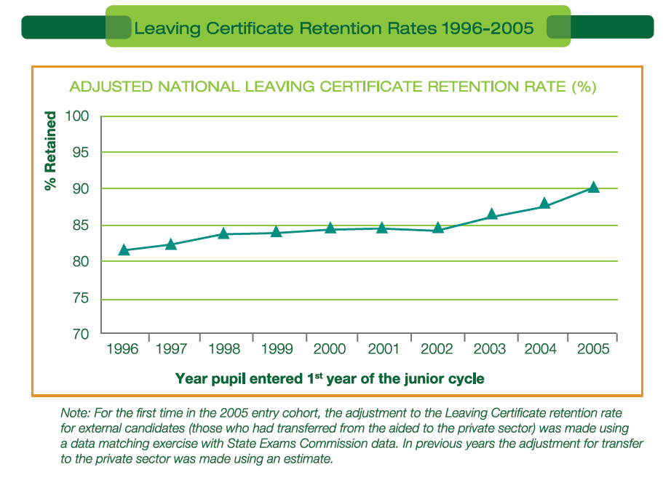
Source: DES (Education Statistics 2010/2011)
Notes:
This graphic illustrates the change in retention rates to Leaving Cert for each cohort from 1996 to 2005 (same point as previous)
So, in 1996 about 82% of the intake eventually completed the Leaving Certificate, whereas in 2005 it had increased to 89%

Slide 25
Highest level of Education Attained (Aged 25-64)
Source: CSO (Census 1996 & QNHS Q2 2011)
Notes:
This graph shows a clear change in the profile of the Education achievements of Irish adults between 1996 and 2011.
Double the proportion of adults with some post-leaving certificate qualifications

Slide 26
Population change 1996 to 2011
+1m (26%)
Notes:
We have added 1m (26%) to the population since 1996, and the graph shows that proportionally or on average the Irish adult population is now younger than it was in 1996.

Slide 27
Country of Birth
Source: CSO (Census 1996 & 2011)
Notes:
Another key factor in analysing the PIAAC results for Ireland will be the proportion of non-native Irish in the population now.
In 1996 only 7% of the usually resident population were born outside Ireland, and more than two-thirds of these were born in English-speaking countries
In 2012 20% of the same population were born outside Ireland but this time only one-third were born in English-speaking countries

Slide 28
PIAAC results
International report
2nd October 2013
Two volumes
  Results (I) and Technical (II)
Distribution of skills (mean scores)
International comparisons
Main focus on LITERACY
Other domains on the web
Problem-Solving in TRE for later thematic releases
National report
Focus on Irish performance
Trends from IALS
Relevant international comparisons
Notes:
The international report will be published on October 2nd 2013
The report will mainly focus on the Literacy domain (due to space constraints).
However, it will also make use of a derived variable that reflects performance in multiple domains.

Slide 29

Profile 9 – Census 2011
A Study of Education & Skills in Ireland
November 22nd 2012

Slide 30


Thank you
Questions?

