Slide 1
Census 2022
Census Post-Primary Geography Resources
Notes:
Teacher Notes:
Census of Population fact sheet has information about the Irish Census. See Teacher’s Resource handout.
Census of Population
Central Statistics Office (CSO) conducts the Census of Population every five years. The last census was conducted in 24 April 2016. The next census will be conducted on 3rd April 2022.
Census 2016
A census takes place in Ireland every five years. It counts all the people and households in the country. Each census gives a clear picture of the social and living conditions of the people. The census, therefore, provides vital information for planning Ireland’s future.
Census 2022 will take place on Sunday, 3rd April 2022. This census is compulsory. Under Section 26 of The Statistics Act, 1993 any person who fails or refuses to provide this information or who knowingly provides false information may be fined up to €25,000.
The confidentiality of each household’s census return is legally guaranteed by The Statistics Act, 1993 and information may only be used for statistical purposes.
Population of Ireland
1841 6,528,799
1951 2,960,593
2011 4,588,252
2016 4,761,865

Slide 2
Lesson 4
What matters to our school community
Notes:
Lesson 4
L.I. Students can identify groups in their school community and the issues important to them, giving examples on how to encourage these groups to take part in the CSO census.
https://www.shutterstock.com/image-photo/young-parents-saying-goodbye-their-little-1106709884

Slide 3
Who’s in our school community?
Students
Working Parents
People with accessibility needs
Families that speak other languages at home
Teachers
Students who play sports
Notes:
Timing 5 minutes: Questioning/Shout-out pedagogy
Question: Who’s in our school community?
Ask students to contribute their own ideas of different groups in their school community. These can be large groups (like ‘students’ or ‘parents’) or more specific such as ‘students with additional education needs’, etc.
https://www.shutterstock.com/image-photo/schoolboys-private-school-uniform-sharing-computer-1873346464
https://www.shutterstock.com/image-photo/high-school-students-assembling-robotic-structure-1873296865
https://www.shutterstock.com/image-photo/redhaired-ginger-woman-wheelchair-kitchen-1932884174
https://www.shutterstock.com/image-photo/happy-little-girl-sitting-on-fathers-1936794757
https://www.shutterstock.com/image-photo/pretty-teacher-smiling-camera-back-classroom-210171001
https://www.shutterstock.com/image-photo/september-22nd-2019-whitechurch-ireland-se-1511389172

Slide 4
What matters to our community?
How would you encourage someone from this group to take part in the census?
Choose one group from the previous slide.
What matters to them?
Notes:
Pair work: Timing: 10-15 minutes
Assign or let students (in pairs) choose a group they would like to focus on and brainstorm their ideas. Show the next slide to give them some examples as a starting point.

Slide 5
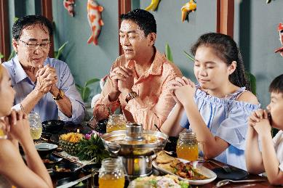
What matters to our community?
Example 1
Parents who work full time.
What matters to them
Having safe places for their young children to go after school e.g. After school clubs, childcare, parks
Good public transport or roads to get to and from work and school.
How to encourage them to complete census
Explain how the census information can help make sure we know the childcare needs of local families.
Example 2
Families that speak other languages at home.
What matters to them
Socialising with other people who speak their language.
Being able to understand other people in their daily life (e.g. at the doctor’s or dentist surgery or their children’s school for parent teacher meetings and school reports).
How to encourage them to complete the census
Give them information about the census in their own language.
Notes:
Students can add their own ideas to the examples, or focus on the group they have chosen.
Note: Example 2
Foreign Languages Page of the Census Website.
https://www.cso.ie/en/census/censusforms/foreignlanguages/
Braille, cassette and cd versions of the census form are available on request from census enumerators and from CSO.
In addition, the main text of the household form is made available in the following languages:
Arabic, Czech ,Chinese, French, Latvian, Lithuanian, Polish, Portuguese, Romanian, Russian, Spanish.
Additional information in the above languages and also Estonian, Hungarian, Slovak, Turkish and Yoruba is available on the Foreign Languages page.
Supplementary information.
Migration and Diversity 2016 Results
Country of Origin
The 535,475 non-Irish nationals living in Ireland in April 2016 came from 200 different nations. Polish nationals were the largest group with 122,515 persons followed by 103,113 UK nationals and 36,552 Lithuanians. Just twelve nations each with over 10,000 residents – America, Brazil, France, Germany, India, Italy, Latvia, Lithuania, Poland, Romania, Spain and the UK – accounted for 73.6% of the total non-Irish national population.
Languages spoken
Census 2016 revealed that 612,018 residents spoke a language other than Irish or English at home, an increase of 19.1% since 2011. Of these, 363,715 were non-Irish nationals and the top languages spoken were Polish (113,225), Lithuanian (30,502) Romanian (26,645) and Portuguese (16,737).

Slide 6
Choose one group from your school community
What matters to them?
How would you encourage someone from this group to take part in the census?
___________________________________________________ ___________________________________________________ ___________________________________________________ ___________________________________________________ ___________________________________________________ ___________________________________________________ ___________________________________________________ ___________________________________________________ ___________________________________________________ ___________________________________________________
___________________________________________________ ___________________________________________________ ___________________________________________________ ___________________________________________________ ___________________________________________________ ___________________________________________________ ___________________________________________________ ___________________________________________________ ___________________________________________________ ___________________________________________________
Notes:
Timing: 5-10 minutes
Worksheet:
Optional: You can print or share this page digitally for students to record their answers on your VLE e.g. Google Classroom.

Slide 7
The 5 minute reflection plan!
What do you know? What don’t you know? How could you get there? Steps to success!
The bits I understand are….
The bits I don’t understand YET are….
What could I do to make sure I understand?
What will I do to consolidate my understanding? How will I make it ‘stick’?
What resources will I need to help me understand?
What will I do to ensure I remember this topic in the future?
Notes:
The 5 minute reflection plan!
The bits I understand are….
What resources will I need to help me understand?
The bits I don’t understand YET are….
What will I do to ensure I remember this topic in the future?
What could I do to make sure I understand?
What will I do to consolidate my understanding? How will I make it ‘stick’?

Slide 8
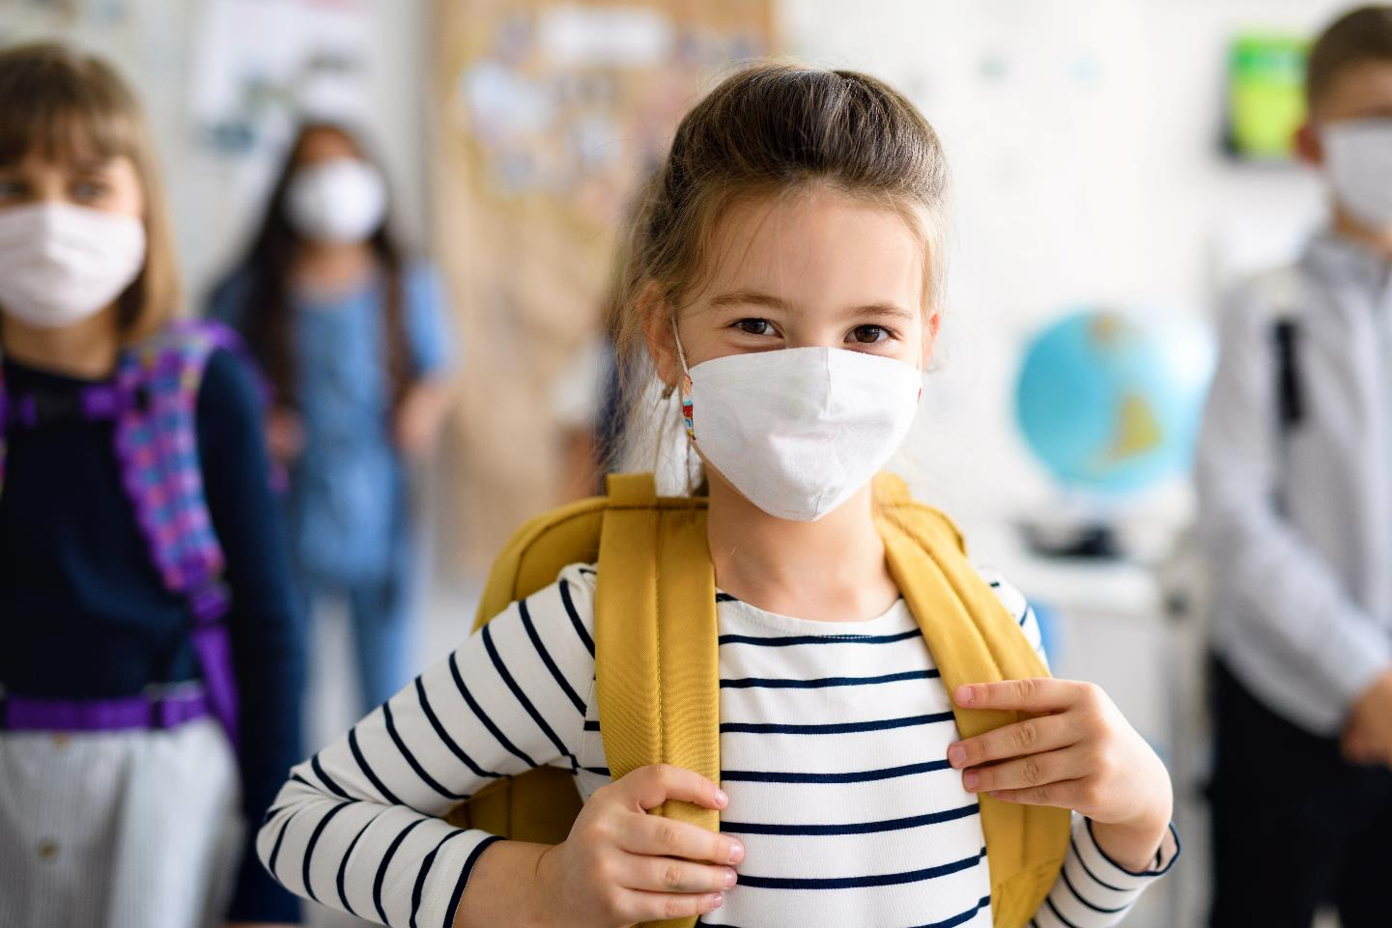
Class 4
Exploring our responsibilities
Notes:
https://www.shutterstock.com/image-photo/child-face-mask-going-back-school-1746069479

Slide 9
The census and our and responsibilities
Our responsibility
It is every household’s responsibility to complete the census so they can help build an accurate picture of who lives in their local area/county/town/city.
The community’s responsibility
The local community and organisations can fulfil their responsibilities better if they know who lives where and what services they need.
Our rights
This helps make sure everyone’s rights are protected.
Notes:
Timing: 5 minutes
To conclude these series of lessons, display this slide and clarify to students that the census is one example of a responsible and active citizenship. Every household needs to take part, because this helps to build an accurate picture of who lives in their county/town/city, and gives the government, local authority, local community and local organisations the information they need. They can then use the information to understand the local area better, and to make sure they can provide what is most needed. In this way, our rights are also protected.
Statement of Learning: Junior Cycle.
No. 7 - values what it means to be an active citizen, with rights and responsibilities in local and wider contexts
Cross-Circular links: CSPE - L.O. 1.4 assemble a ‘basic needs basket’ representing the needs of a family living in Ireland (not just their economic needs).
If time allows, ask students to share ideas on how they could help ensure more households in their community fulfil their responsibility to complete the CSO census.

Slide 10
Time Capsule:
After 100 years, this Time Capsule will be made available to the public. This space is for handwritten messages only. Photographs or other attachments will be removed and cannot be returned.
Notes:
Homework:
Ask students to complete the box with what they would like to include in the 2022 CSO census (handwriting only) and they can bring this home to their parents/guardians for consideration for Census night on 3 April 2022.
Time Capsule:
Information you provide in this Time Capsule is optional and is collected voluntarily under Section 24 of the Statistics Act 1993. This content is protected by the same confidentiality protections as all your Census data for 100 years. After 100 years, this Time Capsule will be made available to the public. This space is for handwritten messages only. Photographs or other attachments will be removed and cannot be returned.
p.23: https://www.cso.ie/en/media/csoie/census/census2021/Sample_Census_2022_Household_Form_English.pdf

Slide 11
What did you learn today?
What did you find tricky?
What can do next time?
Don’t forget the hashtag # describes the lesson or something memorable from the lesson
@
#
Notes:
Twitter student reflection exercise: @CensusIreland
What did you learn today?
What did you find tricky?
What can do next time?
https://www.shutterstock.com/image-photo/valencia-spain-march-05-2017-twitter-601425683
8 Reflective Questions To Help Any Student Think About Their Learning
1. What surprised you today, and why?
2. What’s the most important thing you learned today? Why do you think so?
3. What do you want to learn more about, and why?
4. When were you the most creative, and why do you think that is?
5. What made you curious today? How does learning feel different when you’re curious?
6. When were you at your best today, and why?
7. Assuming we were studying the same thing and you could decide and have access to anything, where would you start tomorrow? Why?
8. What can/should you do with what you know?

Slide 12
Discussion and Debate: Four Corners
Strongly Agree
Agree
The Central Statistics Office should be disbanded as tax payers money should instead be provided to shelter the homeless in Ireland?
Strongly Disagree
Disagree
Notes:
The purpose of this activity is to highlight the usefulness of discussion and debate for teaching and learning.
Give students a few minutes to think about this statement (wait time) – initially this is an individual, silent reflection.
Label the four corners of the room (as indicated on the slide)
Invite students to go to whatever corner of the room most suits their opinion
In each corner, participants justify to the others in that corner why they have chosen to be there – explaining their reasoning and attempting to justify why they have chosen that position.
Take feedback from each of the corners, encouraging the spokesperson to justify their reasoning and attempt to persuade others as to why their position is ‘correct’
Group discussion could ensue about the role of the CSO.
Note:
The Census gives a comprehensive picture of the social and living conditions of everyone in Ireland in 2022. Only a census can provide such complete detail right down to the smallest area. This information is essential for developing policy, planning, and decision-making. It provides information so that public resources can be shared evenly across the country and to ensure that services at local level are relevant to all the people who live there. Census figures are important to each and every community in Ireland. They provide information about age, education, employment, language spoken, health, etc.

