Slide 1
Junior Cycle Geography
1st Year Resource
Notes:
Key Points about the Census:
Census night is Sunday 3rd April 2022.
The Census is very important to the government, businesses and all communities.
Co-operation from the public ensures a successful census.
There is a legal requirement on the public to co-operate.
The information provided is treated as strictly confidential by the CSO.
How the Census is carried out
5,618 field staff are recruited and trained.
Census Enumerators (who carry ID) deliver over 2 million Census Forms to every household, and any place where people live, in the 5 weeks before Census night.
All areas of the country are included.
People are reminded in the media about completing the Census Forms.
People fill in the form on Census Night. 3rd April 2022
Census Enumerators (5,100) collect all Census Forms in the 4 weeks afterwards.

Slide 2
Teacher Guidance
Age: 12-15
Time: Two sessions of 120 minutes, plus homework
Preparation:
Review the slides and adapt to suit your class
Review the display/presentation option on slide 21 and plan how students will research and create their display after the series of lessons
Preview how to use each source of census information and choose which source you will help students to include
Resource: Lesson slides and handouts
Learning Outcomes:
Students can:
Name some geographical themes that can create changes in a local community
Describe some ways in which census information can illustrate these changes
Identify and plan a geographical structure enquiry to investigate a local change through an interview, census information and other sources
Notes:
Teacher Guidance:
The Census gives a comprehensive picture of the social and living conditions of everyone in Ireland in 2022. Only a census can provide such complete detail right down to the smallest area. This information is essential for developing policy, planning, and decision-making. It provides information so that public resources can be shared fairly across the country and to help ensure that services provided where they are needed. Census figures are important to each and every community in Ireland. They provide information about age, education, employment, language spoken, health, etc.

Slide 3
Teacher Guidance
Delivery:
Before delivering this lesson, you may want to use the Introductory film and lesson activities on www.cso.ie, in order to provide your students with more background about the census.
These lessons include approaches and slides for Geography.
Lesson 3:
Students will learn about collecting data to better understand a group of people. They will gather information and compare their findings with simplified statistics derived from the 2016 Census and CSO IRELAN’S FACTS & FIGURES 2019.
Homework: Students complete their interviews, local research and census information research
Lesson 4:
Students will think about their class as a community and will consider how they are similar to other small groups of people who live in Ireland. They will learn how data can be used to make sure people in communities have services to support their needs. They will make decisions for their class community, using survey data to inform those decisions.
Homework/Project work: Students turn their stories and information into an exciting display to share
Notes:
CSO: YouTube
https://youtu.be/lzNspRFiYII
Note:
Completing the Census Form is compulsory. Under the Statistics Act, 1993 any person who fails or refuses to provide this information or who knowingly provides false information may be prosecuted and fined - up to €2,500 on summary conviction
or €44,440 on conviction on indictment.
The Statistics Act, 1993
This piece of legislation outlines in law all of the conditions that apply to carrying out the Census in Ireland.
Alternative Homework:
(a) Create a slogan for Census 2022.
(b) Design a poster encouraging people in your community to complete Census 2022 on Census Night (3rd April 2022). Be sure to include the following information: a) the day and the date; b) three reasons why it is important to complete the Census Form.

Slide 4
Teacher Guidance
Virtual delivery:
Please note that the following ideas may vary depending on the platform your school uses
You could use the narration option in PowerPoint to record a voiceover of the slides, and post them on your school’s VLE e.g. Google Classroom/ MS Teams or share via your school’s preferred method. (You may want to split it into shorter sections.)
Students can replay the presentation as needed, and complete the worksheet in their own time.
Particularly if delivering this as a live lesson, you could incorporate polls at fixed points in the lesson to check learning e.g. Mentimetre
For group work or discussion, you can use online rooms or breakout spaces within the platform e.g. Breakout rooms
Encourage students to use the private chat feature to ask any questions if delivering the lesson remotely
Notes:
References:
https://www.mentimeter.com/

Slide 5
Teacher Guidance
General Curriculum links - JC:
Geography
Understand how geographical processes interact to create distinctive human and physical landscapes that change over time.
Develop greater competence in using geographical skills in analysing and interpreting different data sources
Understand key processes in human geography relating to: population and urbanisation; economic activity in the primary, secondary, tertiary activities
Enquiry, exploration and investigation inspire curiosity about Ireland, its past, present, future
I can use appropriate methods to gather information related to my enquiries and I am able to interpret the information obtained in the context of the structured inquiry project – CBA’s
Human societies are complex and diverse, and shaped by human actions and beliefs.
I can describe how some different characteristics of communities and societies have changed, within and across periods of time, in my locality such as town/county and in Ireland
Notes:
General Geography objectives are included on the slide.
An awareness of the work of the census is a vital component of Junior Cycle Geography as evident in NCCA sample questions (NCCA JC Geography Sample 1) and SEC Sample paper Q10 A.
References.
https://curriculumonline.ie/getmedia/a705cdb4-53b4-4263-9b23 50322601b655/Geography_Assessment_Items_COL_EN.pdf
https://www.examinations.ie/misc-doc/EN-EX-38118093.pdf
Note for teachers:
Article 16.2 of Bunreacht na hÉireann (The Constitution) lays down that the total membership of Dáil Éireann depends on the population as measured by the census (i.e. 1 TD per 20,000 to 30,000 people.) Constituency reviews normally happen when the results of the census have been published. The Census is also the only means for measuring accurately the exact extent of migration – the movement of people into Ireland (immigration) and out of Ireland (emigration).

Slide 6
Teacher Guidance
Curriculum links – JC geography specification:
3.1 use the demographic transition model to explain populations’ characteristics and how populations change
3.2 investigate the causes and consequences of migration
3.3 examine population change in Ireland and in a developing country
3.4 consider the facts affecting the location and origin of rural and urban settlement in Ireland
3.5 examine the causes and effects of urban change in an Irish town or city
3.6 identify global patterns of economic development
3.7 compare life changes for a young person in relation to gender equality, health care, employment and education opportunities in a developed and developing country
3.8 evaluate the role of development assistance in human development
3.9 synthesise their learning of population, settlement and human development within the process of globalisation
Notes:
Source: https://www.curriculumonline.ie/getmedia/2a7a8d03-00e6-4980-bf20-f58def95688f/JC_Geography-en.pdf

Slide 7
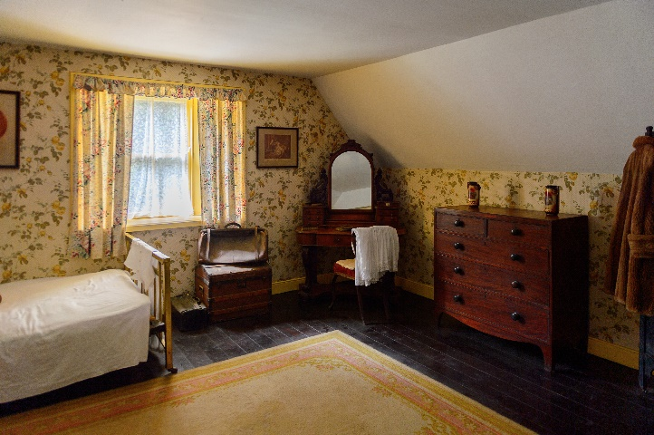
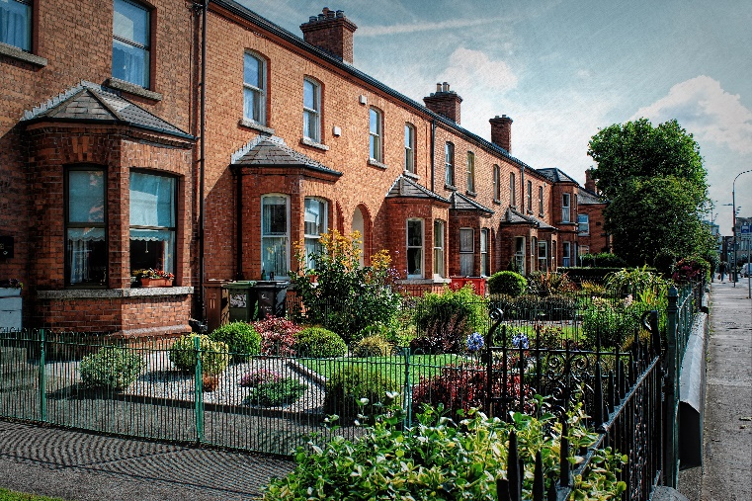
What were you doing on night of Sunday 24 April 2016 or 10 April 2011?
If someone took a photograph of a house in your community on that day, what would be in it?
How would it be the same or different to a photo taken today?
Notes:
Lesson 3
Starter Activity
Timing: 5 mins
Questioning. Be sensitive to students’ personal circumstances. Guide their discussion to avoid sharing personal information, touching on sensitive topics or highlighting inequality.
Note: Last Irish census dates - 10 April 2011. 24th April 2016.
Encourage students to think of a household ‘something like theirs’, or one in their street/estate/park. This can help to distance students from any sensitivities like negative changes to family or employment especially since the Covid-19 pandemic.
Students will have been babies or young children at the time, so they won’t know what they were doing at the time. However, this is intended to get them to think about how much can change in a household in five/ten years. They can make some general statements and guesses based on what they know or have been told.
https://www.shutterstock.com/image-photo/bunratty-ireland-july-13-2016-interior-462053653
https://www.shutterstock.com/image-photo/walking-through-streets-dublin-ireland-592564607
“Census night” means the period of time commencing at 9 p.m. on 3 April 2022 and ending at 7 a.m. on 4 April 2022.
Reference:
S.I. No. 637/2020 - Statistics (Census of Population) Order 2020
http://www.irishstatutebook.ie/eli/2020/si/637/made/en/

Slide 8
This is our story?
Write down some things that may have changed for a household in your community/town/village over the last five years. Try to think about…
Moving
Living
Employment
Big Events
Notes:
Timing: 10 mins
Be sensitive to students’ personal circumstances. Guide their discussion/dialogue to avoid sharing personal information or touching on sensitive topics. The suggested topics on the slide can help to keep them focused on the types of geographical changes that they can explore further later in this lesson 3.
This activity helps students to see that changes over time are part of the unique stories of each household. Give students the worksheet or Post-it notes to help guide their questions.
Students may struggle to think of relevant examples, so you may wish to model this with examples from your own life or family history, or perhaps a celebrity or public figure your students will relate to. For example, you could share how a parent or grandparent moved from one place to another and the reasons for this, or your own journey from being a school student to university, training in PME/HDE and your first teaching roles.
You can also provide some additional prompts:
Moving (movement, migration, urbanisation)
Do they still live in the same city or town or village?
What was the reason for moving?
Living (settlement, population structure)
Do they live in the same house?
With the same people?
Employment (industry, economy)
Do they work in the same job?
How have their jobs changed over time−for example, with new technology?
Technology – Smart TV’s, Laptops, Digital Devices, Streaming services e.g. Netflix, Video Games PS4
Big events
Have there been any important events, like weddings or the birth of a new baby?
Covid-19 – Global Pandemic – School Closures 12th March 2020
Once students have written their sentences, ask them to work in pairs to dig deeper.
(e.g. How old is your Grandmother? Has she always lived there? What's her middle name? What did her mother do?)
Encourage them to dig down until they come up with something they don't know. This then becomes a question that they will have to ask a relevant member of their family, household or school community, and use it to form the story they will tell when they complete these activities in 2nd or 3rd year.

Slide 9
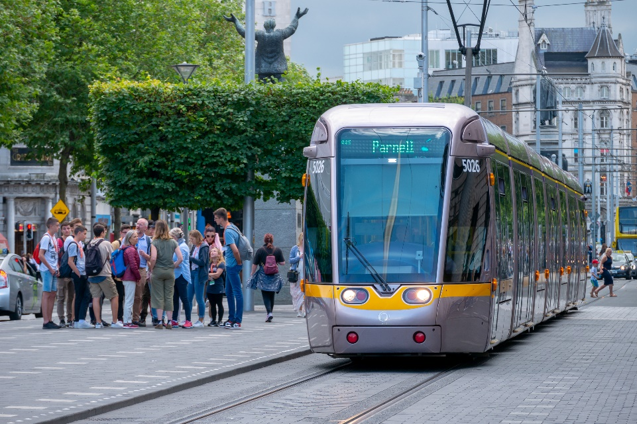
Change in our Irish communities
What are some national or local changes that have happened related to the themes listed?
Economy
Settlement
Movement
Events
Can you see any connections between the changes that have happened for your family, and the changes that have happened in your community or in Ireland?
Notes:
Activity
Timing: 5 mins
Explain to students that our individual stories add to the bigger picture of our community and Ireland.
Explain that the stories students will tell through their interview will become part of a class display or on a notice board about a larger story about the moments, events or changes in history that can affect us all. Stories happen when changes take place. Some changes can be national and large. Some can be local and small. Some may take a long time, while others can be very sudden.
Ask students to form pairs and think for one minute about the questions on the slide (they can do this as a Think-Pair-Share activity). The slide shows some broad geographical themes related to the topics they explored on slide 8, within which changes can take place. Students generate and share ideas about changes that can take place at national and local level in each theme.
Virtual delivery: Use breakout spaces for students to discuss the questions in small groups.
Questions that can help students answer, which is more nuanced and challenging:
Movement: Why have people migrated to our town or community, or away to another place? (For example, people may move to a town because of a new job opportunity for a specific person or for many people, as industries and sectors change over time. There are few remaining mining jobs in Ireland e.g. Tara Mines Navan, but the green energy sector is growing.)
Settlement: How has housing changed in our community? (For example, spare brownfield sites may now be housing estates, or historical landowners may have sold land they could no longer afford to keep. Over time, some cultural (Language) have declined in certain parts of Ireland, leading to decline in the Irish speaking communities.)
Economy: Have any traditional industries declined here, or new industries or services grown in our area, like a big new employer or type of work? (Manufacturing employers may have closed down large factories, but food production and distribution may have taken over, or business parks developed that are home to IT, finance and tech companies.)
Events: What local, national or international events have significantly changed our community? (A significant local event might be the closing of a large factory, or the opening of a new one; the increasing probability of flood events due to climate change, or perhaps a natural disaster, Covid-19 global pandemic, civil war or human rights issue in another country that has forced its people to migrate abroad, including to communities in Ireland e.g. Syrian people.)
https://www.shutterstock.com/image-photo/dublin-ireland-mar-05-2020-subway-1929041738
https://www.shutterstock.com/image-photo/dublin-ireland-july-29-2019-public-1747728137
or
https://www.shutterstock.com/image-photo/dublin-ireland-july-3-2011-two-716770315
Alternative Activity:
Ask students to bring in local newspapers, newsletters, articles from e-papers, magazines, photographs, posters of events, etc. that are taking place in their community currently.
If you don’t have time to gather newspapers you could have a brain storming session with the students about how your community has changed in the last few years. Think about buildings (infrastructure), services, people, languages spoken...
Shout out pedagogy:
When the students have thought about changes in our Irish communities you could ask the students to think about the following questions:
Q: What facilities does the community have?
Q; What do you think your community needs or wants?
Q: What do you think might improve the community?

Slide 10
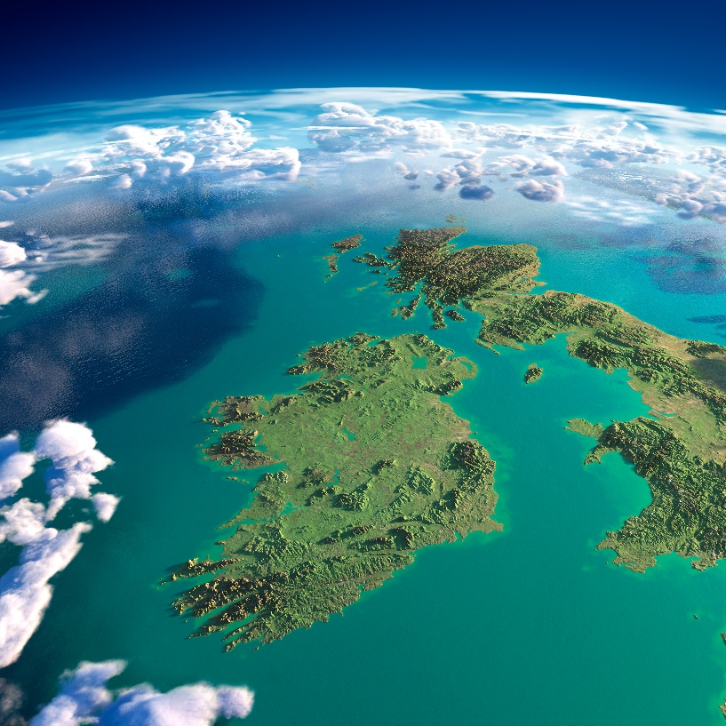
Junior Cycle Geography
What are some Irish national or local changes that have happened related to the themes listed?
Urbanisation
Migration
Industry and economy
Population structure
Can you see any connections between the changes that have happened for your family, and the changes that have happened in your community or in Ireland?
Notes:
Main Activity
Timing: 5 mins
Explain to students that our individual stories add to the bigger picture of our community and in Ireland.
Explain that the stories students will tell through their interview will become part of a class display or project about a larger story about the moments, events or other geographical changes that can affect us all. Stories happen when changes take place. Some changes can be national and large. Some can be local and small. Some may take a long time, while others can be very sudden.
Ask students to form pairs and think for one minute about the questions on the slide (they can do this as a Think-Pair-Share activity). The slide shows some broad geographical themes related to the topics they explored on slide 8, within which changes can take place. Students generate and share ideas about changes that can take place at national and local level in each theme.
Virtual delivery: Use breakout spaces for students to discuss the questions in small groups.
This activity is more nuanced and challenging especially for 1st Year Students:
Urbanisation: How has our community grown over time? (New housing has expanded many small towns into much larger conurbations, for example to use brownfield sites left vacant after the loss of manufacturing, or on land sold by farmers on the outskirts to cities and town and may be rezone for residential purposes or retail.
Industry and economy: Have any traditional industries declined here, or new industries or services grown in our area, like a big new employer or type of work? (Manufacturing employers may have closed down large factories, but food production and distribution may have taken over, or business parks developed that are home to IT, finance and tech companies e.g. Google, Facebook, Twitter, Microsoft, Tiktok etc.)
Population structure: Do you think our local population has changed in any significant way? Are residents generally older or younger? Does our community include groups that perhaps it once did not? (Many places are now home to far more diverse populations than in the past as the result of migration. At the same time, internal migration means that some places have a growing younger population, while others are popular with retired people, for example.)
Migrations: Why have people migrated to our town or community, or away to another place? (For example, people may move to a town because of a new job opportunity, as industries and sectors change over time. There are few remaining mining jobs in Ireland e.g. Tara Mines, Navan, Co. Meath, but the green energy sector is growing. A natural disaster, civil war or human rights issue in another country that has forced its people to migrate abroad, including to growing communities in the Ireland, and people may migrate to take advantage of work opportunities, such as Eastern European workers in reland’s farming, food, service and other sectors.)
Reference of Image:
On 15 April 2020, Copernicus EU 🇪🇺, the European Earth Observation Programme with its 7 Sentinel satellites, acquired this stunning (and rare) almost cloud-free view of Ireland during the lockdown, its green vegetation and a cloud front along its northwestern coast.
https://www.facebook.com/EUIreland/photos/a.156808461043981/3013612582030207/?type=3

Slide 11
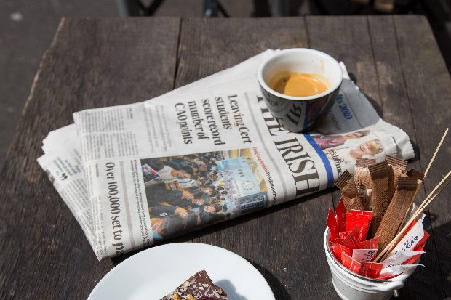
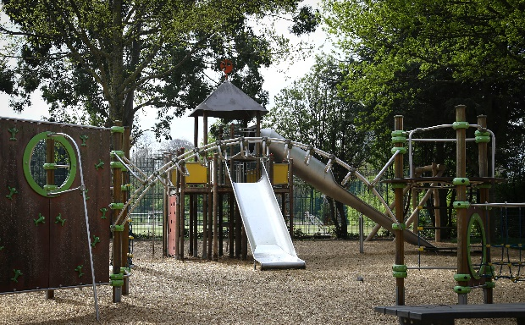
A more complete picture
What information do we need to spot and understand changes related to living, moving, employment and big events?
What source can provide this information?
Notes:
Timing: 3 mins
Cross Curricular link - History Ask students if they can name the two main types of information: primary and secondary, and explain each type.
Students generate a list of primary and secondary sources of information:
Primary: any original source, like an interview, questionnaire or survey, physical survey (e.g. traffic, people, land use, environment, mapping), historical documents written at the time, such as eyewitness accounts, original documents and records, diaries, artefacts.
Secondary: any source that discusses, interprets or analyses a topic or event, often based on primary sources: internet content, books, newspapers, articles.
Extra Challenge: Turn the lists above into cards for students to sort into primary and secondary sources if working closely with a history teacher on these lessons.
Challenge: Ask students to explain the difference between primary and secondary sources to create a cross circular link with history and how each type of source should be used differently by a geographer who wants to understand the true facts and reasons behind a change or event.
https://www.shutterstock.com/image-photo/ireland-county-wicklow-bray-public-playground-395528626
https://www.shutterstock.com/image-vector/monochrome-detailed-plan-city-dublin-1160166016
https://www.shutterstock.com/image-photo/howth-co-dublin-ireland-august-2019-1478056052

Slide 12
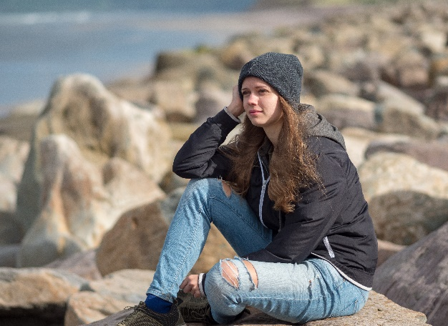
The census: a snapshot of us
It happens every 5 years in Ireland. All the information collected is anonymous for 100 years.
The census asks questions about every household, to build a detailed picture of who we are – as individuals, communities and as a nation.
The Central Statistics Office (CSO) plans and runs the census.
Notes:
Timing: 2 mins
Before showing this slide, invite students to share what they already know about the census.
Briefly review the information on the slide. Highlight that since the census takes place every 5 years, they are like a picture of us at a specific moment in time, and they build up into a story of how the Republic of Ireland is changing over time. (Northern Ireland conduct their own census.)
The census also collects information about people (such as age, sex and occupation). This information is called Data. For case studies about how census information is used, visit: www.cso.ie
https://www.shutterstock.com/image-photo/beautiful-girl-ireland-on-journey-irish-1191101740
https://www.shutterstock.com/image-photo/young-redhead-man-sweater-jeans-standing-277670210
Notes:
Census 2022 - A census takes place in Ireland every five years. It counts all the people and households in the country. Each census gives a clear picture of the social and living conditions of the people. The census, therefore, provides vital information for planning Ireland’s future. Census 2022 will take place on Sunday, 3rd April. This census is compulsory. Under the Statistics Act, 1993 any person who fails or refuses to provide this information or who knowingly provides false information may be prosecuted and fined. The confidentiality of each household’s census return is legally guaranteed by The Statistics Act, 1993 and information may only be used for statistical purposes.

Slide 13
A story of a Census Form
Step 1
The CSO consult with the citizens of Ireland and then put the Census Form together.
Step 2
The Census Forms are designed and checked (and checked again) then translated into Irish
Step 3
Over 2 million Census Forms are printed and delivered to the CSO warehouse – they then go to 466 sites around Ireland.
Step 4
Census Enumerators (5,100) deliver Census Forms to every household in Ireland in plenty of time for Census Night
Step 5
Census Forms are completed in every household on Census Night, Sunday 3rd April 2022
Step 6
Census Enumerators collect the Census Forms and answer any questions from respondents
Step 7
The Census Forms are scanned and the information is analysed, summerised and prepared for publication
Step 8
The initial results of Census 2022 are released to the public in Summer 2022 and definitive results will be made available on a phased basis from April to December 2023
Step 9
Plans are made for the future of Ireland (locally, regionally and nationally) based on the data from Census 2022
Step 10
And then the process starts all over again for the next census!
Notes:
Timing: 4 minutes
Explain the formation of a census form by the Central Statistics Office to the students.
The Journey/story of a Census Form
Step 1
The CSO consult with the citizens of Ireland and then put the Census Form together.
Step 2
The Census Forms are designed and checked (and checked again) then translated into Irish.
Step 3
Over 2 million Census Forms are printed and delivered to the CSO warehouse - they then go to 466 sites around Ireland.
Step 4
Census Enumerators (5,100) deliver Census Forms to every household in Ireland in plenty of time for Census Night.
Step 5
Census Forms are completed in every household on Census Night, Sunday, 3rd April 2022.
Step 6
Census Enumerators collect the Census Forms and answer any questions from respondents.
Step 7
The Census Forms are scanned and the information is analysed, summarised and prepared for publication
Step 8
The initial results of Census 2022 are released to the public in Summer 2022 and definitive results will be made available on a phased basis from April to December 2023.
Step 9
Plans are made for the future of Ireland (locally, regionally and nationally) based on the data from Census 2022
Step 10
And then the process starts all over again for the next census!
Optional exercise:
Distribute worksheet Appendix 1 p.49 of First Year Teacher Resource lesson plans

Slide 14
The census: a picture of us
Census information helps many organisations to do their work:
Government, Local Authorities and public bodies
Businesses
Voluntary organisations
Academics in Universities/Colleges
The general public
Notes:
Timing: 2 mins
Ask students to suggest some ways in which each group might use census information:
Government:
develop policies
plan and run services, such as schools (Department of Education & Science), health services (Health Service Executive), roads and libraries
decide how to allocate funds to make sure public money gets to where it is needed most
Health
Health Service Executive (HSE) plan and budget for medical and health services required e.g. Nursing Homes, Hospitals
Businesses
Understand customer locations and needs
Understand where skilled workers in their industry may be living
Voluntary sector:
Gather information about communities they help provide services
Academics
Carry out research by University and College lecturers
Public:
People can research their family history
Virtual delivery: You could use a poll or survey question to check understanding here. Give examples of how different groups may or may not use census information and ask students to indicate if they think the statements are true or false.
Notes:
The results are then used to plan infrastructure in services like public transport, healthcare, housing and education. Local authorities use census information to predict demand on their services and facilities.
And the number of seats in Dáil Éireann is also dependent on the results of the census.
The 2022 census contains eight new questions on topics such as renewable energy sources, smoking, internet access and devices, smoke alarms, working from home, volunteering, childcare and travelling home from work, school or college.

Slide 15
Who the CSO are?
What questions would you put on a census to help understand our country? Why?
Notes:
Timing: 5 mins
Ask students to imagine they were planning the next census, and their goal is to get a good understanding of the people and the country.
What kinds of questions would they want to ask? Why?
How would those questions help build a clearer picture of the country, the people and their needs?
How is the census taken?
In April 2022, every household in the Republic of Ireland will be asked to complete a census questionnaire on paper. Over 2 million households are expected to participate. A total of 2,003,645 houses and apartments in the State were enumerated in the 2016 Census.
Sample 2022 census form -
https://www.cso.ie/en/media/csoie/census/census2021/Sample_Census_2022_Household_Form_English.pdf
Virtual delivery: Use a document with shared editing for students to contribute their ideas e.g. Jamboard.
https://jamboard.google.com/
https://www.shutterstock.com/image-photo/co-dublin-ireland-april-2-2021-1992140306
Notes:
Census 2022 – 3rd April, 2022
A census takes place in Ireland every five years. It counts all the people and households in the country. Each census gives a clear picture of the social and living conditions of the people. The census, therefore, provides vital information for planning Ireland’s future.
Census 2016 took place on Sunday, 24th April. This census is compulsory. Under the Statistics Act, 1993 any person who fails or refuses to provide this information or who knowingly provides false information may be prosecuted and fined. The confidentiality of each household’s census return is legally guaranteed by The Statistics Act, 1993 and information may only be used for statistical purposes.
Optional:
Reading exercise for students: Distribute handout What is the Census of Population?

Slide 16
What can the census tell us?
The census asks questions like…
Who lives in this household?
Do you own a car?
How old are all the people in your house?
What is your place of birth?
What is your ethnic group?
What is your religion?
What is your level of education?
What languages do you speak?
What is your health like?
What kind of job do you do?
Why do you think the census asks these questions?
What stories can they help us to understand about our local area and Ireland?
Notes:
Timing: 5 mins
To see the sample 2022 household census questionnaire, visit https://www.cso.ie/en/media/csoie/census/census2021/Sample_Census_2022_Household_Form_English.pdf
Briefly review these questions, which paraphrase many of the main questions found on a CSO census questionnaire/form.
Explain that, although the questions may seem basic, when you combine them or look at how they’ve changed over time, they can tell a range of stories. Can students think of any examples?
As a class or in groups, identify some ‘local stories’ that the students would like to explore relating to the themes and topics they have looked at earlier, for example:
Moving: How many people from outside Ireland have become part of our community?
Living: What kinds of homes are found in our community today versus 100 years ago?
Working/Employment: How many people are self-employed? How has employment changed?
Identify which census questions, singly or combined, can provide information that helps to illustrate these changes.
Highlight that great efforts have always been made to ensure everyone is included in a census, to provide the most complete and accurate snapshot of people’s lives at the time. Ask students to suggest what might happen if some people, including groups who may feel unwilling to be included in a census, do not take part? These impacts can include a lack of understanding of these people's lives and needs, and in turn a lack of awareness and representation when decisions are made based on census information.

Slide 17
What is your story?
Choose who you will interview
Identify the theme connected to their story
Develop your interview questions
Identify what other sources you can use
Think of what census information you can use
Plan how you will share their story
Notes:
Plenary Activity (lesson 3)
5 mins
At the end of lesson 3, use this slide to review what students will do as independent learning as they interview a family member, friend or guardian, find relevant census information and collate together what they discover, ready to share through a physical or digital display.
Review what key themes in Geography might provide the backdrop to these personal stories, the ‘because’ that provides a wider reason for what happened, or that show that this story, while personal, was repeated in some form for many people.
See examples on slides 19-22.
Students should now have found a personal story they can help to tell, and identified a ‘bigger picture’ local or national story that it can relate to. Use the fictional examples on the next slide, and any others of your own, to illustrate how personal stories and wider changes can be related.
Help students to plan their interviews and research, and to agree how they will bring together written words, photos and documents to create your class display (the extension ideas slide at the end of the lesson provides more detailed suggestions). Agree a timescale and how you will support students during their project.
Starter Activity (lesson 4)
Timing: 10 mins
Use this slide as a starter activity at the beginning of session 2. Ask students to remind you of the wider themes that provide the background to the personal stories they have researched. Invite students to share how they have responded to each question on the slide, and to outline the story they have discovered and the census information they have found.
Timing: 20 mins
Students then finish collating together their research, ready to turn into an engaging display to share with others.
https://www.shutterstock.com/image-photo/typical-irish-semi-detached-house-on-151991504
https://www.shutterstock.com/image-photo/young-irish-plus-size-girl-talking-1946385958

Slide 18
A Review Triangle
Notes:
An alternative to the Review Triangle could be a KWHL chart.
KWHL Charts
• K stands for what you already KNOW about the subject.
• W stands for what you WANT to learn.
• H stands for figuring out HOW you can learn more about the topic.
• L stands for what you LEARN as you read.
What I Know What I want to find out How I can learn more What I have learned
The Irish Census counts all the people and households in the country on Census Night. On the 3rd of April 2022 the census is the twenty-sixth Census to be held since 1841. The Census results will give a comprehensive picture of the social and living conditions of our people and will assist in planning for the future.

Slide 19
Example 1
Agnieszka’s father moved here with his parents, when manufacturing and construction employment was growing in 2004 as EU Accession States joined the European Union.
The bigger picture This is related to how employment in Ireland has changed over time as construction (1994-2007) expanded in the Celtic Tiger and tertiary sector and services expanded.
The story This story might be about how the wider economy has shaped individual people’s working lives. L.O. 3.2
Census information to explore Changing occupations over time
Notes:
Lesson 4
Agnieszka’s parents are originally from Poland and came to Ireland in 2005. She was born in Ireland.
https://www.shutterstock.com/image-photo/picture-woman-showing-hand-polished-nails-56752537
Timing: 10 minutes
Give each student a copy of the Census Form/Template (Activity Sheet) and take them through each question and explain that these are four fictional citizens.
Photocopy and cut out the 4 Residents Cards. Give each student a card.
Ask each student to read the information given on his/her card. Then ask each student to fill in the information for the main individual and the other people mentioned on his/her card on the Census Form.
Fictional Characters:
Name: Agnieszka Nowak
Address: 6, Summerhill Rise, Tramore, Co. Waterford.
Sex: Female
Date of Birth: 27/12/2005
Place of Birth: Waterford
Age: 17 years
Nationality: Irish
Other Information:
Agnieszka lives with her mum Julia (37), her dad Kacper (40) and her sister (Lena). Their grandfather Jakub (71) lives with them. Agnieszka is very good at web design and recently designed the School website. She goes to school in Waterford city by bus. Agnieszka’s father moved here with his parents, when manufacturing and construction employment was growing in 2004 as EU Accession States joined the European Union. Agnieska grandmother (Katarzyna) is currently in Poland caring for a sick relative. She is a Roman Catholic. Young People: 2 Adults: 2 Older People: 1

Slide 20
Example 2
Alima’s house was home to an extended family from another country or culture, who moved to Ireland and are now part of a thriving community along with others from their home country.
The bigger picture This relates to how people migrate to Ireland in pursuit of economic opportunities, or to flee conflict, natural disaster or human rights issues.
The story This story might be about how people migrate in search of a better life L.O. 3.2, 2.8
Census information to explore Country or place of origin, ethnicity
Notes:
Alima is originally from Syria and came to Ireland in 2017
https://www.shutterstock.com/image-photo/beautiful-girl-ireland-on-journey-irish-1191101740
Name: Alima Kaled
Address: 19, Main Street, Ballaghaderreen, Co. Roscommon
Sex: Female
Date of Birth: 10/04/2003
Place of Birth: Damascus
Age: 17 years Nationality: Syrian
Other Information: Alima lives with her mother Taqwa (37) in Ballaghaderreen. Her dad was killed seven years ago in the war in Syria. She has two sisters (Emany, 14 years old and Sidra, 11 years old) and one brother (Ahmad, 8 years old). Her family were selected to come here by the Irish Refugee Protection Programme. She walks to school in Ballaghadereen and her favourite subject is Geography. She would love to own a personal computer as she would like to Zoom/Skype her friends in Syria. She is a Muslim
Young People: 4 Adults: 1 Older People: 0

Slide 21
Example 3
Jack’s mother saw her small village grow into a town as new housing and facilities were built in the 20th century.
The bigger picture This relates to patterns of settlement change and urbanisation, as conurbations grow and new employment opportunities have opened up in the tertiary sector
The story This story might be about how urban planning reflects the different reasons for a growing urban population L.O. 3.5.
Census information to explore Housing types and population
Notes:
Jack O’Brien is from Tallaght, Co. Dublin.
As recently as the 1970s, Tallaght was just a small village well outside the city, but after being designated as a new town its population exploded to more than 55,000 by the early 1980s. It now stands at nearly 80,000 [76,119, as of the 2016 census].
https://www.shutterstock.com/image-photo/young-redhead-man-sweater-jeans-standing-277670210
Name: Jack O’Brien
Address: 14, Fernwood Avenue, Tallaght, Co. Dublin.
Sex: Male
Date of Birth: 08/03/2007 Place of Birth: Tallaght, Dublin
Age: 15 years Nationality: Irish
Other Information:
Jack lives with his parents, Mary (aged 39) and Patrick (aged 42). He gets the LUAS to the Gaelcholáiste in Tallaght. They speak both English and some Irish at home. Peter spends all his free time on the PS4 gaming and has lots of interest in Soccer as he follows Shamrock Rovers F.C. Jack’s mother Mary works in a social media company in Dublin and travels there each day in her hybrid car under Covid-19 came where now she works from home. The family do not practice any Religion.
Young People: 1 Adults: 2

Slide 22
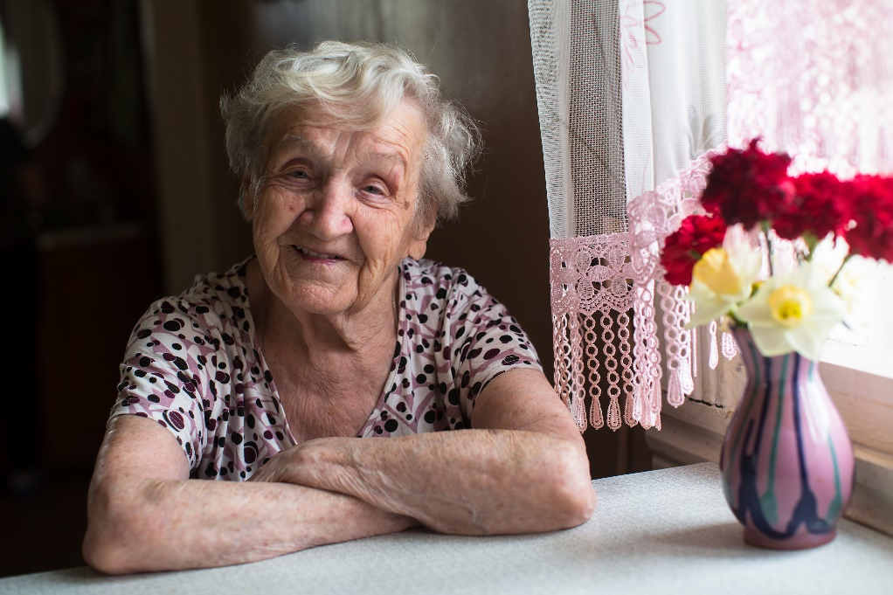
Example 4
Mrs. Olivia O’Sullivan saw her vibrant community with older houses built in the 1960’s get renovated as younger generations of families move into the community over time.
The bigger picture The population of the Republic of Ireland aged 65+ was estimated at 696,300 in 2019 and it is projected this will double to 1.56m by 2051
The story By 2030, one in five people resident in Ireland will be 65 years or older. Ireland’s ageing problem will apply more spending pressure on the already cash-strapped health service
Census information to explore Changing population over time. The ‘greying’ of the Irish Population. Implications for the future as regards Geriatrics services (care of elderly).
Notes:
https://www.shutterstock.com/image-photo/elderly-woman-portrait-near-window-house-1092780644
Name: Olivia O’Sullivan
Address: 8, Beechwood Park, Ballinlough, Cork.
Sex: Female
Date of Birth: 12/05/1937
Place of Birth: Dingle, Co. Kerry
Age: 83 years Nationality: Irish
Other Information: Olivia has been living on her own in Cork city for the past 16 years since her husband, Denis who was older than her died. She is actively involved in everything that happens in Ballinlough community. Ballinlough online Newsletter keeps her informed of local events e.g. Bingo and she uses her computer for her weekly masses and funerals broadcast online since Covid-19. Olivia is a Roman Catholic.
Young People: 0 Adults: 0 Older People: 1

Slide 23
What will your story be?
What stories have you discovered and shared?
What Geographical factors influenced your stories?
What events, changes or patterns affected the people in your story?
What are the most interesting or important parts of your story that you want to share with others?
Notes:
Plenary Activity
15 mins
Remind students that at the beginning of this activity, they considered how national events in Ireland or changes have local effects that shape people's individual stories.
Invite students to suggest what broad Geographical factors shaped the stories they researched and presented.
Using students’ stories as examples, identify some of the most important factors that have shaped your community, such as patterns of urbanisation, migration, or changes to the local economy and to individual patterns of employment. Highlight what primary and secondary sources of information helped to bring these stories to life and which provide a reliable guide to how these factors influenced people's lives.
https://www.shutterstock.com/image-photo/beautiful-cheerful-young-indian-asian-woman-1783363415
https://www.shutterstock.com/image-photo/portrait-businessman-looking-future-proud-his-719918842

Slide 24
Do not count the days, make the days count!
Your stories are a great way to celebrate our community and show everyone the importance of the census!
What could you include? Written or recorded stories, photos, copies or scans of original documents, mapping that helps to illustrate changes, photos of articles, newspapers and other artefacts, tables or charts of census information.
Physical displays Set up an area of your school where you can create a notice board, particularly where members of the wider school community can see it. Show how each of your individual stories come together to build a picture of your local area.
Virtual displays Create a collaborative presentation where students each contribute a few slides. Set up an online gallery via your school’s virtual learning environment e.g. Microsoft Teams, Google Classroom etc. Students’ projects can be featured on your school’s website, social media channels or linked to in the School newsletter.
Notes:
Independent work / extension – project work
Creating and sharing the students’ work is a great way to get the message out to your school community about the importance of taking part in the census.
Use this slide to set students an extended task to turn their stories into an exciting display to share with their parents/guardians, families and your wider school community.
Agree what form your display will take, how you can support students as they create their contribution, and a timescale for completion ready to share.
Ensure you adhere to your school’s GDPR and consent policies for using photographs etc. and that students obtain permission to use any content they include. Ensure that you are also mindful of safeguarding, and that students are not sharing any sensitive information.
Student Project work
Plan how you can bring your story to life. Use one of these ideas, or come up with your own.
• Write an article with the questions and answers from your interview.
• Make an audio/video recording of your subject speaking.
• Design a poster or comic strip illustrating their story.
• Create a presentation with text, photos and other sources. E.g. PowerPoint, Google Slides, Keynote, prezi, Haiki Deck
Student Advice:
Designs the layout of the census and checks spelling errors
Makes sure it is easy to read and understand
Wellbeing:
https://ncca.ie/media/4940/updated_guidelines_2021.pdf

Slide 25
What did you learn today? What did you find tricky? What can you do next time?
Don’t forget the hashtag describes the lesson or something memorable from the lesson
Notes:
Student reflection:
Twitter Student reflection Exercise @CensusIreland
What did you learn today?
What did you find tricky?
What can do next time?
https://www.shutterstock.com/image-photo/valencia-spain-march-05-2017-twitter-601425683
8 Reflective Questions To Help Any Student Think About Their Learning
1. What surprised you today, and why?
2. What’s the most important thing you learned today? Why do you think so?
3. What do you want to learn more about, and why?
4. When were you the most creative, and why do you think that is?
5. What made you curious today? How does learning feel different when you’re curious?
6. When were you at your best today, and why?
7. Assuming we were studying the same thing and you could decide and have access to anything, where would you start tomorrow? Why?
8. What can/should you do with what you know?

Slide 26
Time Capsule
After 100 years, this Time Capsule will be made available to the public. This space is for handwritten messages only. Photographs or other attachments will be removed and cannot be returned.
Notes:
Homework:
Ask students to complete the box with handwriting and they can bring this home to their parents/guardians for consideration for Census night on 3 April 2022.
Time Capsule:
Information you provide in this Time Capsule is optional and is collected voluntarily under Section 24 of the Statistics Act 1993. This content is protected by the same confidentiality protections as all your Census data for 100 years. After 100 years, this Time Capsule will be made available to the public. This space is for handwritten messages only. Photographs or other attachments will be removed and cannot be returned.
https://www.cso.ie/en/media/csoie/census/census2021/Sample_Census_2022_Household_Form_English.pdf (p.23)

