Slide 1
Apprenticeship Outcomes – Qualification Year 2020
Anais Colibaba
Education Liaison Group Meeting
11th July 2025

Slide 2
What Are Apprenticeships?
Apprenticeships
  provide education and training in a craft trade or profession.
  consist of on-the-job employer-based training and off-the-job training
Two types of apprenticeships:
    CRAFT (Traditional) → carpentry, plumbing, electrical, pipefitting, motor mechanics
    CONSORTIA-led (Recent) → accounting technician, laboratory analyst, manufacturing engineering
Notes:
Consortia-led are more recent apprenticeships introduced in 2016. They were created as a response to industry needs with the first qualified apprentices in 2019.

Slide 3
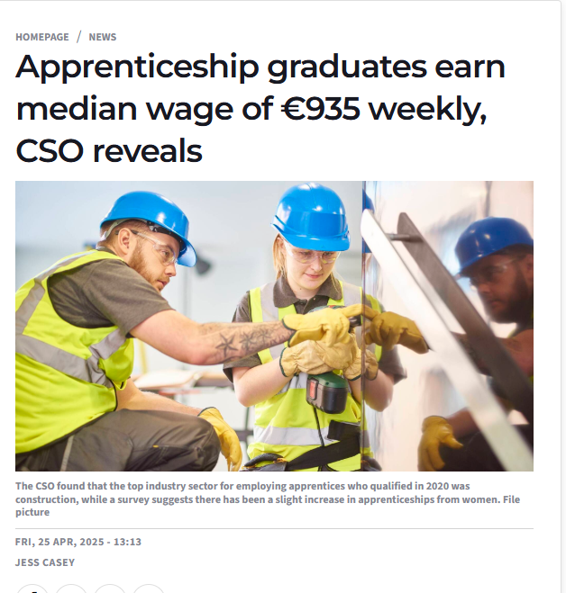
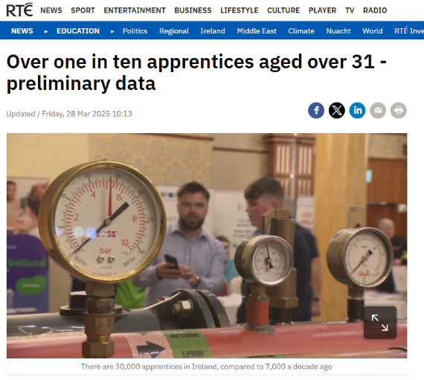
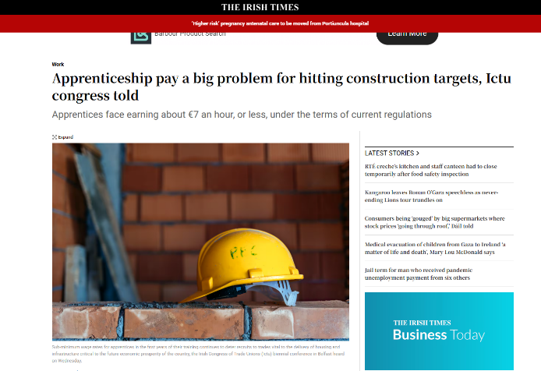
Apprenticeships – Hot Topic

Slide 4
SOLAS & National Apprentice Office
SOLAS offers craft apprenticeships which are delivered by a range of collaborating providers (ETBs, IoTs and TU).
Responsibilities include:
→ designation of statutory apprenticeships
→ approval of employers
→ registration of apprentices
In response to “Action Plan for Apprenticeship 2021 – 2025” SOLAS and HEA established National Apprenticeship Office (NAO).
SOLAS
HEA
SOLAS
NAO
HEA

Slide 5
Craft Apprenticeship Data Sources
  Quality & Qualifications Ireland (QQI) graduates dataset & Apprentices Registration dataset
QQI
Filter for ‘Craft’ in award titles.
SOLAS
Add new variables on:
apprentice employer &
apprentice county
craft qualified apprentice dataset

Slide 6
Consortia-led Apprenticeship Data Sources
How do we identify the consortia-led apprentices?
SOLAS Apprentices Registration dataset
status_description = “Completed programme successfully”
Filtered SOLAS dataset
(consortia-led)
“enriched” QQI qualified apprentice dataset
(craft)
full qualified apprentices dataset

Slide 7
Apprenticeship types - a rethink
Apprenticeships by ISCED
(broad, narrow and detailed)
‘Plumbing’ →
Detailed ISCED 0732
(Building & Civil Engineering)
Narrow ISCED 073
(Architecture & Construction)
Broad ISCED 07
(Engineering, Manufacturing & Construction)
- Dept. of Education & SOLAS assisted with the ISCED recoding
Craft
Printing & Paper Industry
Motor
Engineering
Electrical
Construction
Consortia-led
Biopharma
Construction
Electrical
Finance …

Slide 8
Apprenticeship Outcomes Data Sources
Apprenticeships
Re-enrolled in Education
Employment / Welfare
Higher Education enrolments (HEA)
Self-Employment (Revenue)
Social Transfers (Dept. Social Protection)
Qualified apprentices - QQI, SOLAS
Further Education enrolments (QQI, HEA)
Employment (Revenue)

Slide 9
Timeline of Data Availability
Qualified cohorts from 2010 to 2020
Outcomes available from 2012 to 2022
2010 | 2011 | 2012 | 2013 | 2014 | 2015 | 2016 | 2017 | 2018 | 2019 | 2020 | 2021 | 2022
Qualified apprentices
 | In Education (QQI, SOLAS)
 | Employment (Revenue)
 | Self-Employment (Revenue)
 | DSP

Slide 10
Outcomes of Qualified Apprentices

Slide 11
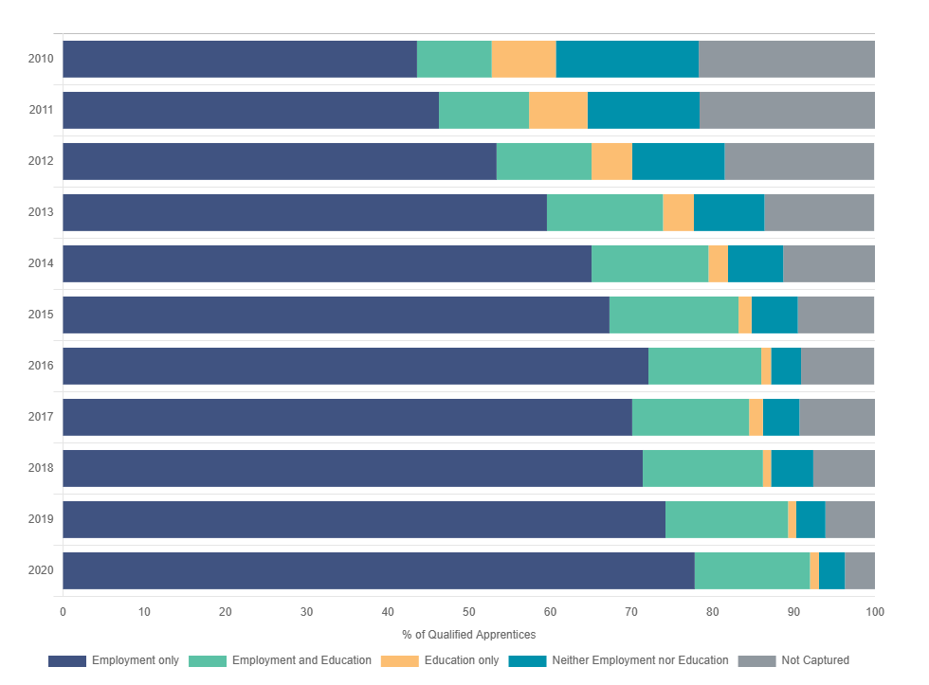
Where do qualified apprentices end up?
Between 2010 and 2020 ~ 40% increase in the number of qualified apprentices going into employment within two years of completion
The numbers for Neither Employment nor Education or Not Captured dropped from ~ 40% to 7%
Notes:
More apprentices remain in the system → have not emigrated, are in the country

Slide 12
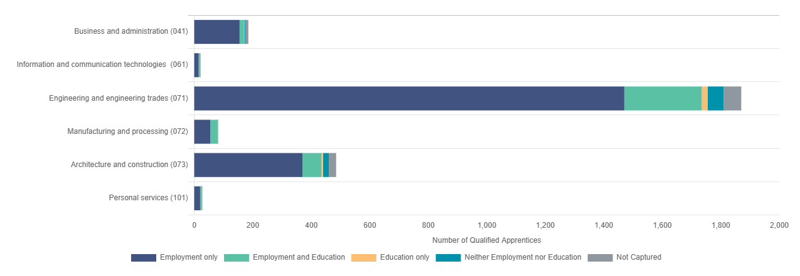
Outcomes by narrow ISCED code
Notes:
The data can also be divided into ISCED codes, so we can look at outcomes by narrow ISCED codes. Around 93% engineering apprentices are in employment within two years after completion.

Slide 13
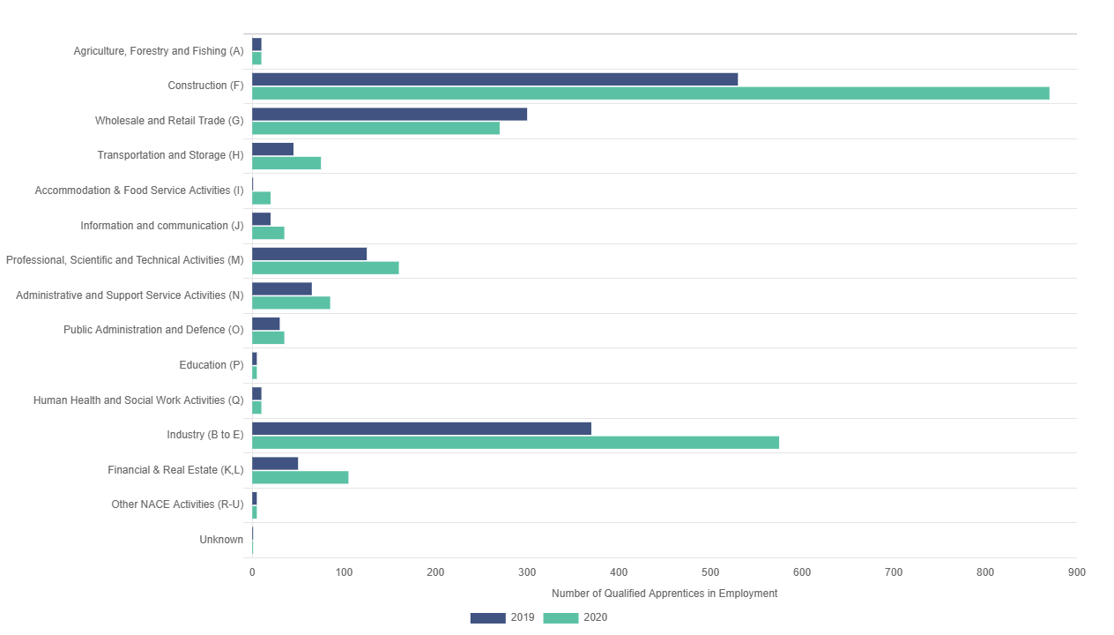
Number of Qualified Apprentices by NACE
Notes:
There was a huge increase in qualified apprentices in construction and industry sector.

Slide 14
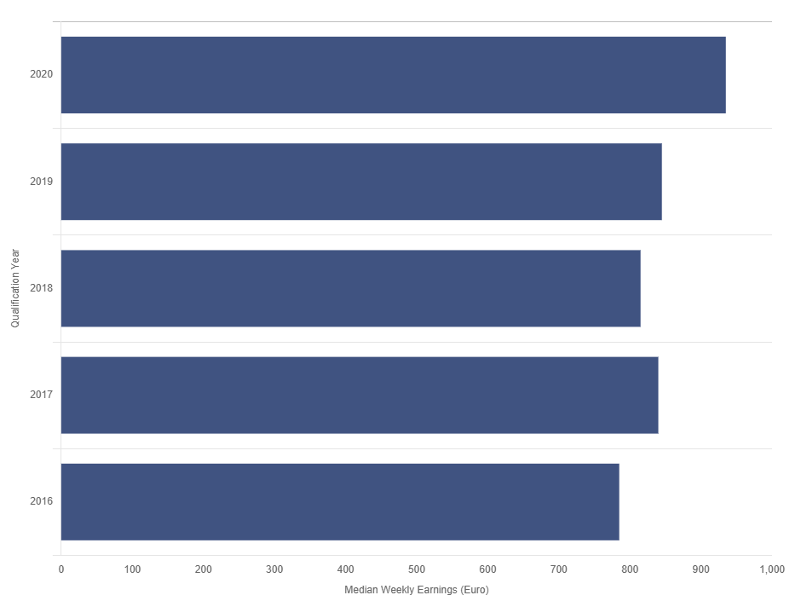
Earnings
Slight decrease for those who qualified in 2018 over those who qualified in 2017, from €845 to €815.
In 2020 the median weekly earnings after two years was €935, €90 more than in 2019.

Slide 15
Thank you!
Questions?
anais.colibaba@cso.ie

