Slide 1
Enterprise Statistics Liaison Group 2019
Recent Developments & Planned New Activities

Slide 2
Business Statistics
Developments in the past year
New EU Developments planned
Update on the Framework Regulation on Business Statistics

Slide 3
New Developments in Business Surveys in 2019
Gender Balance in Business Survey
Structure of Earnings Survey
Timeliness and Campaign Management

Slide 4
Gender Balance in Business 2019
The Gender Balance in Business Survey 2019 provides the first official statistics from the CSO on gender representation in Senior Executive teams and Boards of Directors of large enterprises in Ireland.
The survey was conducted in response to the Balance for Better Business initiative and it aims to provide benchmark information on gender representation.
The survey was collected by the CSO between February and April 2019. The online questionnaire asked for the gender breakdown of the Senior Executive team and Boards of Directors.
The scope of the survey is large enterprises (i.e. those with over 250 employees). 600 enterprises - response was 55%.

Slide 5
Gender Balance in Business 2019 Only one in nine CEOs in Ireland were women
Gender breakdown by senior roles in business, 2019
 | Male | Female
 | % | %
Chairpersons | 92.6 | 7.4
Boards of Directors | 80.4 | 19.6
Chief Executive Officers (CEOs) | 88.5 | 11.5
Senior Executives | 71.7 | 28.3

Slide 7
Structure of Earnings Survey 2018
EU Requirement
Post out November 2019
Last conducted in 2007 as the National Employment Survey
The Structure of earnings survey, abbreviated as SES, is conducted every four years in the Member States of the European Union (EU) and provides comparable information at EU level on relationships between the level of earnings, individual characteristics of employees (sex, age, occupation, length of service, educational level) and their employer (economic activity, size of the enterprise, etc).

Slide 8
Structure of Earnings Survey 2018
After 2009 SES statistics on earnings were based on administrative data sources.
The primary data source was the Revenue Commissioner’s P35 dataset of employee annual earnings which was linked to CSO and other data to provide demographic breakdowns of earnings similar to those previously provided by the National Employment Survey (NES).
However, this data did not replicate all of the tables available from the former NES; nor did it contain any breakdown of hours worked or hourly earnings

Slide 9
Proportion of low wage earners in the EU, by sex, age groups, level of education and type of contract, 2014

Slide 10
Business Based Social Surveys
Structure of Earnings Survey to be repeated annually.
2020 Job Vacancy Survey Quarterly & follow-up Annual Occupational Breakdown Survey
Continuing Vocational Training Survey 2020 – collected in 2021

Slide 11
Continuing Vocational Training Survey CVTS 2020 (2021)
The Continuing Vocational Training Survey (CVTS) is an enterprise survey which is part of the EU statistics on lifelong learning. The survey covers the following topics:
Continuing vocational training, skills supply and demand, training needs
Measurement of the form, content and volume of continuing training
The enterprises own training resources and the use of external training providers
The costs of continuing training
Initial vocational training

Slide 12
Continuing Vocational Training Survey CVTS 2020 (2021)
+ OECD Employer Module on Skills Gaps - piggy back onto the CVTS
Key Results in 2015
77% of all enterprises provided training
50% of staff attended training courses
19.4 hours per employee spent on training courses
Training course costs equal 2.2% of total labour costs
One half of enterprises assess the outcomes of their training activities

Slide 13
Community Innovation Survey
The Community Innovation Survey (CIS) is a survey of innovation activities of enterprises in Ireland and other EU Member States.
The survey collects information about product and process innovation, as well as organisational and marketing innovations and other key variables during the three year period 2016 to 2018 inclusive.
Most questions cover new or significantly improved goods or services or the implementation of new or significantly improved processes, logistics or distribution methods.

Slide 14
Community Innovation Survey 2016 – Key Results
Total spending on innovation activities in Ireland during 2016 increased by almost 22% to €4.6 billion
Industrial enterprises spending on machinery, equipment and software accounted for a quarter of total innovation expenditure
Foreign enterprises accounted for 64% of total innovation expenditure
66% of large enterprises had innovation expenditure in 2014-2016 compared with 36% of SMEs
Over 43% of foreign owned enterprises had innovation expenditure
57% of all enterprises were innovation active during 2014-2016
Nearly 31% of enterprises were engaged in process innovations, with 29% engaged in product innovations
Almost two thirds of large enterprises introduced an organisational innovation

Slide 15
Community Innovation Survey 2018
In the field since 3rd week of August
Piloting a new electronic questionnaire EQ
Response rate after 14 weeks 51% - 1 further reminder to issue (54%)
2018 - 29 weeks data collection - response rate 65%
Campaign Management - cut data collection to 19 weeks - response target 60%
Deadline Eurostat June 2020
Publication April 2020

Slide 16
Campaign Management
Improve the management of surveys in the field
Improve response - quality - timeliness
Reduce time-lag in the field - annual surveys
CIS - 2 months less in the field
ICT Survey - improved response and reduced timeframe for publication by 2 months - October 2019 (December 2018)
Annual Services Inquiry - collection period 2 months shorter

Slide 17
Business Expenditure in Research & Development 2020
The Business Expenditure on Research and Development (BERD) Survey is a survey of the research and development activities of enterprises in Ireland and other EU Member States.
The BERD Survey is a targeted survey which is issued to all enterprises which are believed to be actively engaged in research and development
Most questions gather information on the spending and performance of research and development.
Research and Development (R&D) is creative work undertaken on a systematic basis in order to create new or improved products, processes, services or other applications. R&D is distinguishable from other activities by the presence of an appreciable element of novelty and by the resolution of problems and uncertainties using scientific or technological means.
Routine activities, such as routine software development, routine monitoring/analysis or pre-production preparation, where there is no appreciable novelty or problem resolution, are not considered to be R&D for the purpose of this survey.

Slide 18
R&D spend by enterprises increased by 24% from 2015 to 2017
Large enterprises’ share of R&D expenditure at 63% in 2017
Labour Costs accounted for 60% of all R&D expenditure

Slide 19
69% of total R&D expenditure was by Foreign owned enterprises
The largest 100 enterprises in terms of R&D spend accounted for almost 75% of the total R&D expenditure
Services sector accounted for 55% of total R&D expenditure
82% of funding for R&D expenditure came from enterprises' own funds
Nearly 1,800 enterprises engaged in R&D activities in Ireland in 2017
Ireland ranked 13th in EU28 in terms of R&D intensity in 2015

Slide 20
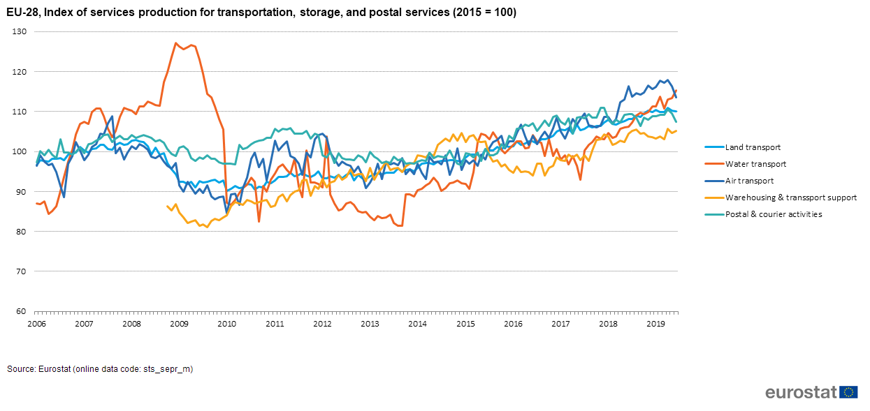
Development of Services Statistics
Monthly Services Inquiry - monthly services value index (MSI) monitors trends in output at current prices of enterprises in the non-financial traded services sector.
This is the first step in the development of a Services Production Index that measures gross value added changes at constant prices, i.e. a volume index.
Volume Index - deflate turnover to measure the monthly changes of the price adjusted output of the services.

Slide 21
Framework Regulation Integration of Business Statistics - FRIBS
Basic Act (Framework Regulation) - adopted this month
General Implementing Act - under discussion & to be finalised middle of next year
Implementation – Jan/Qtr 1 2021 (2022 Trade)
Actively planning for implementation

Slide 22
Key Changes for Business Statistics
Volume Index in Services
Global Value Chains 2021 (pilot) 2024
Extension to coverage ASI - Health, Education & Culture
Rebase Reference 2020 to 2021 and return to 0/5 intervals
Shorter EU transmission deadlines
Minor changes in variables – new/breakdowns/renaming – minor in nature
Services Producer Price Index – further development
Commercial Real Estate Indictors pilots

