Slide 1
Business Statistics Micro Data Linking Projects
ESLG
20 November 2019

Slide 2
Purpose of Micro Data Linking
Create new outputs from existing data sources
  Thematic reports
  More responsive to user needs
  Reduce burden on respondents
Develop comprehensive Business Data Resource

Slide 3
Questions on Trade and Business Statistics
How much turnover was from exports?
What is the number of businesses exporting to the UK?
How many people are employed by these businesses?
What is the value of trade?

Slide 4
Business Register
International Trade in Goods Statistics
Merged Dataset
New Outputs for Users
Structural Business Statistics
Notes:
To give an overview of the initial design of the project….
(Talk through LHS and the various data sources)
2016 was the only year we looked at to this point
Original plan was to publish in March but this has been pushed back since the process has been extended
The reason being that when developing the linkage process it became clear that there were a number of further information gaps that we felt we should try to fill before publication

Slide 5
Business Register
Merchanting
Goods for processing
Trade of Goods Data
Merged Dataset
Exporting Enterprises in Ireland 2017
Cross Border Trade
Trade of Services Data
Structural Business Statistics
Notes:
Initially, the linkage work focused on incorporating International Trade in Goods Statistics (ITGS) data with the Business Register and SBS surveys.
Preliminary results did not give a complete picture of the importance of exports to enterprises in Ireland
Included data from Balance of Payments (BOP) and Admin data
Goods for Processing
Merchanting
Exports of Services

Slide 6
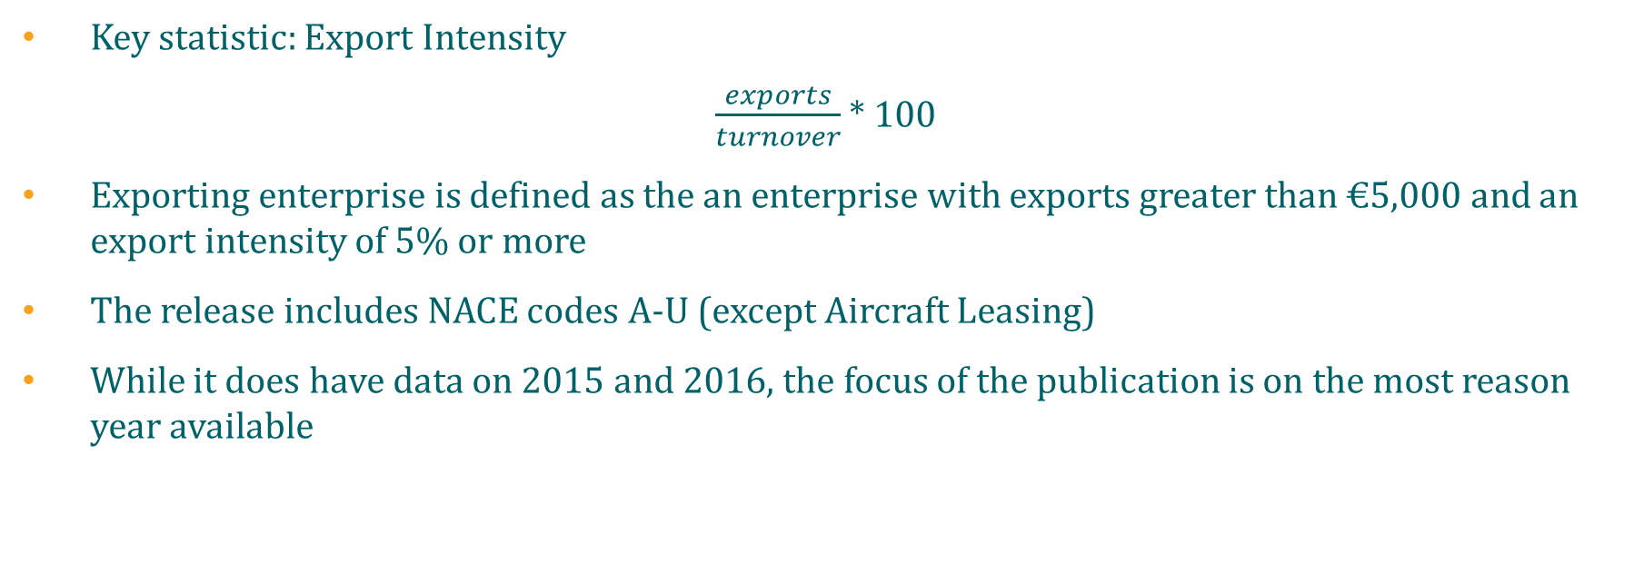
Exporting Enterprises in Ireland 2017
Key statistic: Export Intensity
$\frac{exports}{turnover}$ * 100
Exporting enterprise is defined as the an enterprise with exports greater than €5,000 and an export intensity of 5% or more
The release includes NACE codes A-U (except Aircraft Leasing)
While it does have data on 2015 and 2016, the focus of the publication is on the most reason year available

Slide 8
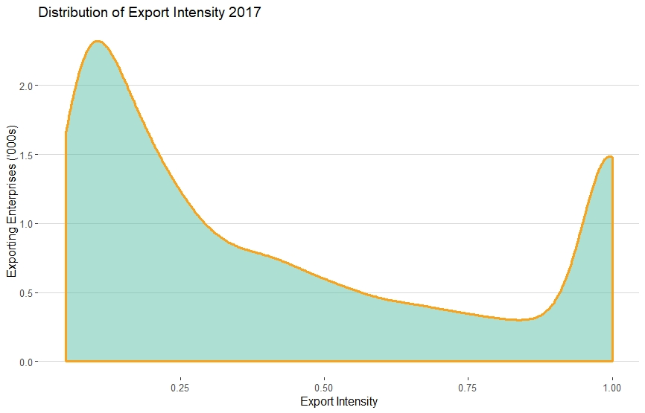
Twin Peak Distribution
Data reveals a Twin Peak distribution of export intensity for exporting enterprises
Half of the exporting enterprises (5301) had an export intensity between 5% and 30%
One in four exporting enterprises (2477) are very reliant on exports 75%+

Slide 9
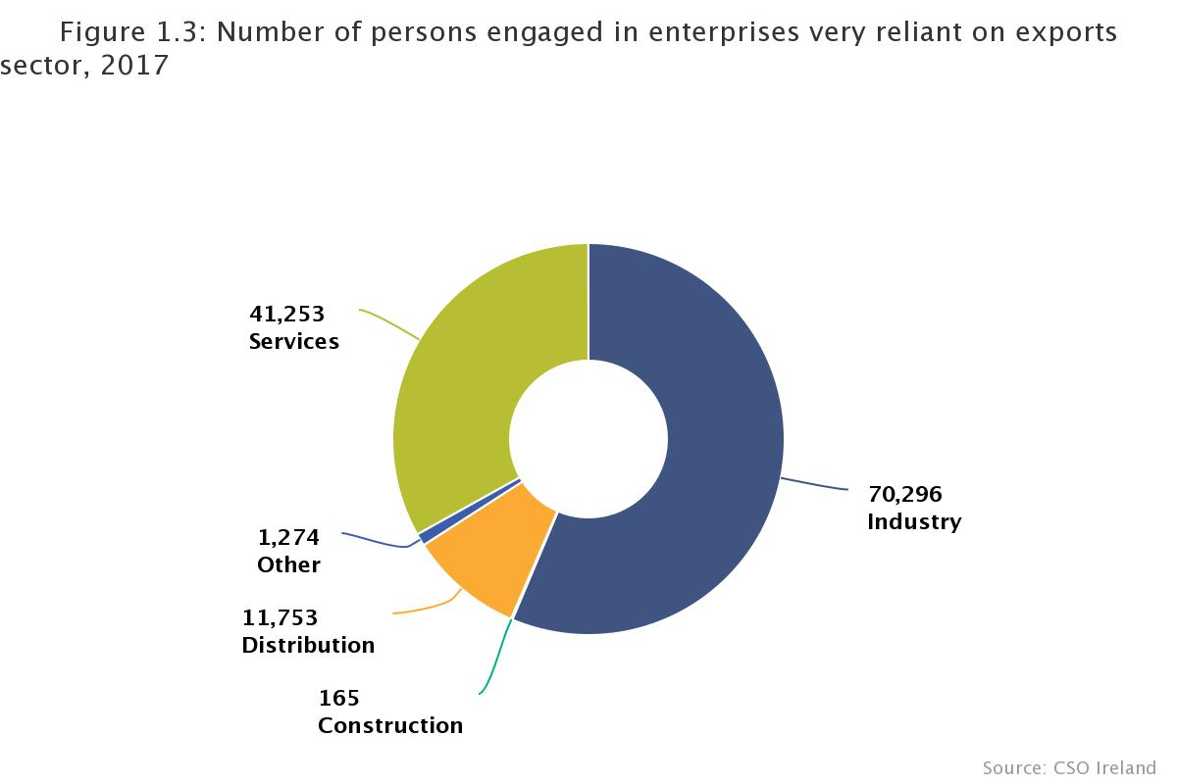
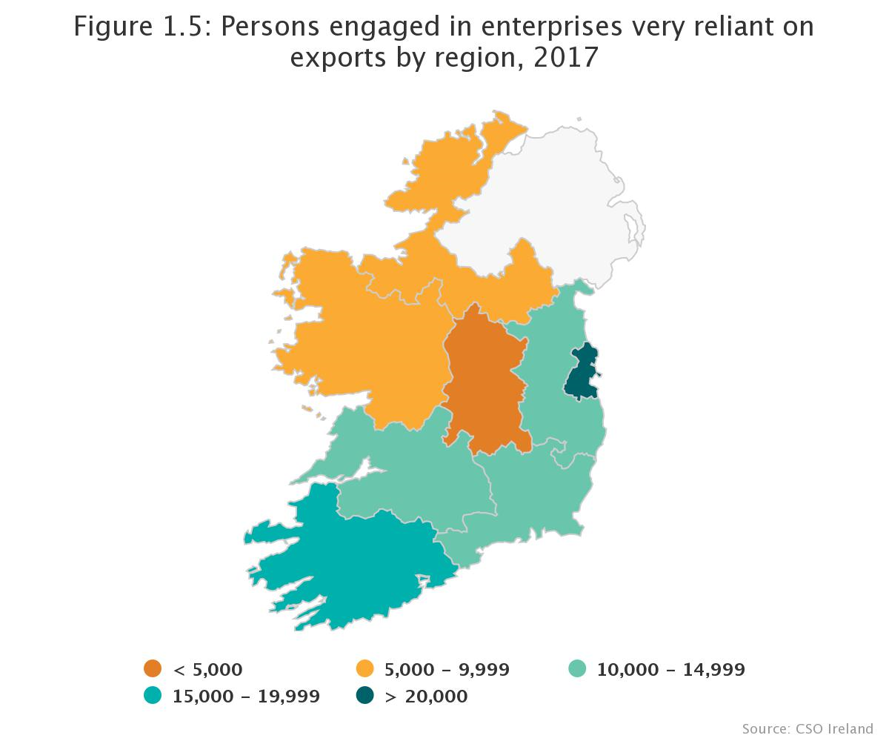
Enterprises very reliant on exports

Slide 10
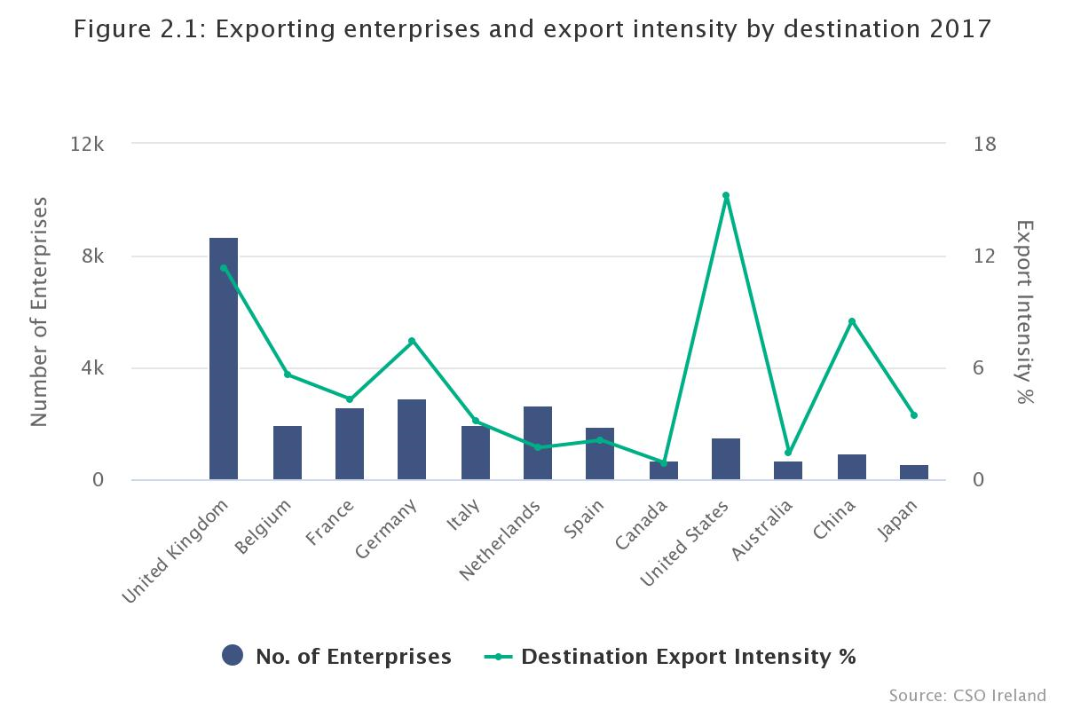
Destination
Highest number of exporting enterprises to a single destination was to the UK with 8,685. Followed by:
  Germany – 2,920
  Netherlands – 2.697
  France – 2,629
United States, United Kingdom and China had the largest destination export intensity with 15.2%, 11.3%, and 8.5% respectively

Slide 11
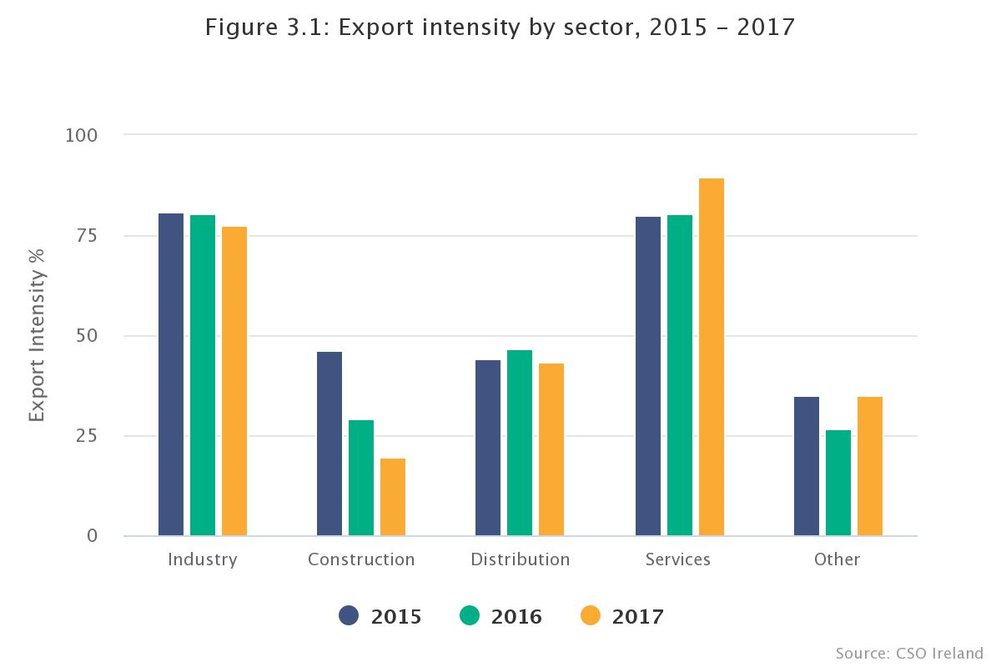
Sector
Services sector had both the highest number of exporting enterprises (5,378) and highest export intensity 89.5%.
Both Services and Industry tend to have the most enterprises reliant on exports where construction and distribution tended to be less reliant
Export intensity in Modern sector was higher (87.1%) than in the Traditional sector (61.7%)

Slide 12
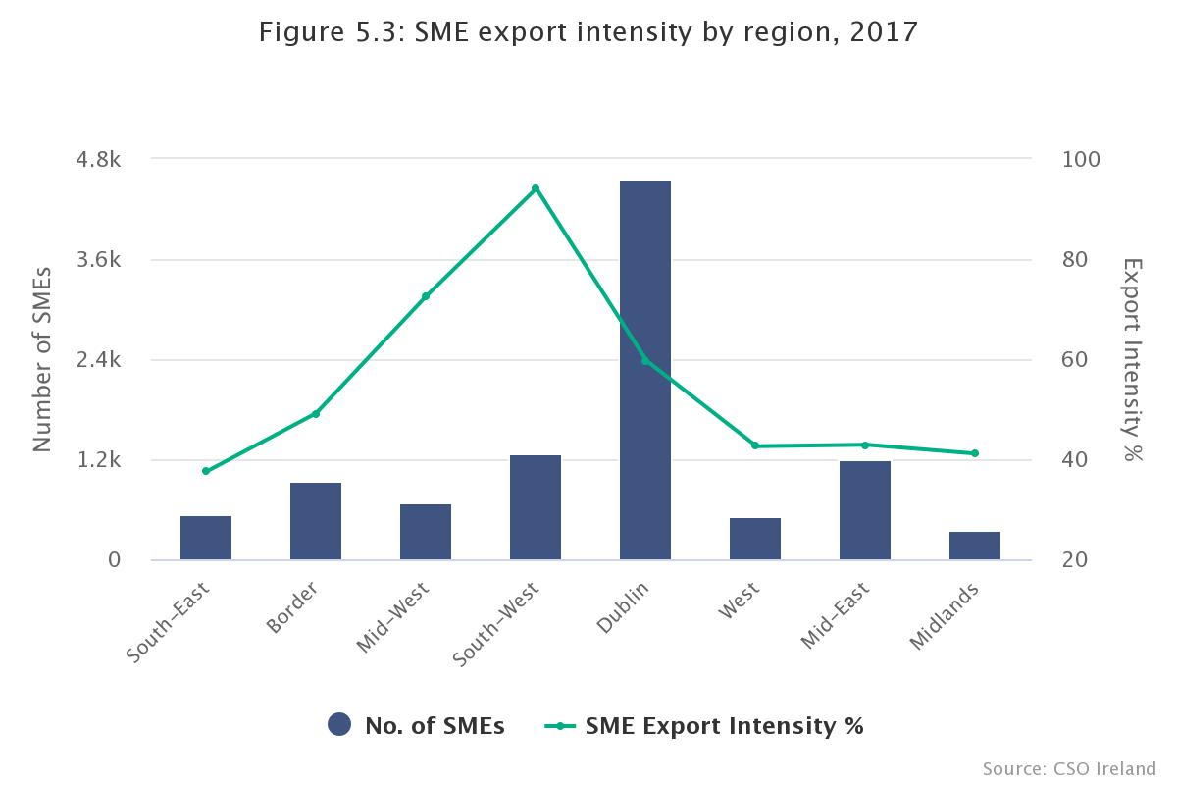
Region
Exporting enterprises in the Mid-West had an overall export intensity with 85.6% and 72.6%
Exporters in the Border and Mid-East region had lowest with 59.9% and 63.6% respectively
Exporting SMEs in the South-West had the highest export intensity with 94.1% (see graph)

Slide 13
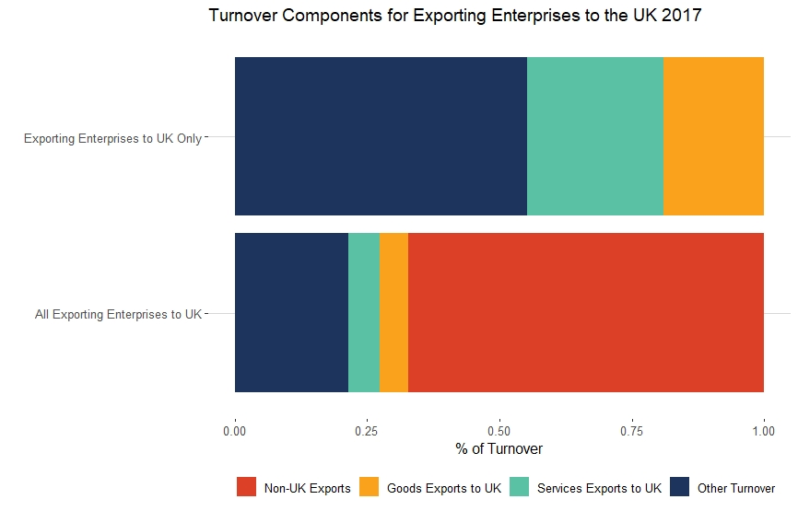
Exporting Enterprises to the UK
There were 8,685 enterprises exporting to the UK in 2017
  325,478 persons engaged in those enterprises
  UK Export Intensity was 11.3%
There were 4,096 enterprises exporting exclusively to the UK
  49,550 persons engaged in those enterprises
  UK Export Intensity was 44.8%

Slide 14
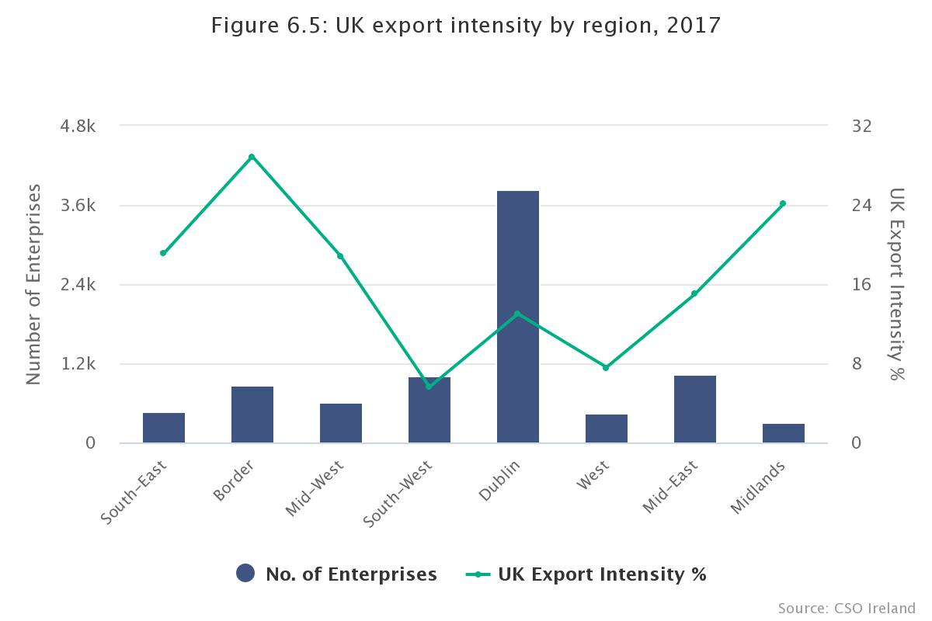
Exports to the UK
UK Export Intensity was highest for enterprises in the Border region – 28.9%
South-West has lowest UK export intensity – 5.6%
UK Export Intensity was higher for SMEs (15.3%) than Large enterprises (9.6%)
Enterprises less than 5 years old had a higher UK export intensity (15.9%) than established firms (10.7%)

Slide 15
MDL Going Forward…
Exporting Enterprises
  Annual Release – may expand to incorporate more statistics on supply chain
High Growth Enterprises
  Q1 release on High Growth enterprises
SMEs
  More detailed regional information
Productivity
  Expanding on our productivity outputs
Gender breakdown
  Persons engaged by gender
Notes:
.

