Slide 1
Environmental Subsidies and Similar Transfers
Clare O’Hara
Environment Statistics and Accounts
24th October 2017

Slide 2
Outline
Methodology
Data
Results
PEDS

Slide 3
Methodology

Slide 4
Environmental Accounts
As part of the implementation of the UN System of Environmental-Economic Accounting (SEEA), Eurostat has developed a series of environmental accounts modules, including the Environmental Subsidies and Similar Transfers module
These accounts can be monetary or physical and are compiled according to national accounts principles
Notes:
Examples:
Greenhouse gas emissions and GDP: emissions due to economic activity of resident units
Use with indicators: Subsidies to biodiversity and number of endangered species
Policy evaluation

Slide 5
Environmental Subsidies: definition
The UN SEEA Central Framework defines an environmental subsidy or similar transfer as a current or capital transfer that is intended to support activities which protect the environment or reduce the use and extraction of natural resources.
Notes:
Environmental protection activities aim to prevent or reduce pollution and other negative impacts on the environment.
Resource management activities aim to preserve natural resources from overconsumption.

Slide 6
Environmental Subsidies Module: scope
Is it a subsidy or similar transfer?
Current or capital transfers are defined by ESA 2010 classification of economic transactions
Is the primary purpose environmental?
Environmental protection/resources management activities are defined by CEPA/CReMA classifications

Slide 7
Environmental Subsidies Module: scope
ESA (European System of Accounts) 2010
ESA 2010 Code | Description
D.39 | Other subsidies on production
D.63 | Social transfers in kind
D.73 | Current transfers within general government
D.74 | Current international cooperation
D.92 | Investment grants
D.99 | Other capital transfers

Slide 8
CEPA
CEPA: Classification of Environmental Protection Activities
01. Protection of ambient air and climate
02. Wastewater management
03. Waste management
04. Protection and remediation of soil, groundwater and surface water
05. Noise and vibration abatement
06. Protection of biodiversity and landscape
07. Protection against radiation
08. Research and development
09. Other environmental protection activities

Slide 9
CReMA
CReMA: Classification of Resource Management Activities
10. Management of water
11. Management of forest resources
12. Management of wild flora and fauna
13. Management of energy resources
13A. Production of energy from renewable sources
13B. Heat/energy saving and management
13C. Minimisation of the intake of fossil resources for raw materials for uses other than energy production
14. Management of minerals
15. Research and development activities for natural resources management
16. Other natural resource management activities

Slide 10
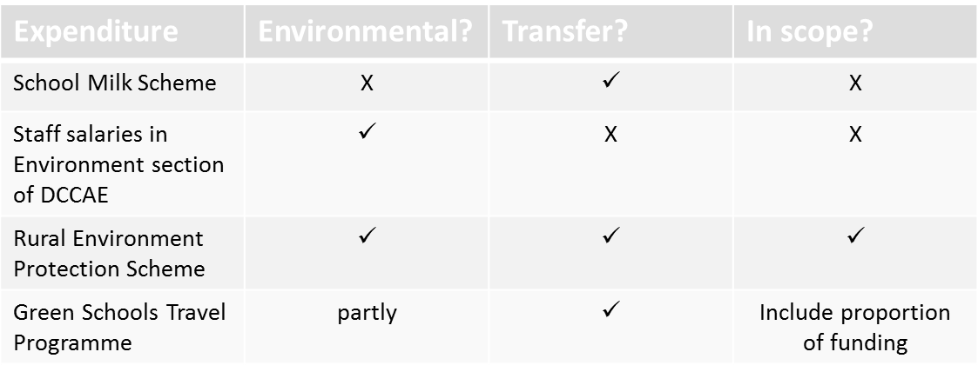
Environmental Subsidies Module: scope

Slide 11
Classification of Schemes by CEPA/CReMA: examples
Programme | CEPA/CReMA
Water Services Investment Programme (Wastewater) | CEPA 2: Wastewater management
Street Cleaning (Local Authorities) | CEPA 3: Waste management
Organic Farming Scheme | CEPA 4: Protection and remediation of soil and groundwater
Corncrake Grant Scheme | CEPA 6: Protection of biodiversity and landscape
Lobster V-notching Scheme | CReMA 12: Management of wild flora and fauna
Electric Vehicle Programme | CReMA 13A: Production of energy from renewable sources CEPA 1: Protection of ambient air and climate
Ocean Energy Scheme | CReMA 13A: Production of energy from renewable sources
Accelerated Allowances for Energy Efficient Equipment | CReMA 13B: Heat/energy saving and management

Slide 12
Classification of beneficiaries of environmental subsidies
Beneficiaries were classified according to their institutional sector and NACE section
Sector | Description
S.11 | Non-financial corporations
S.12 | Financial corporations
S.13 | General government
S.14 | Households
S.15 | Non-profit institutions serving households
S.2 | Rest of the world
NACE | Description
A | Agriculture, forestry and fishing
C | Manufacturing
D | Electricity, gas, steam and air conditioning supply
F | Construction
M | Professional, scientific and technical activities
O | Public administration
P | Education
S | Other services
U | Extra-territorial

Slide 13
Summary
Identify potential subsidies/grants/environmental expenditure
Shortlist those that meet ESA 2010 definition of subsidy/grant/transfer and that have environmental objectives as defined by CEPA/CReMA
Assign each transfer to CEPA/CReMA class and ESA 2010
Obtain amounts paid under each programme from 2000-2015 by government and by EU
Obtain data on beneficiaries of programmes
Classify each individual beneficiary by institutional sector and NACE section

Slide 14
Fully classified scheme data: example
Approximately 150 schemes identified and classified

Slide 15
DATA

Slide 16
Data Sources
Department of Agriculture, Food and the Marine (DAFM)
Department of Housing, Planning, Community and Local Government
Sustainable Energy Authority of Ireland (SEAI)
Environmental Protection Agency (EPA)
Bord Iascaigh Mhara (BIM)
CSO National Accounts (government finance statistics)
Local Authority Annual Financial Statements
Revenue Commissioners

Slide 17
Data Sources
Starting point: government expenditure data from CSO government finance statistics – identify potential programmes/expenditure – probably won’t get sufficient detail here
Use annual reports/annual accounts/ value for money reports of government departments and agencies to obtain more precise information and figures on grant/subsidy programmes and payments
Make direct requests for data to departments/agencies and hope for a response!
Parliamentary questions database, newspaper articles, etc.
Direct requests to departments/agencies often necessary to get data on grant beneficiaries, EU/Vote split, etc.

Slide 18
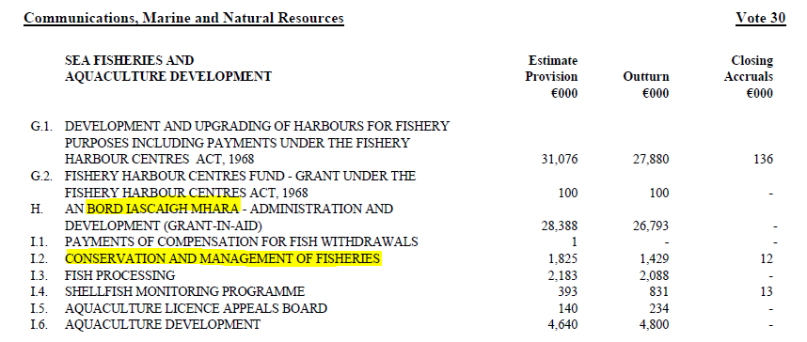
Government Accounts

Slide 19
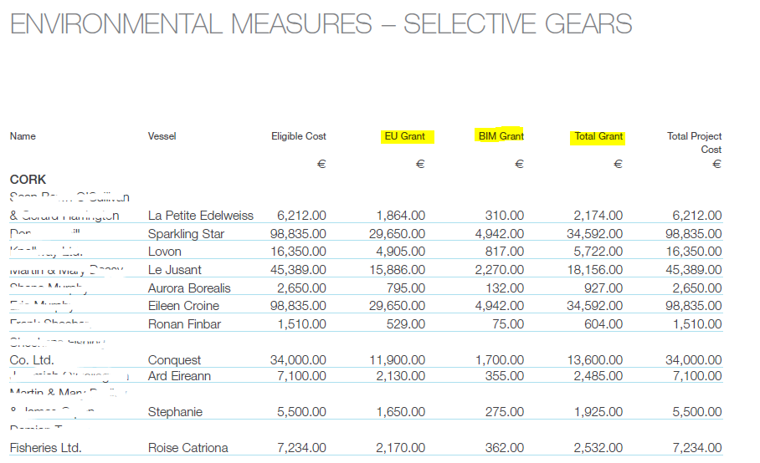

Annual Reports

Slide 20
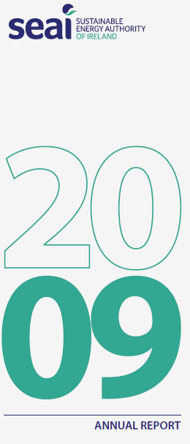
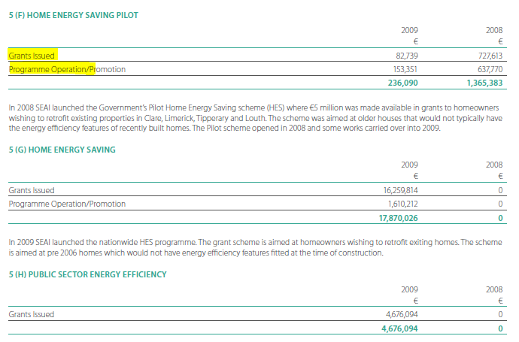
Annual Reports

Slide 21
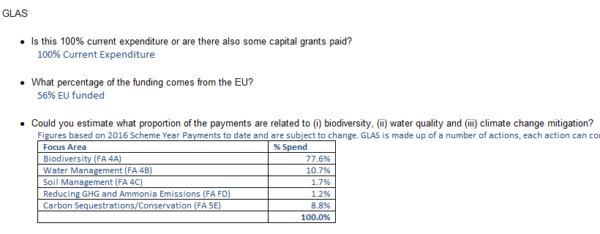
Direct requests

Slide 22
results

Slide 23
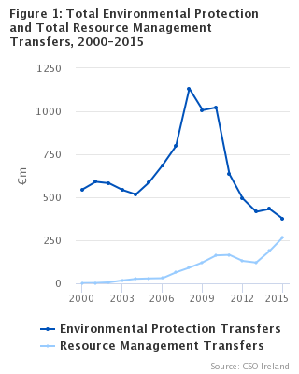
Environmental Protection and Resource Management Transfers
In 2015, €642 million was paid in environmental subsidies and similar transfers to Irish corporations, households and public bodies, as well as to international environmental organisations under Irish government commitments
This was 4% higher than the amount paid in 2014 but 47% lower than the €1.2 billion provided in 2008
Environmental protection activities were subsidised to a value of €375 million, or 58% of the total, while €268 million, or 42%, was used to support resource management activities

Slide 24
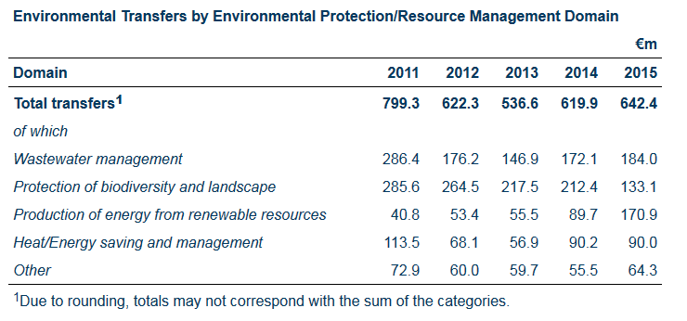
Analysis by Domain
In 2015, 29% of environmental transfers went to wastewater management, almost 27% to renewable energy production, 21% to biodiversity protection and 14% to heat and energy saving measures. Other activities, such as climate change mitigation and waste management, accounted for the remaining 10%.

Slide 25
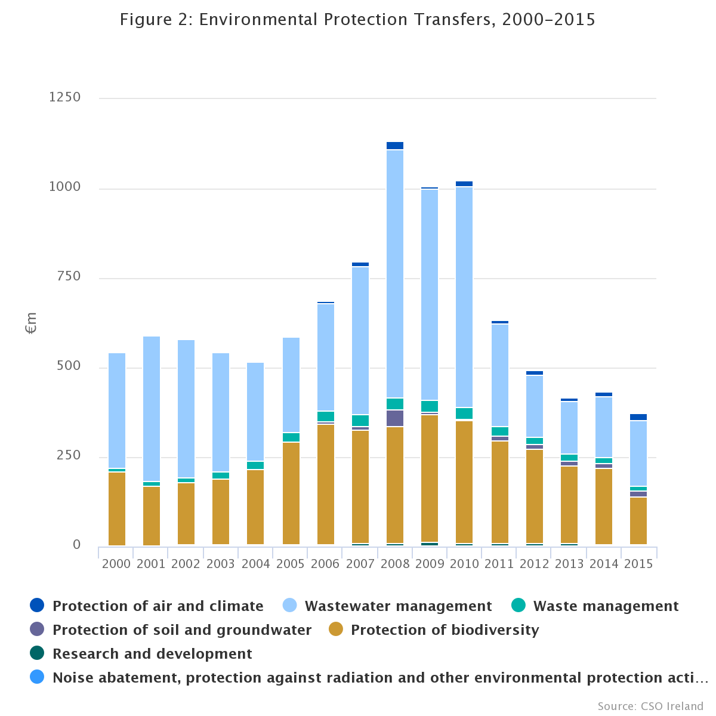
Environmental Protection Transfers
Mainly biodiversity and wastewater management
The peak in the graph from 2008-2010 is due to payments under the Farm Waste Management Scheme

Slide 26
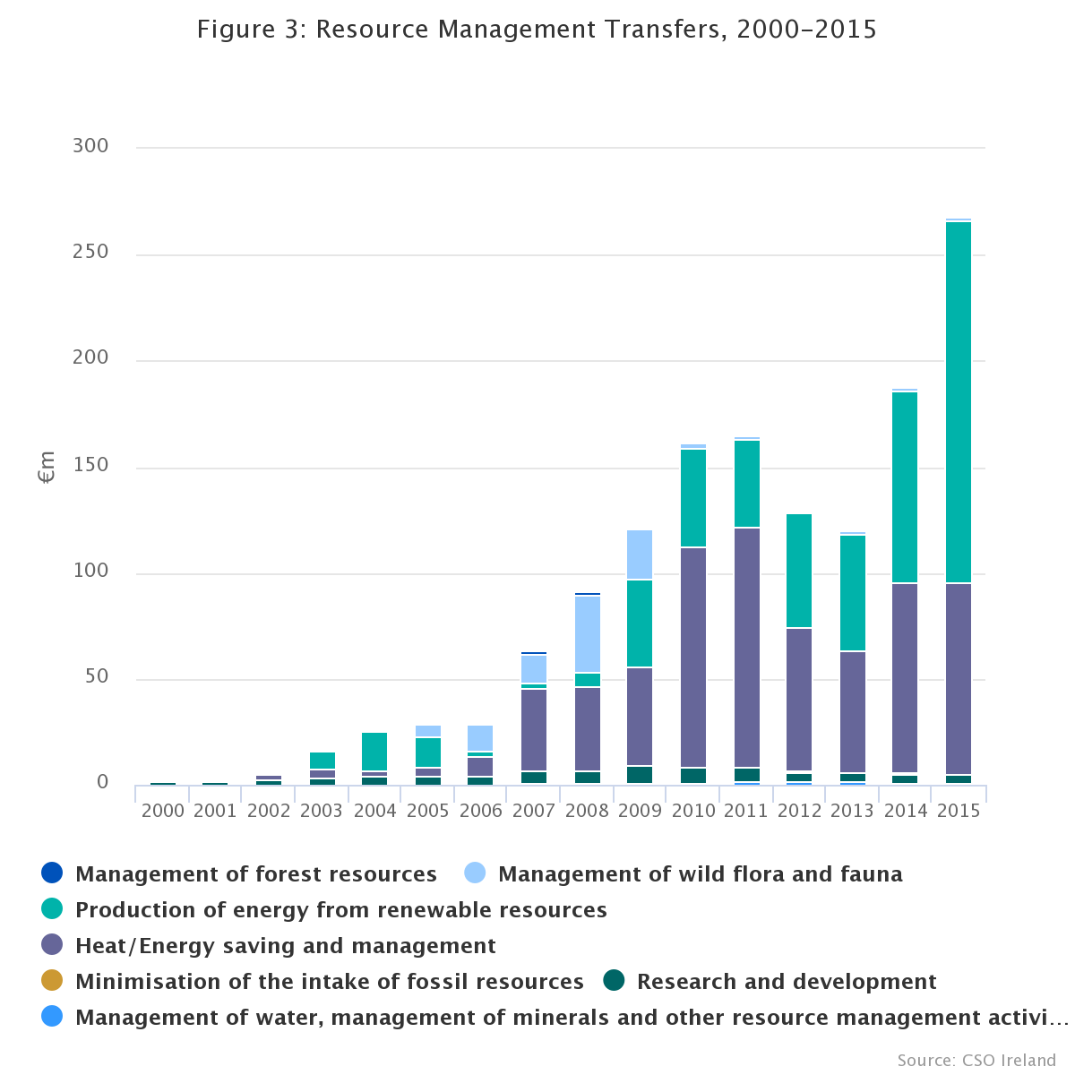
Resource Management Transfers
The impact of the increased PSO Levy subsidy to electricity generation from renewable sources in 2015 can be seen
Along with renewable energy subsidies, energy efficiency grant programmes such as those run by the SEAI account for a large proportion of transfers to resource management activities
Between 2006 and 2009 a fishing vessel decommissioning scheme was implemented by BIM and the compensation payments can be observed in the graph as an increase in transfers for the management of wild flora and fauna during those years

Slide 27
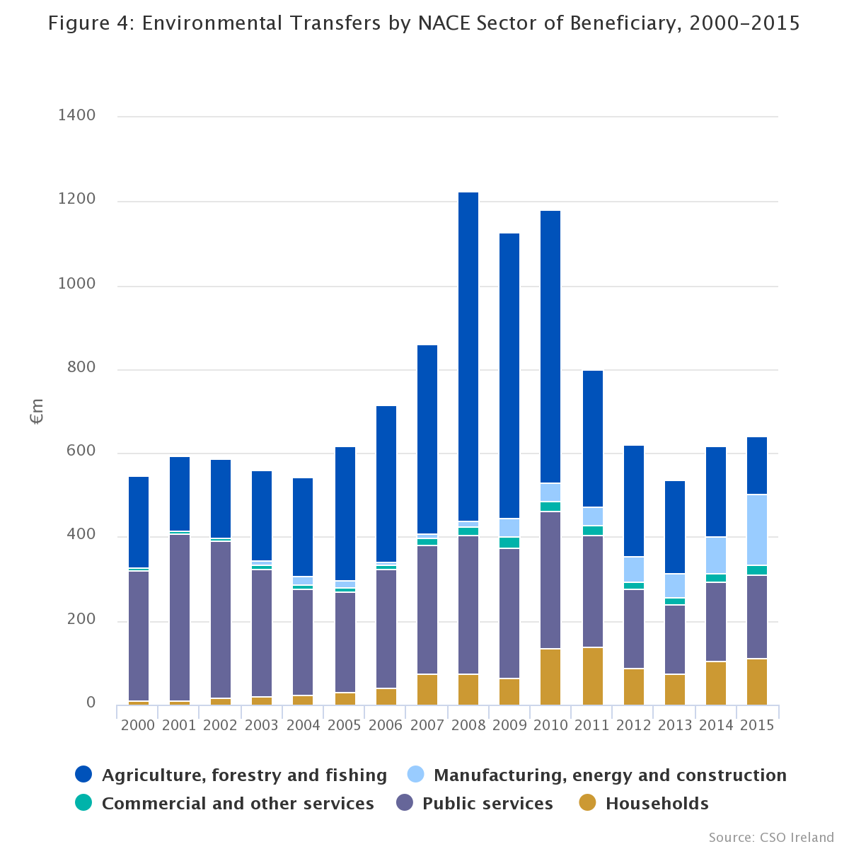
Analysis by NACE
Distribution to different sectors of the economy
In the period 2000-2015 the agriculture, forestry and fishing sector and the public services sector were the two main beneficiaries.
This is due to agri-environment schemes aimed at encouraging biodiversity-friendly farming, and funding to local authorities to develop and operate wastewater treatment facilities

Slide 28
PEDS

Slide 29
PEDS: definition
Potentially Environmentally Damaging Subsidies:
Certain subsidies or other support measures that have social or economic objectives may incentivise behaviour that could be damaging to the environment. For example, transport fuel tax rebates encourage the consumption of fossil fuels
Currently no agreed definition of PEDS but a possible approach is to identify transfers to activities or industries that are considered to have a particularly detrimental effect on the environment, e.g. the transport industry

Slide 30
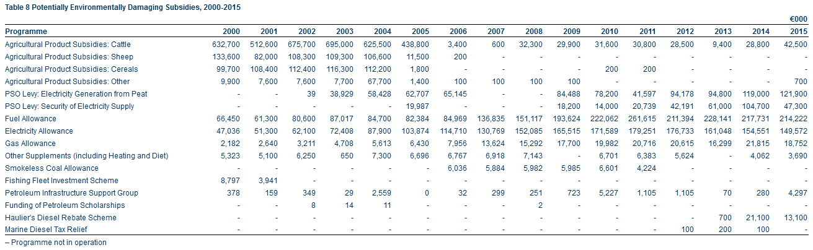
PEDS: preliminary data collection

Slide 31
Thank you

