Slide 1
Live Register Flows Analysis
Outline
- Motivation
- Methodology
- Some Analysis
- High Level Data Flows
- Graphs – Using R Software
ADC Seminar
20th February 2014
Catalina.Gonzalez@cso.ie

Slide 2
Motivation
In depth analysis of unemployment in Ireland
Part of the Role of ADC - Promote and use data to inform decision making/ further develop the Irish Statistical System.

Slide 3
Simple Methodology
Identify those on the Live Register on the last Friday of the month (as per the Live Register methodology)
Compare with previous month
Stayers - Those that are present in both months
Joiners - Those that are present in current month but not in previous month
Leavers - Those that are present in previous month but not in current month
Focus on publishing detailed aggregates on Statbank (http://www.cso.ie/px )

Slide 4
Detailed Outputs
Stayers, Leavers and Joiners by Welfare office
LRM30 – by sex and age group
LRM31 – by previous occupation held
LRM32 – by marital status
LRM33 – by dependents status
LRM34 – by mortgage or rent indicator
Notes:
- Look at some age by sex data
- Look at education occupation over time
- Look at offices with top 10 leavers/joiners rate
- Look at Leavers by dependency status for the State

Slide 5
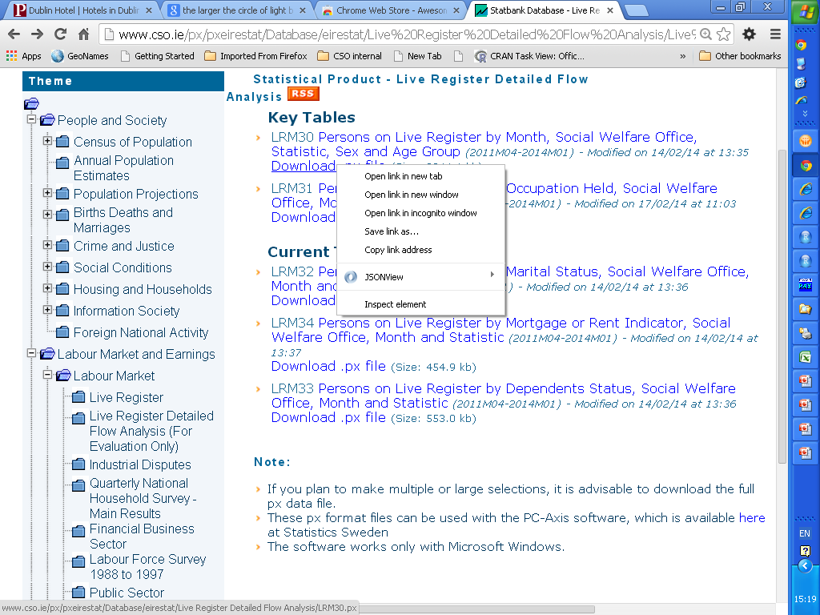
Accessing the data

Slide 6
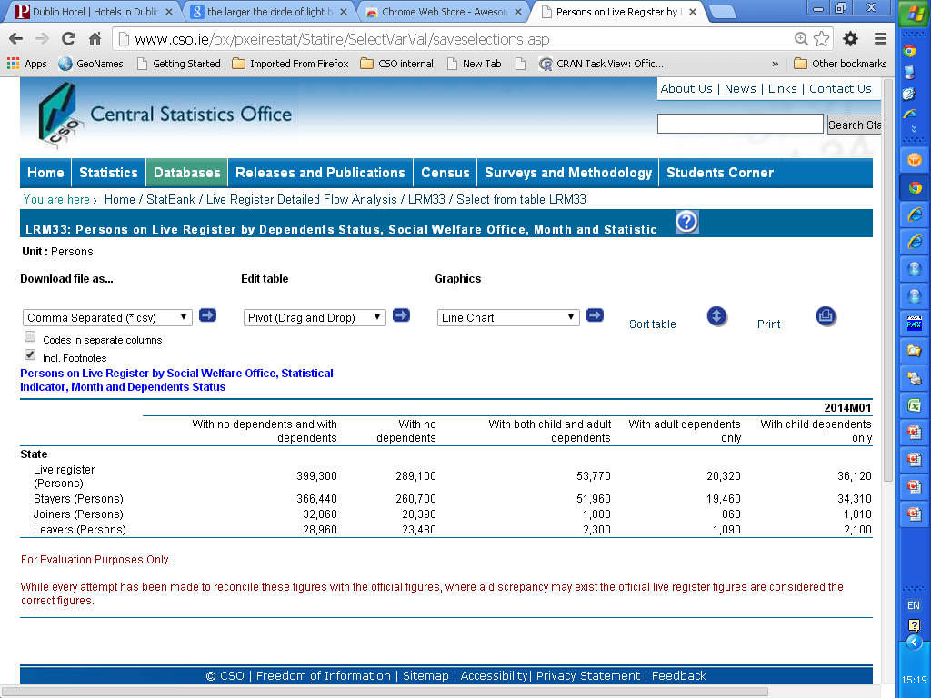
Accessing the data

Slide 7
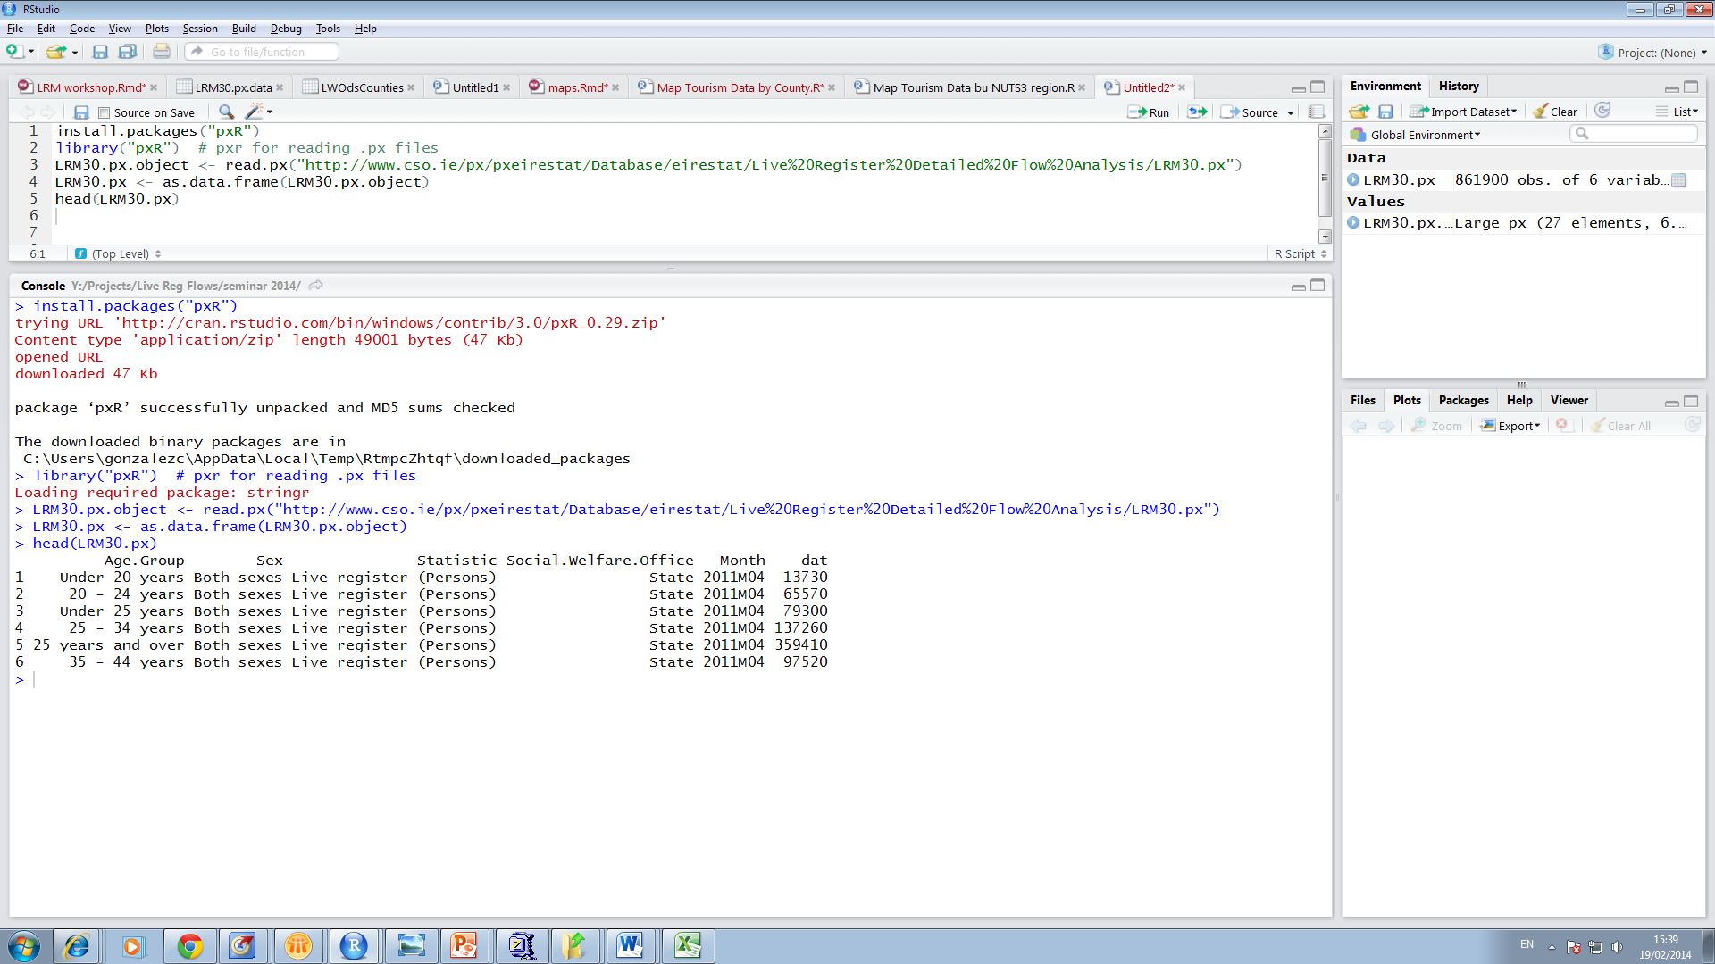
Accessing Statbank with R

Slide 8
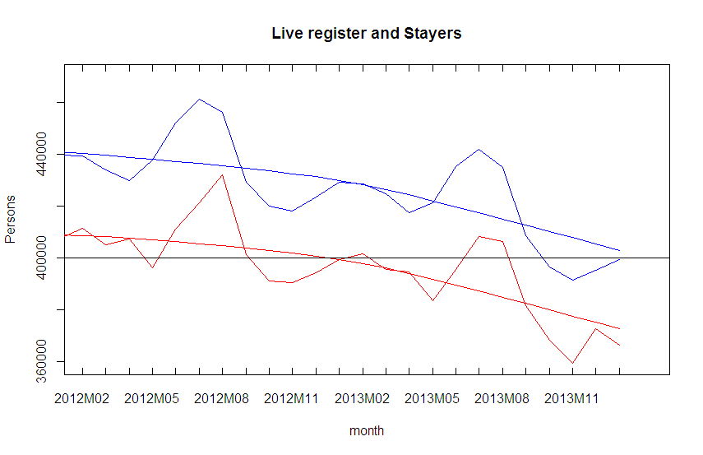
Trend and Actual

Slide 9
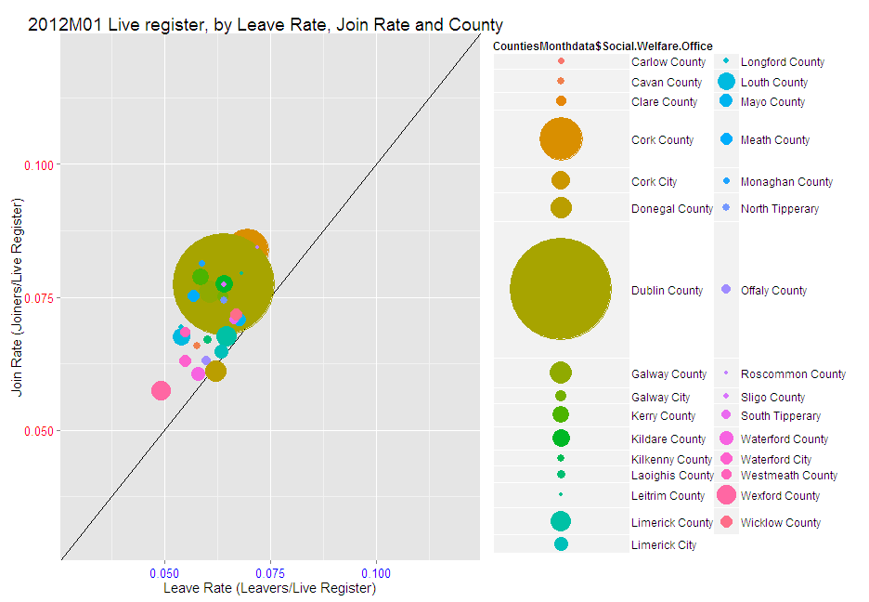
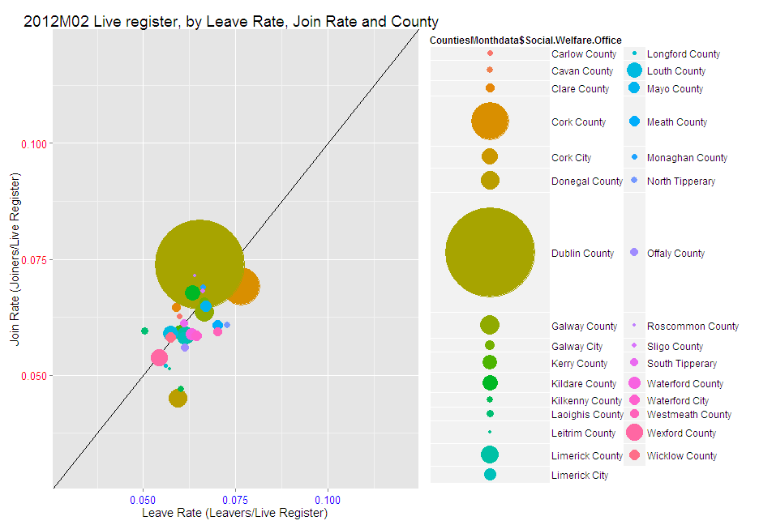
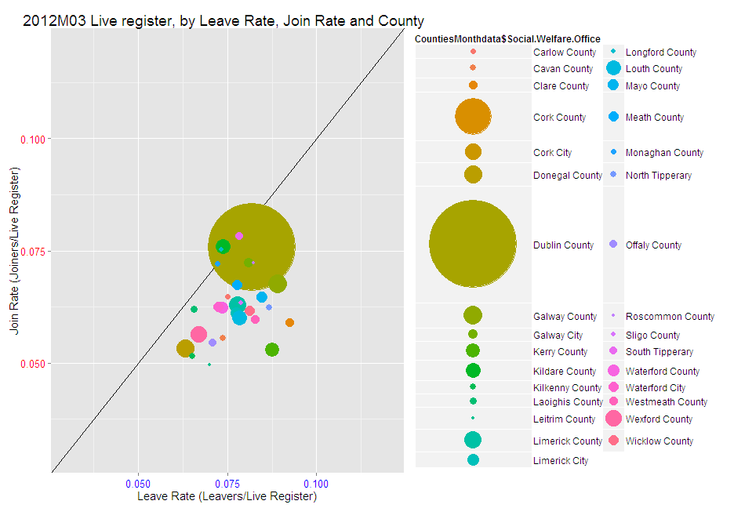
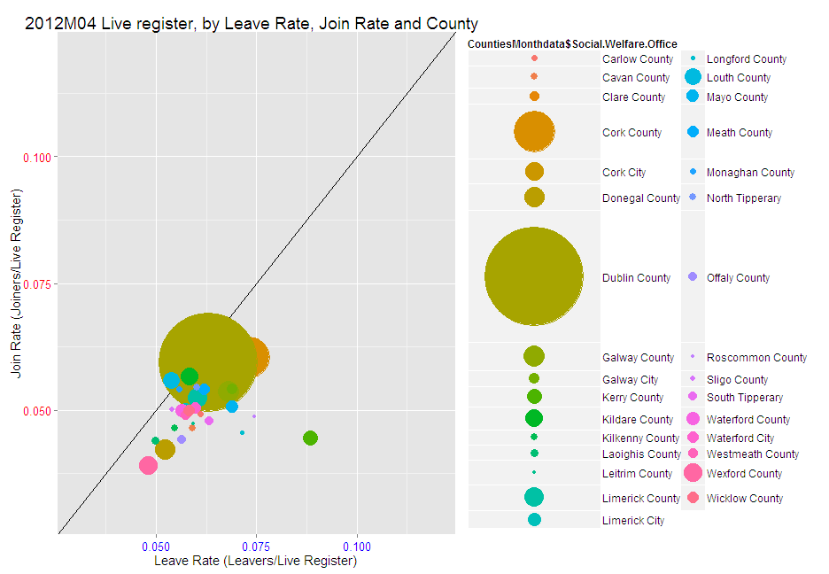
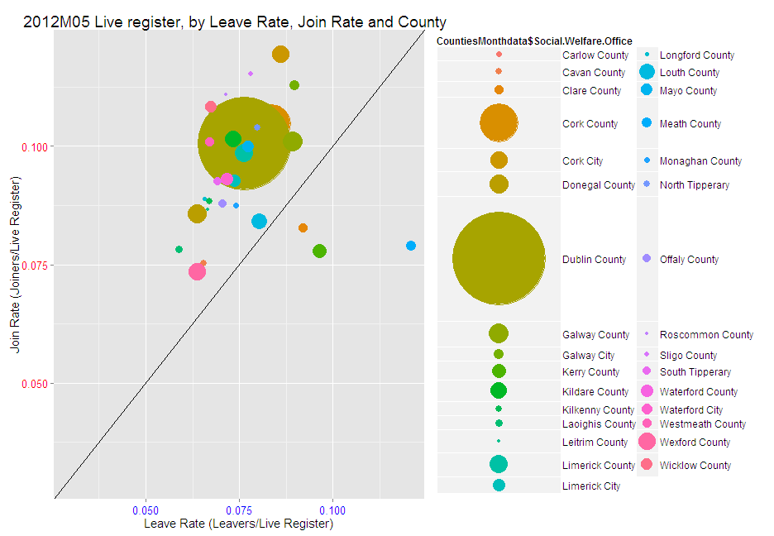
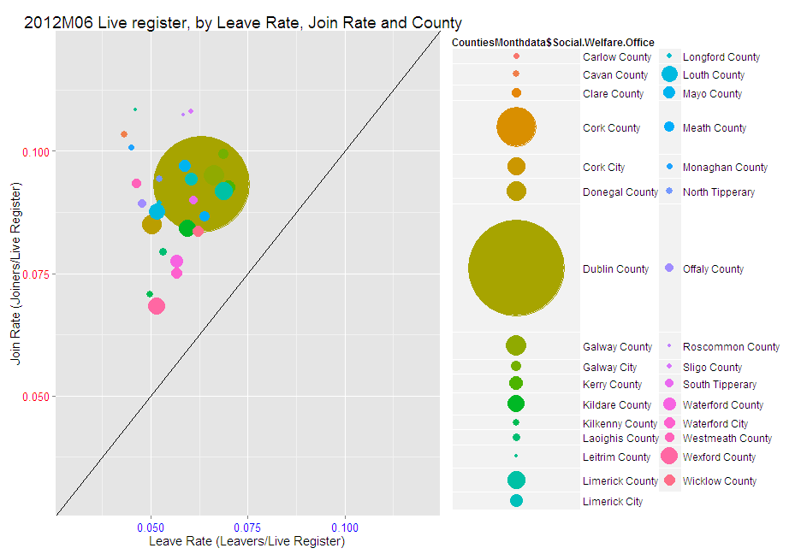
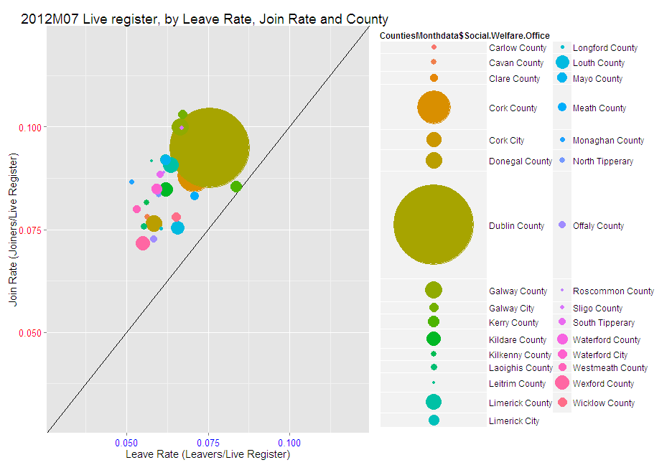
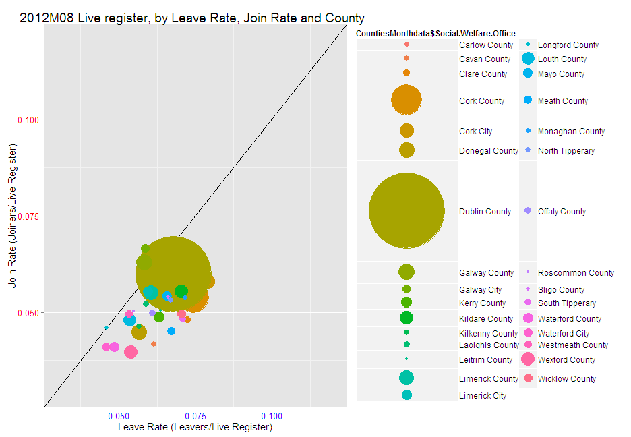
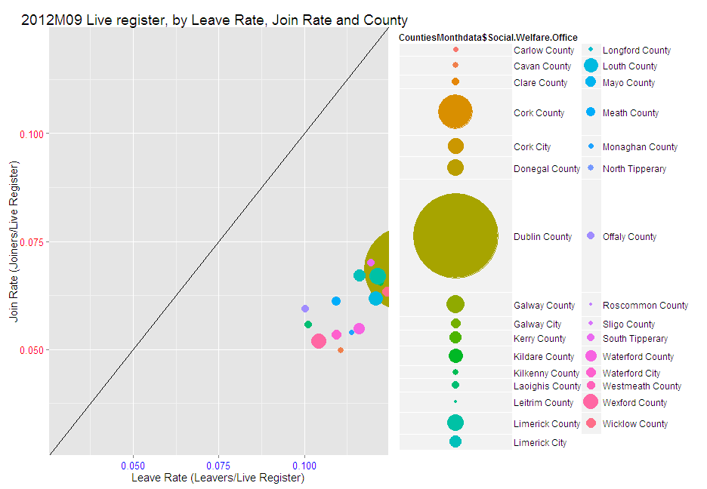
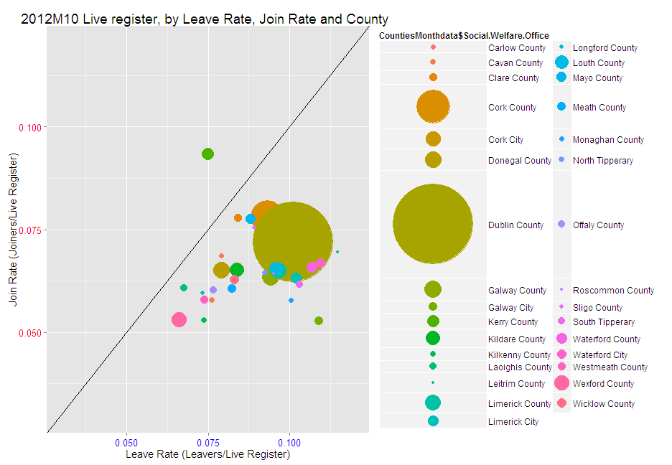
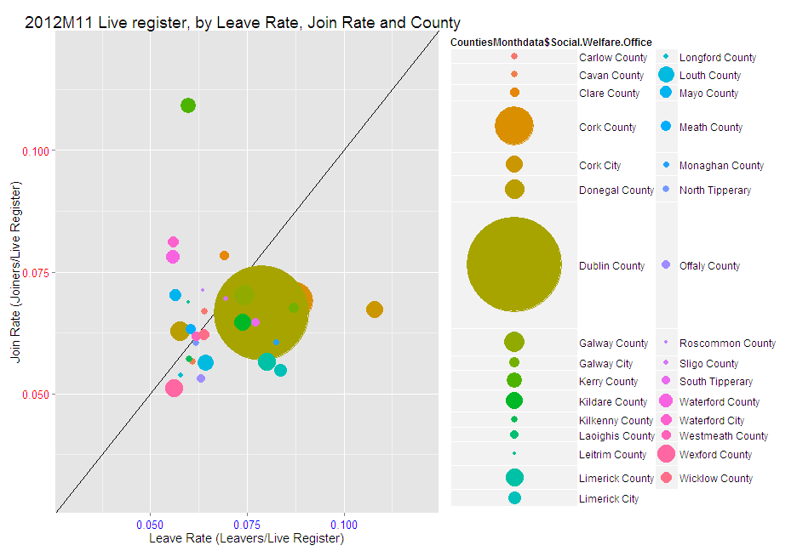
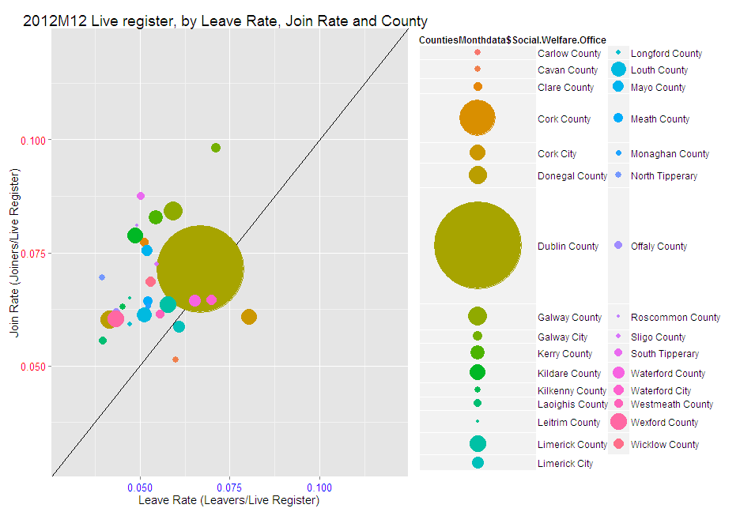
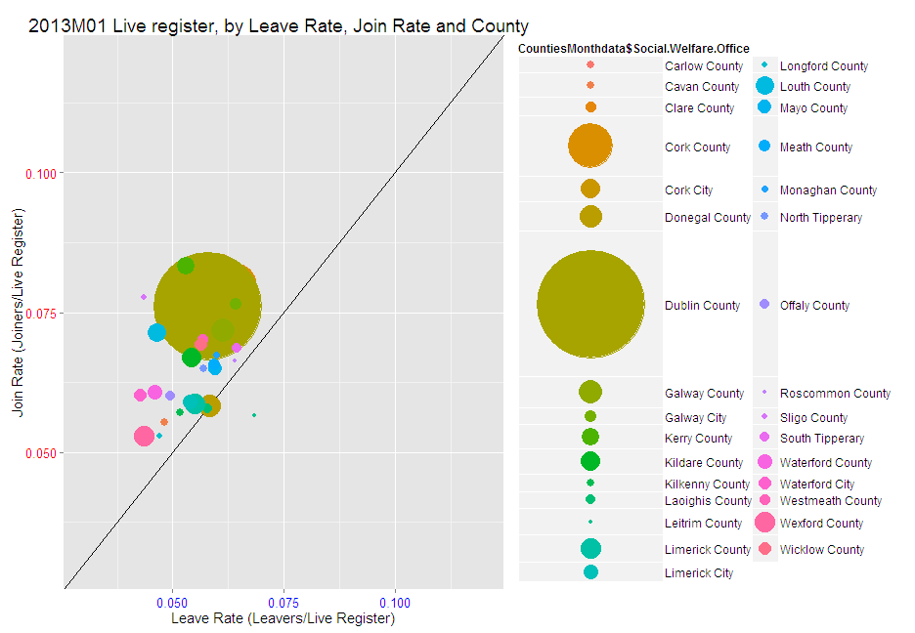
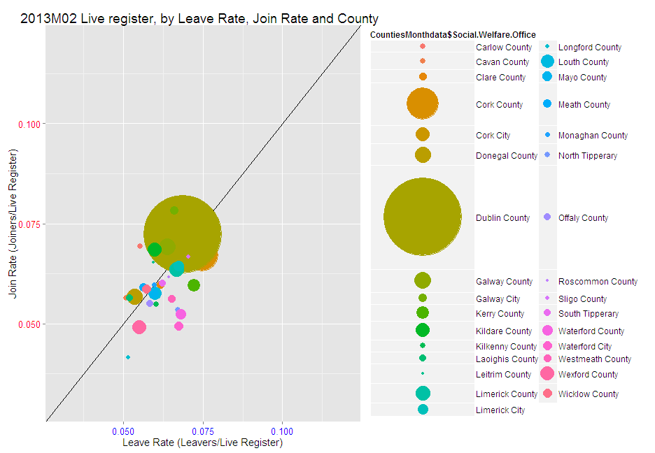
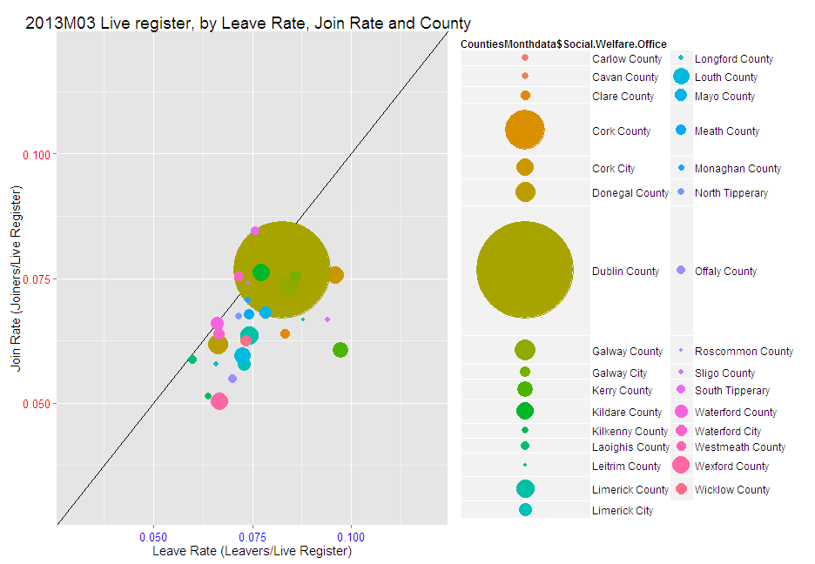
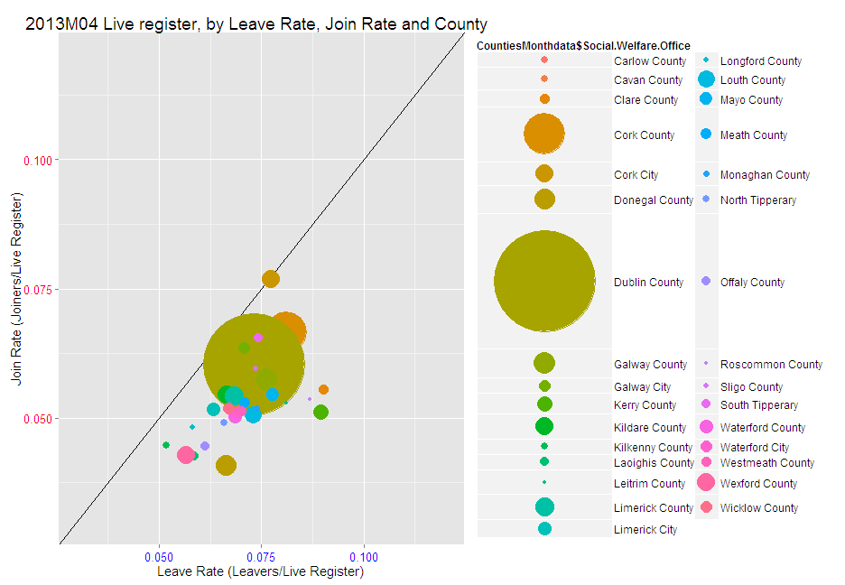
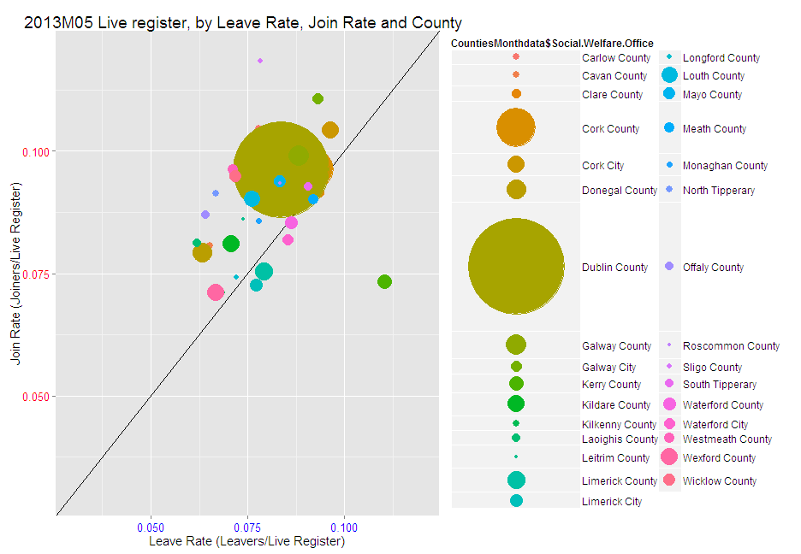
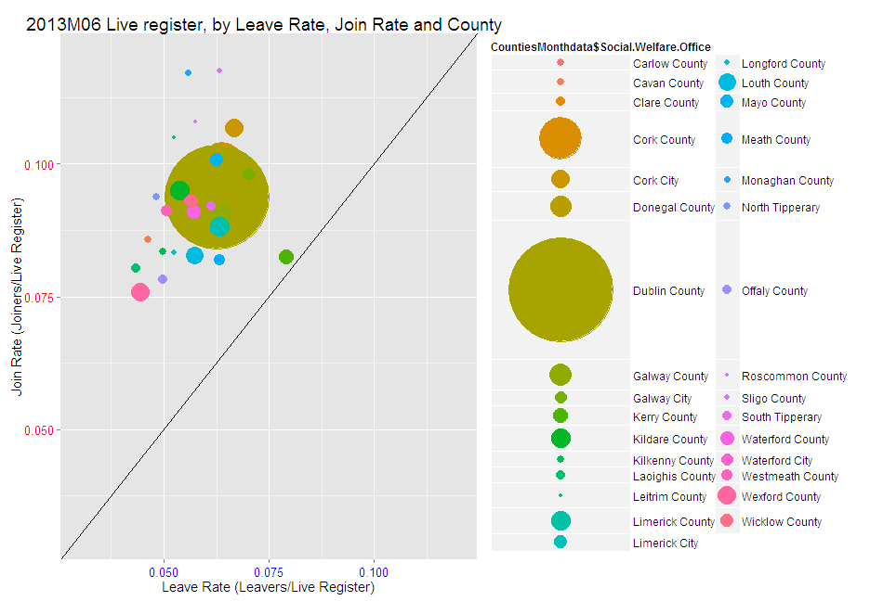
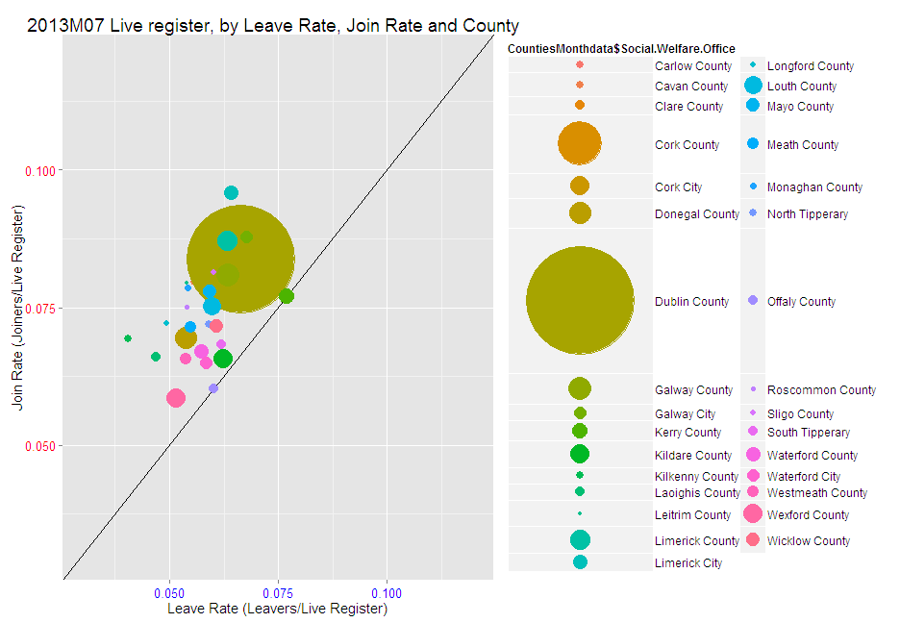
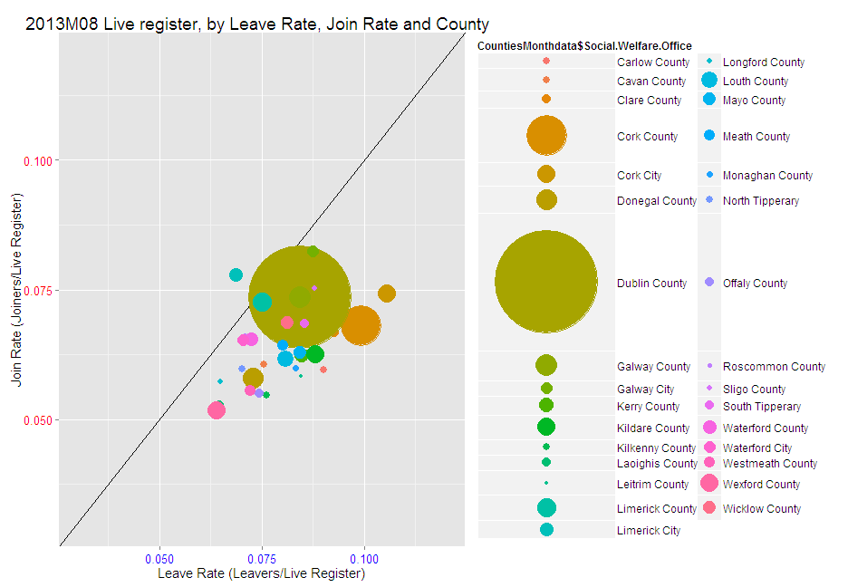
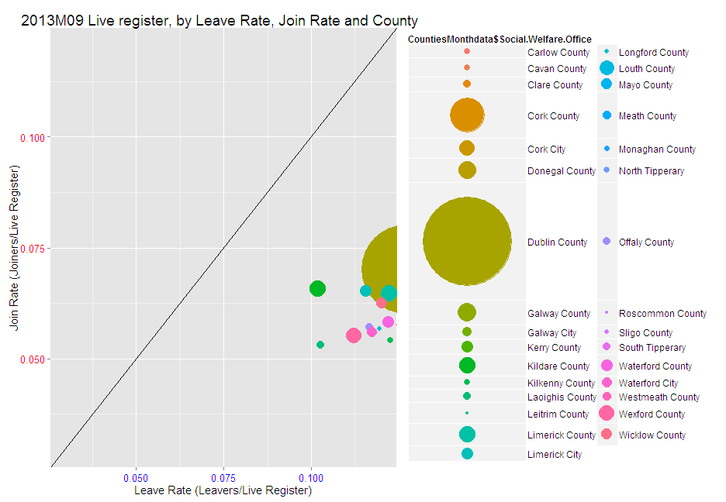
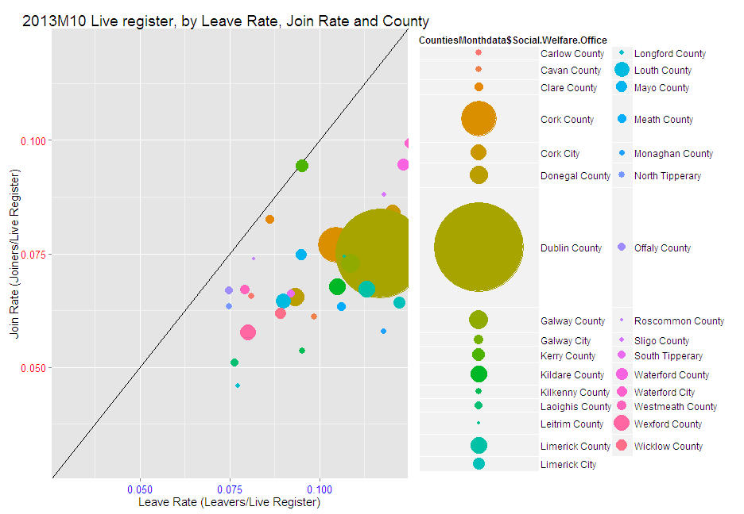
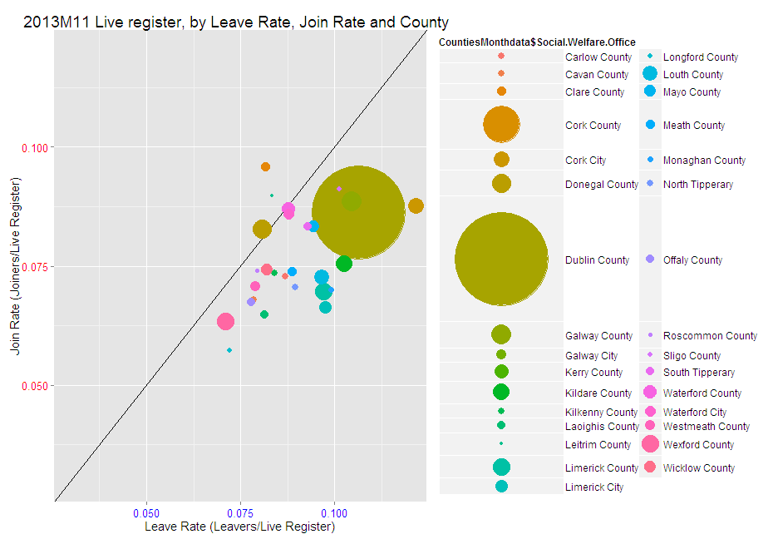
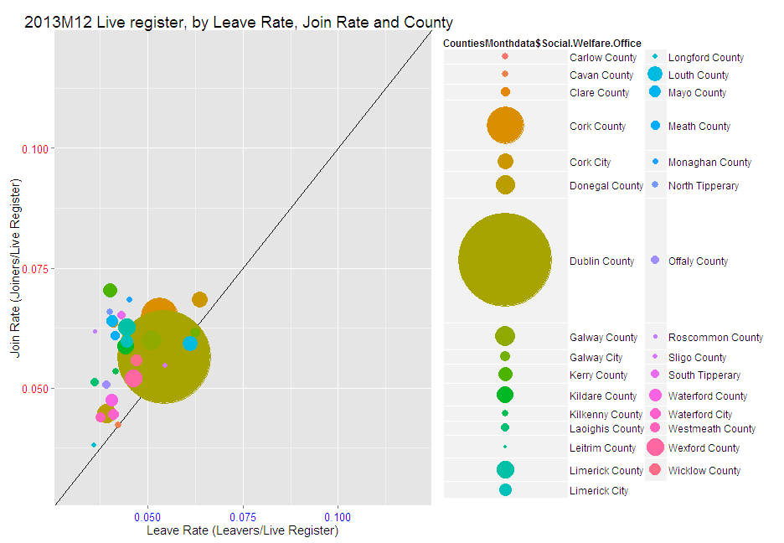
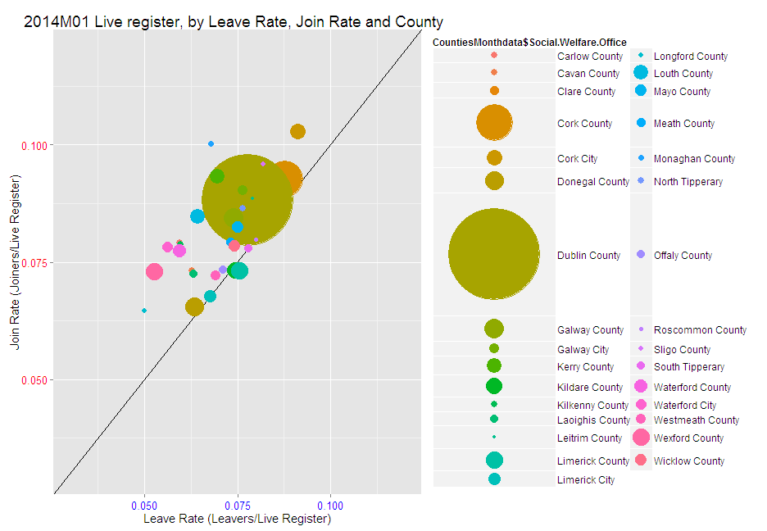

Slide 10
Conclusions
Wealth of data available with respect to the Live Register
Easily accessible
Via Web Interface and other statistical Programs
County visualisation showcase with R
Could have used Local Welfare Office, Occupation, Sex, or other classification variable.
Other programing languages could have been used.
Java Script library to read .px files
Sas Macro also available to read .px file
R code will be made available (as is) in the seminar webpage

