Slide 1
Department of Justice Response to the Ukrainian Crisis Sinead O’Neill

Slide 2
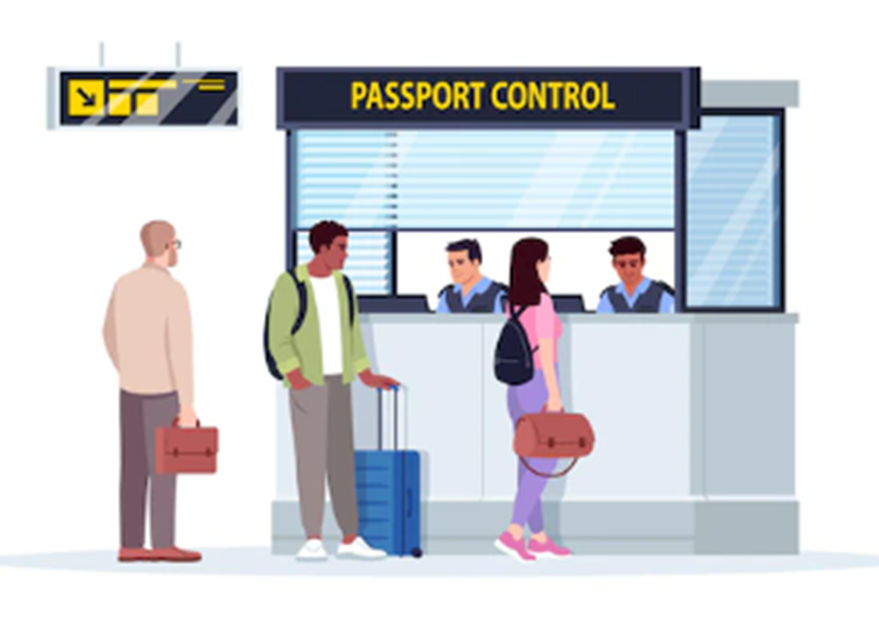
Introduction
Immigration Service Delivery including the Border Management Unit (BMU) and International Protection Office (IPO) are part of the Department of Justice.
The BMU are the staff that check passports and visas in Dublin Airport.
The IPO processes applications for Refugee Status and Subsidiary Protection. They can also make recommendations on Permissions to Remain.
A Ukrainian Response Team was established to process applications for Temporary Protection.
Responsibility for Accommodation and Integration moved to DCEDIY in 2020.

Slide 3
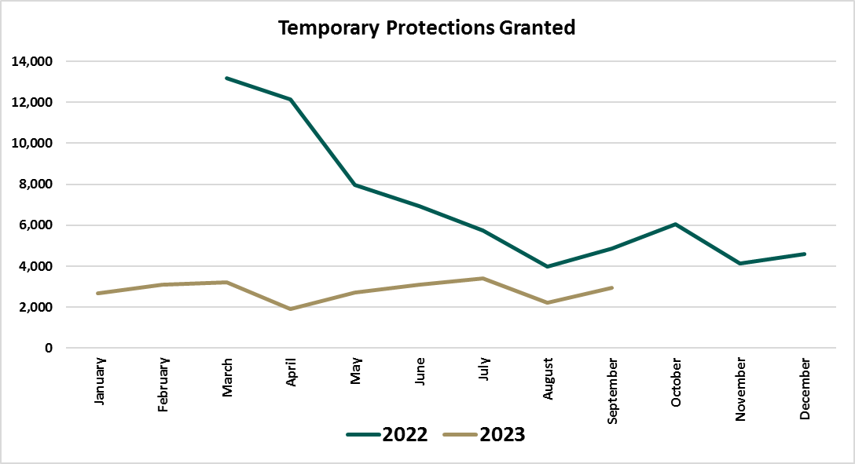
Daily Arrivals and Temporary Protections
BMU staff compile information on arrivals from the Ukraine through Dublin Airport.
An Garda Síochána compile information on arrivals from the Ukraine from all other airports and ports.
Information about Temporary Protections processed is collected by a centralised unit within Immigration Service Delivery. Each morning they get figures from the seven centers who process Temporary Protections.
People arriving are asked if they would like accommodation or if they have their own accommodation.

Slide 4
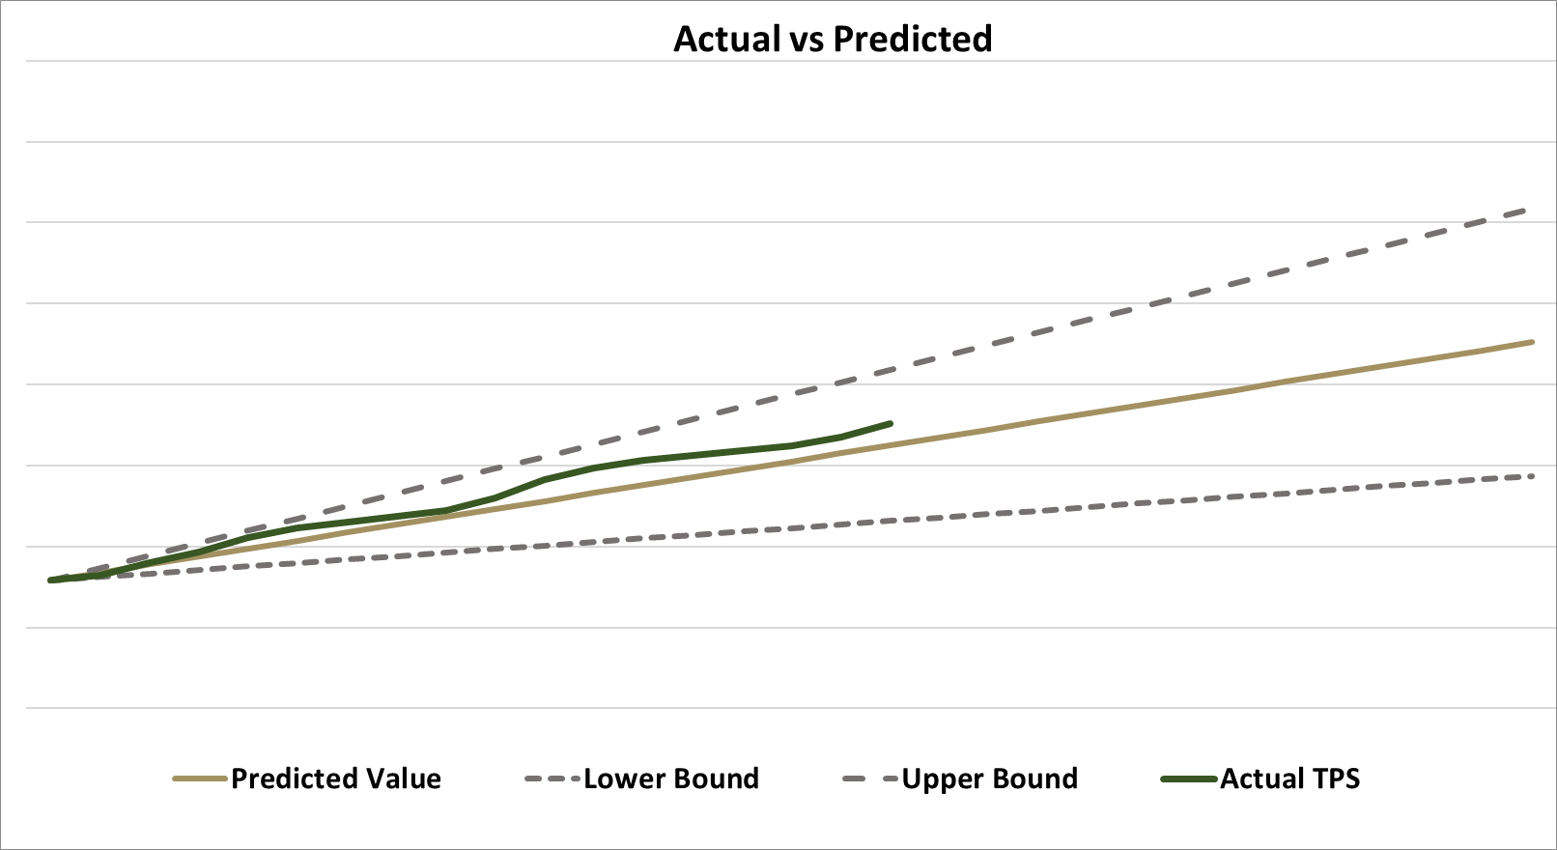
Temporary Protection Forecasts
Daily
Forecast the number of Temporary Protections to be granted each day based on historic data.
There are patterns to which days of the week have higher/lower arrivals.
Monthly
Forecast the number of temporary protections to be granted in the next month based on historic data.

Slide 5
Temporary Protection Forecasts
Annual
At the end of 2022, the CSO, DCEDIY and DoJ collaborated to look at forecasts for how many Temporary Protections would be granted in 2023.
Six scenarios were considered.
These scenarios are reassessed through out the year and adjustments made based on the most recent available data.

Slide 6
Lessons learnt
The importance of data entry
Liaising with Eurostat early in the process
Streamlining requests for data

Slide 7
Thank you ReportingAnalysisUnit@justice.ie

