Slide 1
Data Driven Insight in a Crisis – A case study of the Irish Statistical Systems response to the Ukrainian Crisis - DCEDIY
23rd November 2023
Nicola Tickner

Slide 2
Overview
Background
Context
Role of DCEDIY / role of DAU
Data
Geo-Hive
Accommodation Capacity Model
1

Slide 3
Background
2

Slide 4
Context
100,000+ Beneficiaries of Temporary Protection (BOTPs)
60,000 in accommodation provided directly by DCEDIY
of which, a third are male, two-thirds females
One third under 18 (~18,000 children)
Another 15,000 in state arranged accommodation
3

Slide 5
Role of DCEDIY and of DAU
DCEDIY –
DCEDIY’s focus is on the safety and security of those arriving in Ireland requiring accommodation
DCEDIY Data and Analytics Unit (DAU) –
Provision of key data reporting (internal and external)
Quality assurance/quality improvement of bed management system
the Humanitarian SOG Geo-Hive and
the supply and demand of accommodation model
4

Slide 6
Data
Production of key daily metrics, sourced from
Bed Management System (ePASS)
International Protection Accommodation
Also external data
Department of Justice
Department of Social Protection
Tusla
5

Slide 7
Geo-Hive
Provides a visual representation of where BOTPs are accommodated and where the local available services are
Collaborative cross-government initiative
Developed an internal version of the Geo-Hive Restricted access,
Exploring and expanding this to serve the Department
6

Slide 8
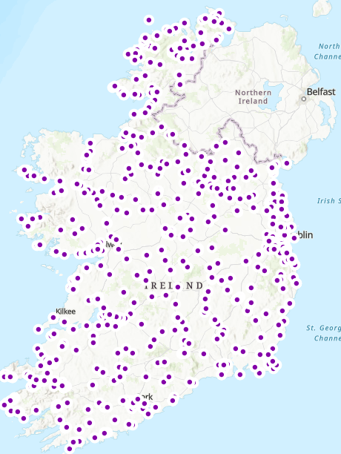
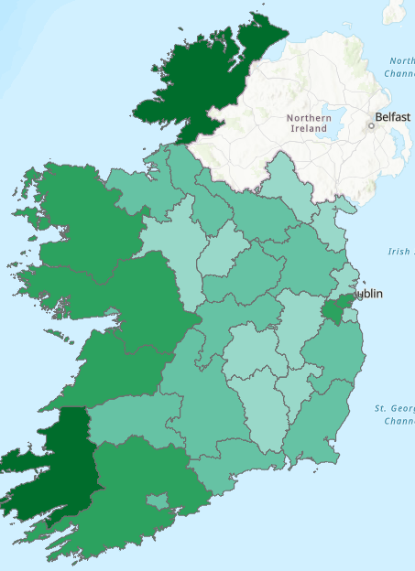
Humanitarian SOG Geo-Hive
7

Slide 9
Supply and Demand Model
Purpose of the accommodation capacity model:
To examine current supply
To forecast further demand under a number of short-term and medium term scenarios
To predict when pinch points in accommodation supply will occur
This is a key input for internal planning purposes and for the Humanitarian Senior Officials Group
8

Slide 10
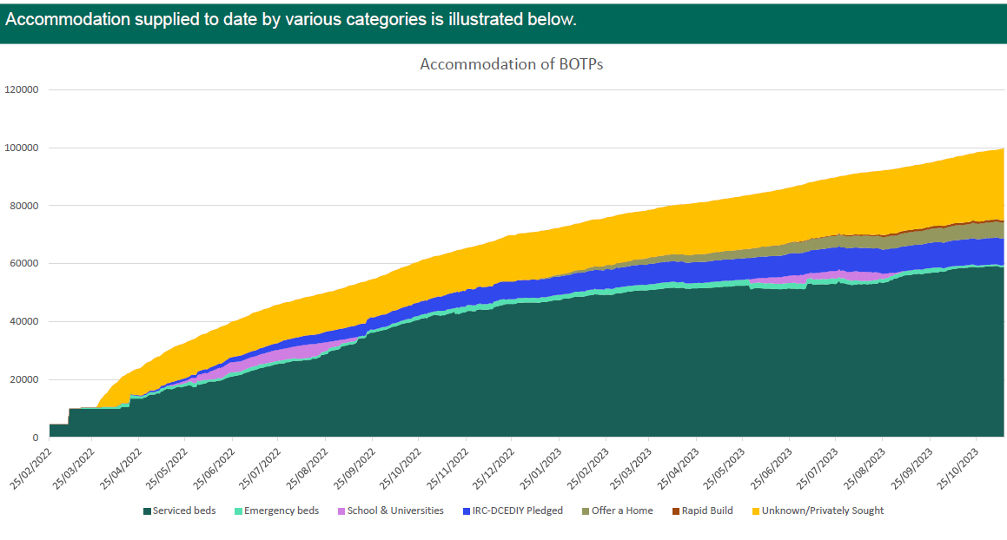
BOTPs
9

Slide 11
Thank you DataandAnalytics@equality.gov.ie

