Slide 1
Arrivals from Ukraine in Ireland
Weekly Situation (SIT) report and updates
Claire Hanley – Statistical System Coordination Unit - Horizontal Reports
Administrative Data Seminar 23 November 2023

Slide 2
Context
The Temporary Protection Directive (2001/55 EC) was activated on the 04 March 2022 by EU Council Decision EU 2022/382, to provide immediate protection in EU countries for people displaced by the Russian invasion of Ukraine that began on the 24 February 2022.
The response in Ireland was an inter-Departmental approach to the arrivals from Ukraine – accommodation, social welfare benefits, medical care, education, employment etc.
The CSO compiles statistics providing insights into Ireland’s response to the Ukrainian crisis.

Slide 3
CSO Statistics
Weekly Ukrainian Arrivals Response - Situation (SIT) report
Weekly since June 2022
‘Arrivals from Ukraine in Ireland’ Frontier Series
First published May 2022
Update of CSO’s Pxstat Tables available on Ukraine Hub
Since February 2023

Slide 4
Cross-Departmental Weekly Situation (SIT) Report – Ukrainian Arrivals Response – Why?
This report is used to inform the whole of Government Humanitarian Response to Ukraine, headed up at national level by a Cabinet Committee, which meets frequently and is chaired by the Taoiseach.
The Cabinet Committee is in turn supported by an Inter-Departmental Senior Officials Group (SOG) which meets monthly.
The SOG is made up of representatives from a range of public bodies including the Department of Children Equality Disability Integration and Youth, Department of Health, Department of Education and Department of Justice.

Slide 5
Weekly SIT Report – Ukrainian Arrivals Response – What?
Mix of CSO analysis and aggregated data provided by public bodies

Slide 6
Weekly SIT Report – Ukrainian Arrivals Response
Arrivals
Accommodation
Education
Health
Employment
How many people arrived in the last week?
Port of entry
Country of departure (for Dublin Airport arrivals)
Unaccompanied minors
Social Welfare
How many arrivals are currently in accommodation?
How many arrivals were issued with PPSN?
How many arrivals enrolled in education services?
How many arrivals were issued medical cards/Individual Health Identifiers?
How many arrivals are in employment?
Type of accommodation – Serviced, Emergency, Independent
Breakdown by age category and gender
Number of benefit recipients by scheme
Numbers eligible to enrol
Primary/post primary breakdown
Issued to date and ‘live’ in the system
Breakdown of employments by NACE sector
Employers by geographic location

Slide 7
Weekly SIT Report – Ukrainian Arrivals Response – Data Providers
SIT Report
(CSO)
DSP
D/CEDIY
Revenue
Tusla
D/Education
HSE
D/Justice
DSP: Daily PPSN and Social Welfare Payments data; weekly ADC file UKR DSP extract
Education: Daily dashboard on school enrolments
HSE: Daily/monthly medical card data; weekly Individual Health Identifier data file
Justice: Daily reports and weekly file on arrivals (incl. airport of departure), temporary protections and marital status
DCEDIY: Weekly data file on accommodation by type
Revenue: Weekly ADC file - Ukrainian employment data
Tusla: Daily unaccompanied minors

Slide 8
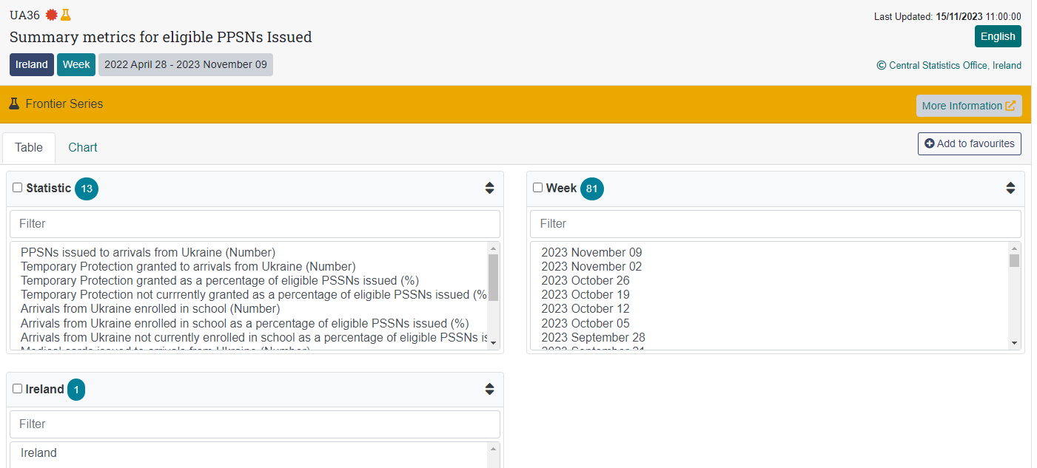
Data provided on PxStat - https://data.cso.ie/
Most of the SIT report metrics are published on the CSO website
Key metrics from the report are updated weekly
Other tables are updated following publication of the Series

Slide 9
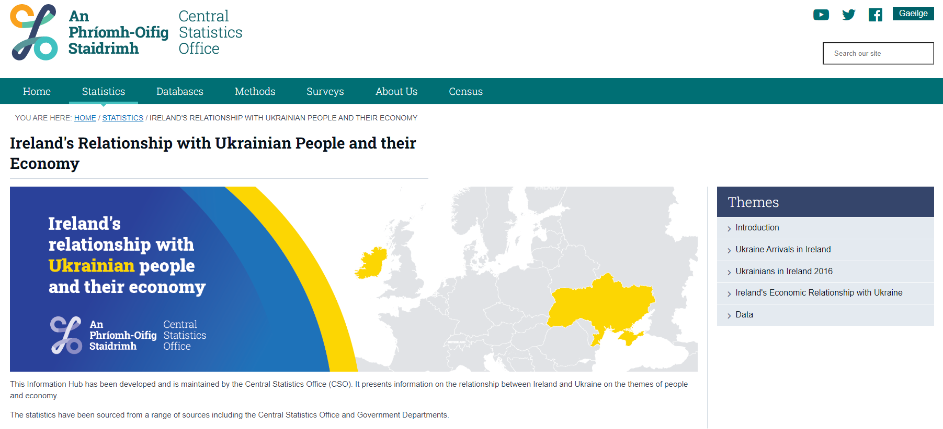
Ukraine Hub on CSO website
https://www.cso.ie/en/releasesandpublications/ep/p-uahub/irelandsrelationshipwithukrainianpeopleandtheireconomy/

Slide 10
Finally…
Many thanks to all our data providers…cross-departmental collaboration
Illustrates some of the many benefits of having the IGSS in place; the importance of the National Data Infrastructure and supporting legislation
Laura Carter will now present the ‘Arrivals from Ukraine in Ireland’ Frontier Series published by the CSO……

